Slide 1

cobas® POC IT solutions
Designed with your expertise in mind to manage POC traffic

Slide 2





cobas® POC IT solutions
Coordinates competence and performance
Enforce best practices and improve efficiency
Manage devices centrally
Manage training and certification
Manage integration with LMS & HR systems
Manage results efficiently
Manage testing quality automatically
HR IT
No training
No QC
LMS
Notes:
cobas POC IT Solutions gives you complete, centralized management of POC testing, including remote configuration and control of devices, user management and LIS/HIS interfacing from a single point of control.
1 - You can customise training courses and deploy training content on your intranet, and also enable user re-certification automatically. It can be set up to issue alerts to nurses a certain number of days before re-training is required, and notify users whose certification is about to expire.
2 – with full integration with your existing learning management system and HR system, you’ll be able to keep track of all your employees’ training and certification status and know exactly who is authorised to use which devices and who needs more training.
3 – Results management is easier than ever before, with visibility of results on mobile devices for clinicians, nurses, and coordinators having access to the patient information they need, when and where they need it.
4 – and the Point -of-Care Coordinator can save time by managing results and devices by exception, instead of wasting time looking into the system to check for problems. You can set rules in place so that the POC coordinator will be alerted only to attend to specific types of issue as and when they arise, so that they can use their time more efficiently.

Slide 3
cobas® POC IT solutions
Designed with your expertise in mind to manage POC traffic
Enable maximum integration
Coordinate operator management
Enable work on-the-go
Support continuous improvement
Notes:
cobas POC IT solutions integrate seamlessly into your existing hospital information system, learning management system and HR system, with drivers to support Roche and third-party devices, so you can manage all your POC tasks, people and instruments from one platform.
It’s easy to manage users and devices and to automate the re-certification process, ensuring you know (and can prove) that everyone carrying out a test is fully trained and certified.
Your coordinators can also carry out most of their daily routine tasks, like checking operator status, replacing devices and organising training, from their mobile devices
And you can extract the data captured by the system in various ways to drive further improvements across your operation.

Slide 4
cobas® POC IT solutions
Designed with your expertise in mind to manage POC traffic
Enable maximum integration
Coordinate operator management
Enable work on-the-go
Support continuous improvement

Slide 5

cobas® POC IT solutions
An integrated solution that keeps you connected as your needs change
Open philosophy
LMS
HR system
Notes:
There’s an open philosophy – you can connect Roche equipment or any equipment – which is essential for managing your landscape. You can add the functionality you need, as you need it.
As we build and develop our platform, we do it with the user in mind, trying hard to meet more and more of your requirements.

Slide 6




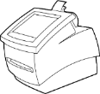



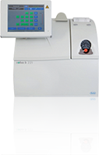










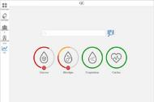

cobas® POC IT solutions
Centralizes decentralization
i
i
i
i
i
i
LIS
HIS
LIS
LIS
Display results in LIS
Manage all POC devices, across hospitals/sites
Display results in HIS
Notes:
0 – cobas point-of-care IT is responsible for collecting results from 100s or even 1000s of handheld and benchtop POC analysers, distributed across a hospital, clinics, or perhaps multiple hospitals and clinics, for Glucose, Coagulation, Blood gas, Urinalysis and cardiac testing.
1 - Results can be sent to the system and displayed in the Laboratory Information System with central lab results, or alongside imaging results in a Hospital Information System.
2 - The application can also interface with multiple LIS systems, which may be necessary for a hospital chain that uses two or more LISs – and it can send different types of results to different LISs, according to pre-defined rules.

Slide 7

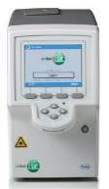
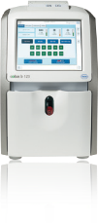




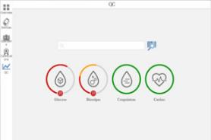

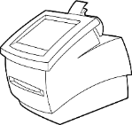





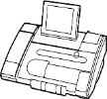




cobas® POC IT solutions
Open connectivity at its best
Over 90 device drivers for maximum connectivity
Notes:
0 - cobas POC IT solutions can connects with the full Roche POC portfolio, for coagulation, urinalysis, cardiac, blood gas and glucose testing. It also connects with third-party instruments: All together the system has more than 90 device drivers built in.

Slide 8
cobas® POC IT solutions
Third-party drivers available to fit your individual needs
Hemochron
Signature Elite
Hemochron Jr.
Signature
Medtronic
ACT Plus
Hemochron Jr.
Signature+
ROTEM
delta
Eurolyser/Sysmex
Smart 546
Siemens DCA
Vantage
Axis-shield
Afinion AS1000
Coagulation
Biosurfit
Spinit
Orion
QuikRead go
Abaxis Piccolo
Xpress
Abbott i-STAT CDs (CC use)
FUJIFILM
DRI-CHEM NX500
Samsung LABGEO IB10
Samsung LABGEO PT10
Quidel Sofia
Cardiac
VTrust
Ketone
HemoCue
Glu201 DM
HemoCue
Glu201 DM RT
Samsung LABGEO HC10
Nova Biomedical StatStrip Glucose/ Ketone
TaiDoc VTRUST Ketone
TaiDoc VTRUST Ketone TD-4258WiFi
ROTEM delta
Clinical Chemistry
ROTEM sigma
Analyticon
Urilyzer 100 Pro
LifeSign
Dxpress POC
LifeSign Dxpress Reader
Siemens
CLINITEK Status
Siemens Clinitek Status +
Siemens Clinitek Status Connect
Sysmex
XS1000i
HbA1c
ABX
e-SAT
Horiba ABX
Microsemi
HemoCue
Hb 201 DM
Sysmex
KX-21N
HemoCue
WBC
Sysmex
XP300
ABX Micros
CRP
Sysmex
pocH-100i
Glucose/ketones
Horiba
Micros 45
Horiba
Micros 60
Horiba
CRP 200
Radiometer
ABL600 series
Abbott i-STAT
CDs (BG use)
IL GEM
PCL Plus
Radiometer
ABL700 series
Radiometer
ABL90 Flex
Hematology
Siemens
RapidPoint 400
IL GEM
Premier 3000
IL GEM
OPL
Radiometer
ABL800 series
Siemens
RapidPoint 500
IL GEM
Premier 4000
Siemens
RapidLab 800
Radiometer
ABL500 series
Pregnancy
Siemens
RapidLab 1200
OPTI Medical
OPTI CCA
IL GEM
Premier 5000
Alere
ePOC
OPTI Medical CCA
Radiometer
AQT90 Flex
Biosite
Triage
Alere
Triage
Blood gas
Philips
Minicare 1-20
*Trademarks are the property of their respective owners.
Notes:
The system has proven open connectivity with increasing amounts of third party drivers being released every year.

Slide 9
cobas® POC IT solutions
Third-party drivers available to fit your individual needs
Hemochron
Signature Elite
Hemochron Jr.
Signature
Medtronic
ACT Plus
Hemochron Jr.
Signature+
ROTEM
delta
Eurolyser/Sysmex
Smart 546
Siemens DCA
Vantage
Axis-shield
Afinion AS1000
Coagulation
Released Drivers Overview
Biosurfit
Spinit
Orion
QuikRead go
Abaxis Piccolo
Xpress
Abbott i-STAT CDs (CC use)
FUJIFILM
DRI-CHEM NX500
30
25
20
15
10
5
0
Samsung LABGEO IB10
Samsung LABGEO PT10
Quidel Sofia
Cardiac
3rd Party
VTrust
Ketone
HemoCue
Glu201 DM
HemoCue
Glu201 DM RT
Samsung LABGEO HC10
Nova Biomedical StatStrip Glucose/ Ketone
TaiDoc VTRUST Ketone
TaiDoc VTRUST Ketone TD-4258WiFi
ROTEM delta
Clinical Chemistry
ROTEM sigma
Analyticon
Urilyzer 100 Pro
LifeSign
Dxpress POC
LifeSign Dxpress Reader
Siemens
CLINITEK Status
Siemens Clinitek Status +
Siemens Clinitek Status Connect
Sysmex
XS1000i
HbA1c
ABX
e-SAT
Horiba ABX
Microsemi
HemoCue
Hb 201 DM
Sysmex
KX-21N
HemoCue
WBC
Sysmex
XP300
ABX Micros
CRP
Sysmex
pocH-100i
Glucose/ketones
Horiba
Micros 45
Horiba
Micros 60
Horiba
CRP 200
Radiometer
ABL600 series
Abbott i-STAT
CDs (BG use)
IL GEM
PCL Plus
Radiometer
ABL700 series
Radiometer
ABL90 Flex
Hematology
Siemens
RapidPoint 400
IL GEM
Premier 3000
IL GEM
OPL
Radiometer
ABL800 series
Siemens
RapidPoint 500
IL GEM
Premier 4000
Siemens
RapidLab 800
Radiometer
ABL500 series
Pregnancy
Siemens
RapidLab 1200
OPTI Medical
OPTI CCA
IL GEM
Premier 5000
Alere
ePOC
OPTI Medical CCA
Radiometer
AQT90 Flex
Biosite
Triage
Alere
Triage
Blood gas
Philips
Minicare 1-20
2014
Present
*Trademarks are the property of their respective owners.
Notes:
So chances are, whatever you’re using now, or whatever you might want to add to your program in the future, cobas POC IT Solutions will accommodate the devices that are right for you.

Slide 10

cobas® POC IT solutions
Third-party drivers available to fit your individual needs
Results
Operator
QC
Phase 1: Core functionality release
Results
Operator
QC
Patient data
Phase 2: Full two-way communication
Notes:
You can request new drivers, as Roche is always keen to add new drivers. Where there is customer demand.
Initially Roche will release new drivers with core functionality – capturing results, operator and QC
Two-way communication to receive patient demographic data, is implemented in phase 2
This allows faster development - already seen new drivers added since 2015, and will see more launched this year.

Slide 11
cobas® POC IT solutions
Designed with your expertise in mind to manage POC traffic
Enable maximum integration
Coordinate operator management
Enable work on-the-go
Support continuous improvement

Slide 12

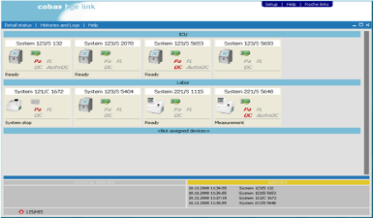

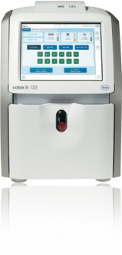

cobas® POC IT solutions
The comprehensive POC management solution
Manage results by exception,
on PC and mobile devices
Mirror screens for faster troubleshooting
Notes:
0 - With cobas POC IT solutions in place, the Point -of-Care Coordinator can save time by managing results and devices by exception. Rules can be set in place so that the POC coordinator will be alerted only to attend to specific types of issue as and when they arise, so that they can use their time more efficiently.
1 – The POC coordinator can also gain extra visibility of an issue via Remote Access, with Roche blood gas devices – mirroring the screen of the device to get an overview of its QC status and reagent status. That allows them to very efficiently pinpoint the source of any problems.

Slide 13

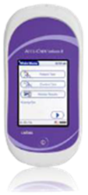


cobas® POC IT solutions
The comprehensive POC management solution
i
i
Unauthorized
QC required
No patient ID
Automatic lockout for improved testing quality and patient safety
Notes:
0 - The system also provides greater control. If a user is not authorised to use a device, or a required QC has not been performed, or the patient has not been properly identified,
1 - that information is shared between the cobas IT 1000 application and the device itself. So a non-certified user can be blocked from using the device, or the device could be locked down until the correct QC or patient ID procedure has been carried out. This improves testing quality and ensures greater patient safety.

Slide 14

cobas® POC IT solutions
The challenge of user management in POC
Device management
Added-value activities
Training & accreditation
Notes:
0 - We understand that the key challenge for the Point-of-Care Coordinator is managing the process of training, compliance and accreditation of users. There are 1000s of nurses using POC devices for testing - and you need to know they are all using the devices safely and correctly. Historically, up to 80% of a POC coordinator’s time may be spent training and accrediting users.
The other 20% is normally spent managing device connectivity, QC, and issues with the devices themselves.
1 – cobas POC IT solutions help the Point of Care Coordinator to manage users in a streamlined and effective manner, on PC or mobile devices automating the processes around training and certification, centralising all the information and processes, and taking the complexity out, so that the coordinator has more time to focus on other valuable activities.

Slide 15
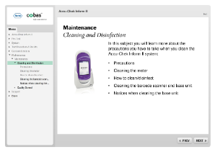
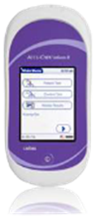
cobas® POC IT solutions
Fully automated user certification – THE time-saver for POC coordinators
New certification status sent to device
Automatic alerts for when training is due
Notes:
0 – cobas POC IT solutions can work together with the hospital Elearning platform to administer the training process automatically.
1 - It can be set up to issue alerts to nurses a certain number of days before re-training is required, and notify users whose certification is about to expire. These notification can be sent via e-mail or to the Roche ACCU-CHEK Inform II itself. Then, the user can use the eLearning platform in their hospital to take the necessary training,
2 - once they have completed it, their results will be sent to the system and to the device automatically, so that the user can continue testing safely. This is a huge time saver for the POC coordinator – they don’t need to manually manage notifications and certifications or document training results in the system. As a supplier of a broad product portfolio, Roche is very competent in helping coordinators use the system to fulfil certification requirements for regulatory bodies all around the world.

Slide 16

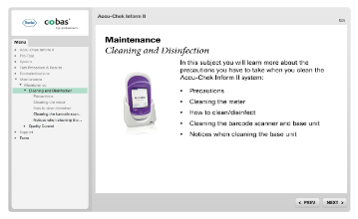
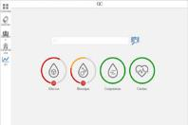

cobas® POC IT solutions
Efficient online user training, customizable to your needs
Time-saving
Content and questions provided for tailoring courses
Face to face
Notes:
0 - You can offer on-line training courses for POC devices, helping you to automate training and demonstrate compliance. It connects to your own hospital LMS and provides all the content and question functionality so you can tailor courses, set pass levels for exams, mandatory questions, and content requirements.
1 – Users can see exactly what courses they have taken and what they still need to complete, and Point of Care coordinators can get a clear overview of the progress and status of each user. All of this helps you to make training easy for your staff, and minimize the time you need to spend on face to face training, by offering in-person support only to the minority of learners that need it.

Slide 17

cobas® infinity POC IT
Seamless learning management system integration
HR system
New staff
Current staff
Leaving staff
101
Operator name
Course name
Date/time
Pass/fail
Easily stay on top of training requirements – for everyone
Notes:
0 - cobas infinity POC IT also integrates perfectly with your existing HR system to take all the effort out of managing the training status of new staff as well as current staff.
1 - Once set up, the system will automatically track the data on all the comings and goings of your employees, so you’ll know which new people need training, who’s due for retraining, and who has left – saving you a huge amount of time and effort and allowing you to concentrate on providing the right support where it’s needed.

Slide 18


cobas® POC IT solutions
e-Learning integration with IT1000
EXAM
---------------------------------------------------------------
i
i
i
i
Data automatically exported to IT1000
Operator name
Course name
Date/time
Pass/Fail
Device/user status refreshed/renewed
Notes:
0 - The training is available for you to use in your own Learning Management System – you don’t need to retrain your users on a different system.
1 - With full SCORM compatibility, all the relevant data is exported to the cobas IT1000 server which captures the ID of the trainee and all the necessary statistics about their training session.
2 - Once this is set up, it will automatically refresh or renew the operator’s accreditation status and liaise with the instrument to make sure the operator’s access is up to date.

Slide 19
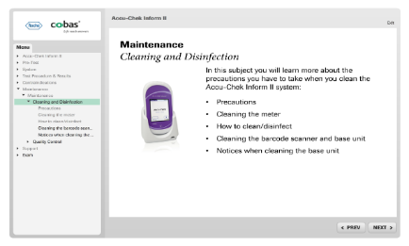
cobas® POC IT solutions
Additional features to support systems integration
FAIL
Configuration file
Enables compatibility and automatic updates
Exception reporting
Default to FAIL status if file cannot be processed
Additional functions
Customise certificate, set/reset attempts
Notes:
0 - A Configuration file brings added flexibility to the interface by manipulating the data from the hospital LMS, to ensure compatibility and seamless communication with the cobas IT1000 server.
1 - If there is an issue with updating the user’s information – for example if there is an anomalous entry made by the trainee that can’t be reconciled in the system, an exception report is generated that sits on the IT1000 server. If it can’t process the file, it renames the data as FAIL and lists the errors.
2 - Additionally, you can configure the system to change the course names on the certificates, or the number of attempts allowed before passing, or to reset the user’s attempts back to zero.

Slide 20



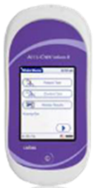

cobas® POC IT solutions
Observed test sequence to ensure patient safety
Demonstrate competence before full certification
Notes:
0 - Using Roche devices with cobas IT 1000 application also allows you to manage observed testing performance or competency using the device.
1- A supervisor can observe or watch a user performing a patient test,
2 – and then can use the device to confirm that the user performed the test correctly. This documentation is automatically sent to cobas IT 1000 and made available for audits and re-certification.

Slide 21
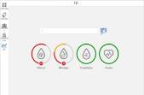


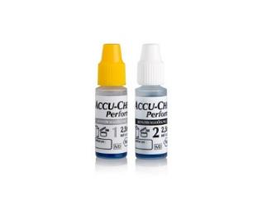


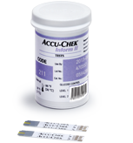
cobas® POC IT solutions
The right test, on the right patient, with the right QC
Automatic lockout and alert to POC Coordinator
Clear audit trail for compliance
i
i
i
i
i
Training status
Device
User
Material lot
QC
Notes:
0 - With Roche, we go beyond just helping you make sure that operators are trained. We check that the user is trained, but also that the device is used correctly, that the device is used on the right patient, that the lot is OK to use, and that QC processes are followed.
1 - The system can automatically lock out users who are not certified, or alert the POC coordinator to any issues.
2 - A clear audit trail is taken for each test, managing compliance to help you meet strict regulatory and quality requirements.

Slide 22
cobas® POC IT solutions
Designed with your expertise in mind to manage POC traffic
Enable maximum integration
Coordinate operator management
Enable work on-the-go
Support continuous improvement

Slide 23

cobas® POC IT solutions
How to be productive while moving around?
At desk
Walking around
Notes:
0 - POC Coordinators - by the nature of the testing that they support - do a lot of their work while 'out and about' around hospital locations
1 - Some of their time is spent at their desk, some 'walking around’ Yet, for many tasks, they need to find a PC in order to access a desktop
2 - This dictates how POC Coordinators work, and limits productivity

Slide 24
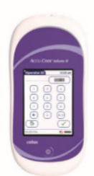
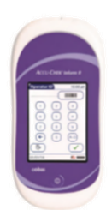
cobas® POC IT solutions
Always with you - act while on-the-go
Monitor performance
and act on issues
Simplified management of
complex job tasks
OPERATOR LIST
Devices
Operators
Check status
Training update
i
Replace
Check status
i
cobas® infinity
POC mobile and tablet
Relocate
Add operator
Install
Change location
Arrange training
Notes:
0 – cobas POC IT solutions is designed for POC coordinators in hospitals to keep control and act on what is important on their mobile phone / tablets while out of the office or away from their PC.
1 - It shows device status and allows the operator to manage replacements.
2 - User status and certification can be checked and even operator trainings can be organized while on the go.

Slide 25
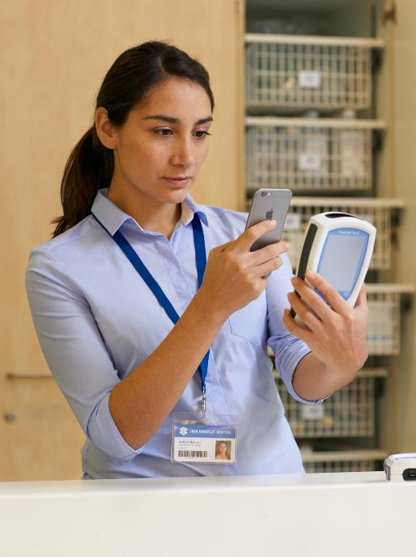
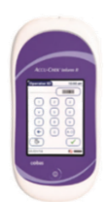
cobas® POC IT solutions
Easily manage devices while on-the-go
Devices
Operator Bob #96748180
Location 1
NOT
Location 2
TRAINED
See where devices
need attention
Manage replacements
Check operator status
Notes:
0 - POC Coordinator can easily monitor device statuses while out of the office, and so identify where they are needed for problem-solving.
1 - easily manage device replacement on the go, simply by scanning the broken device and scanning a replacement device,
2 - and quickly check the certification status and training status of individual users.

Slide 26

cobas® POC IT solutions
Organize training from anywhere
Operator List
Operator Bob #96748180
Trainee #9674
NOT TRAINED
ADD TO COURSE
EXPORT
Check status and export training list
Add operators to scheduled courses
Automatic attendee registration
Notes:
0 - Coordinators will even be able to check the training status of operators, and export lists of users who need training,
1 - add operators to scheduled courses, to manage ad hoc training needs efficiently,
2 - and scan trainee’s identification to automatically register their attendance on the system – all from their portable electronic devices, without having to find a PC

Slide 27
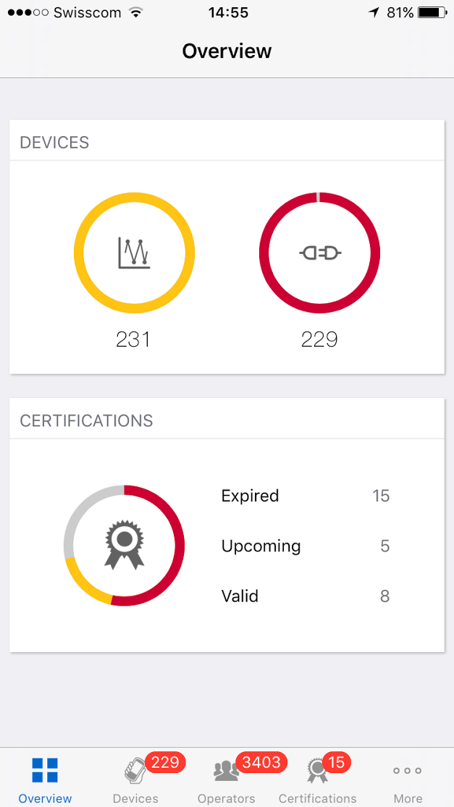
cobas® POC IT solutions
See what’s important – solutions for the POC Coordinator
Clear view including ‘expiring soon’ status
Overview of testing performance with custom alerts
Easy to identify connection/ device errors
Notes:
The POC Coordinator can also monitor overall performance of POC testing, and spot any issues that need to be dealt with quickly and easily.
With cobas POC IT solutions, POC coordinators can monitor the overall performance and act on issues that require their attention out of their pocket, from anywhere. This saves time, optimizes workflow and simplifies complex job tasks.

Slide 28
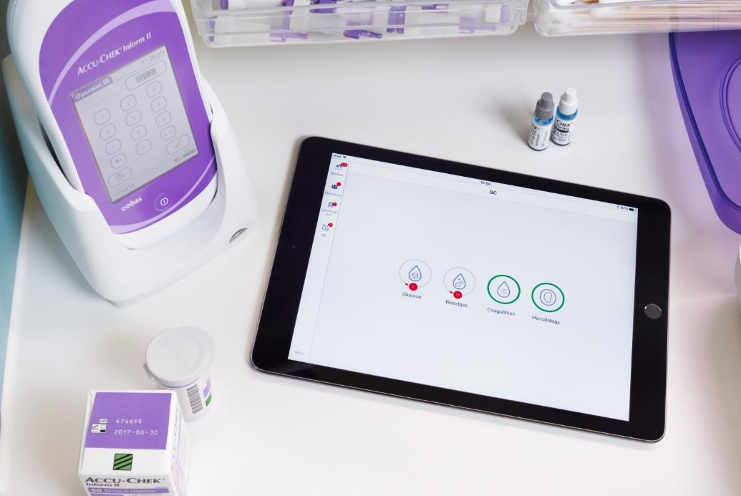

cobas® POC IT solutions
Share vital information wherever you are
Notes:
0 - For example, in meeting the POCC can quickly share QC performance data
1 - or discuss issues with nurses on the ward directly, such as device performance,
2 - or the training status of operators. Lists of operators who need training can be easily exported and emailed directly to nurse managers, all without returning to the office.

Slide 29
cobas® POC IT solutions
Usability by design – the study
 | Pool 1 |  | Pool 2
Participants/gender | 7 | 8 | 5 | 10
Mean age | 42 |  | 46
Average years of POC experience | 17.3 |  | 18.7
10m
Usability scale (industrial norm)
45m
5m
5m
10m
Questionnaire demographics
7 tasks including rating
Questionnaire
SUS
Questionnaire
Post
Interview
Very Poor
Poor
OK
Good
Excellent
81
1h 15m per customer
0
10
20
30
40
50
60
70
80
90
100
Source: Roche internal POC reporting workflow - Usability evaluation study
Notes:
The system has been designed from the bottom up to be easy to use from a portable electronic device.
Two sets of well-experienced POC specialists tested the cobas POC IT applications for ease of use – a total of 30 with a mean age around the mid forties.
1 - They took a series of questionnaires and interviews and were asked to rate the software’s various features.
2 - The software scored very highly, achieving 81 out of a possible 100, which is easily within the ‘excellent’ category. Cobas POC IT solutions infinity POC mobile has been designed for POC with usability in mind.

Slide 30


cobas® POC IT solutions
Take your office with you and accomplish tasks faster
Faster to accomplish most tasks
Notes:
Users have also reported that carrying out common tasks using the cobas POC IT applications is much quicker than accomplishing the same tasks using the desktop, so cobas POC IT solutions will save you time and increase your productivity.

Slide 31
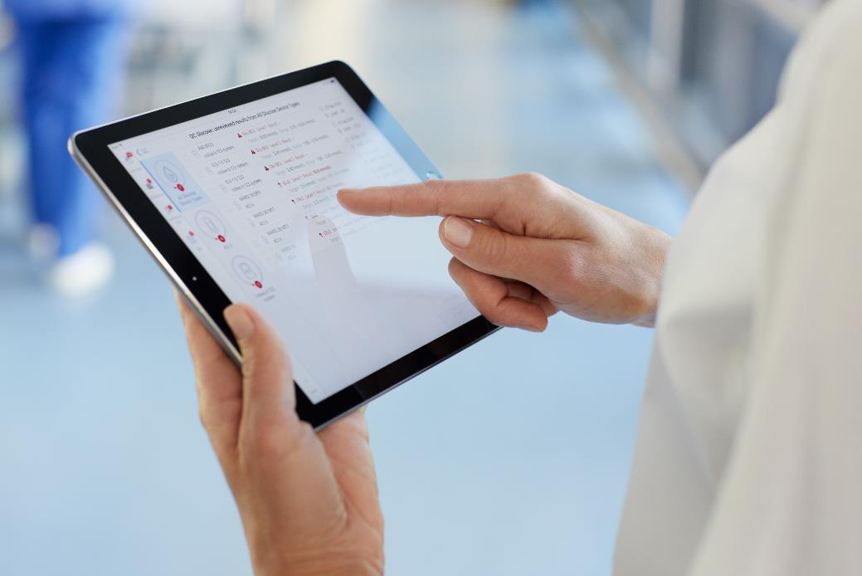
cobas® POC IT solutions
Configure automatic alerts to keep you informed
My settings > Warnings and alerts
Warning type
Severity
Email
Backup error
BGE device critical error
BGE device error
Check disk space
Expired certifications
Instrument events
Maintenance task due
High
High
Medium
Medium
Low
Low
Low
Configurable alerts for improved productivity
Notes:
0 - You can also receive email alerts as required.
1 - This functionality is highly configurable, so that you are only alerted for things that you have decided you want to know about – making sure you make the best use of your time and can respond quickly.
With cobas POC IT solutions, POC coordinators can monitor the overall performance and act on issues that require their attention out of their pocket, from anywhere. This saves time, optimizes workflow and simplifies complex job tasks.

Slide 32
cobas® POC IT solutions
Designed with your expertise in mind to manage POC traffic
Enable maximum integration
Coordinate operator management
Enable work on-the-go
Support continuous improvement

Slide 33

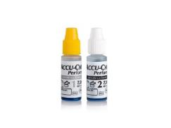

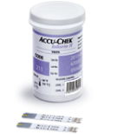
cobas® POC IT solutions
Go beyond compliance to drive improvements
Pathways
and guidelines
Clinical
audit
Clinical incident
reporting
Risk management
Patient experience
Clinical effectiveness
Performance &
outcomes
Staffing & staff
management
Professional
development
Clinical governance
Notes:
0 - The test result you see is the most visible part of POC testing. Below that are all sorts of other factors that need to be verified and traced. A ‘first generation’ approach to POC IT helps support that – things like operator management, QC, and device management.
1 - But then laboratories can go beyond compliance, and use POC IT to check that they conform to their own clinical standards.

Slide 34

cobas® POC IT solutions
Go beyond compliance to drive improvements
i
i
i
i
i
Pathways
and guidelines
Clinical
audit
Clinical incident
reporting
Risk management
Patient experience
Automated support for device, user and QC compliance
Analyze your POC service to meet standards and drive improvements
Clinical effectiveness
Performance &
outcomes
Staffing & staff
management
Professional
development
Clinical governance
Notes:
0 - Data is captured on every aspect of testing, and automatically compiled in the database to make it easy to extract data in various ways.
1 - You can use this information to measure and monitor performance with depth and breadth, to verify that you’re meeting your own standards and to spot further opportunities to improve.

Slide 35

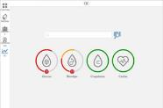

cobas® POC IT solutions
Centralized information to improve quality of care
Modify care pathways to improve outcomes
i
i
i
i
i
i
Collect and analyze results in real time
Notes:
0 - Our commitment to patient care and medical value is also a guiding principle in the way we’ve built our POC IT solution.
1 - The system acts as a data collection tool for patient and QC data to be stored in one place and analysed in real time. This allows you to improve clinical outcomes and affect patient pathways.
2 - For example, you can identify a glucose hypo event from a patient in real time, and prioritise a visit to that patient by a diabetes nurse, so that a timely intervention can be made. The timing of glucose testing, according to meal times, can be analysed from information in the system to ensure testing is being conducted at the right times of the day. So you have more information available to make better clinical decisions and improve the quality of care for patients.

Slide 36
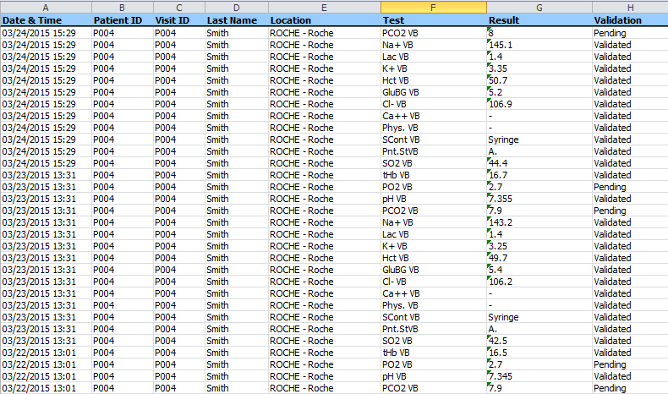

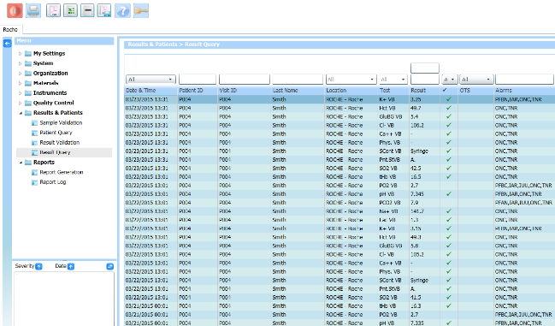
cobas® POC IT solutions
Export patient result queries into Excel
Permission-based
results export into Excel
Check patient events and
record history for auditing
i
Location
i
Tests performed
i
Results
i
Validation
Notes:
0 - The information that is collected by cobas IT solutions can then be analysed at a number of different levels.
1 - Data can be exported into Excel, with tighly-controlled permissions to ensure security
At the patient level, this information can be used by clinicians to support care – for example, the ‘regular’ shift can look to quickly and easily check what happened at night, or at the weekend, and proactively decide where patient care is needed. For example, did a patient have a ‘hypo’ over the weekend? This eliminates the need to rely on being told by staff who may be less experienced and not know what’s essential and what isn’t.
2 - Audits can be performed – and data can be investigated to find whether testing is conducted in line with clinical guidance.

Slide 37
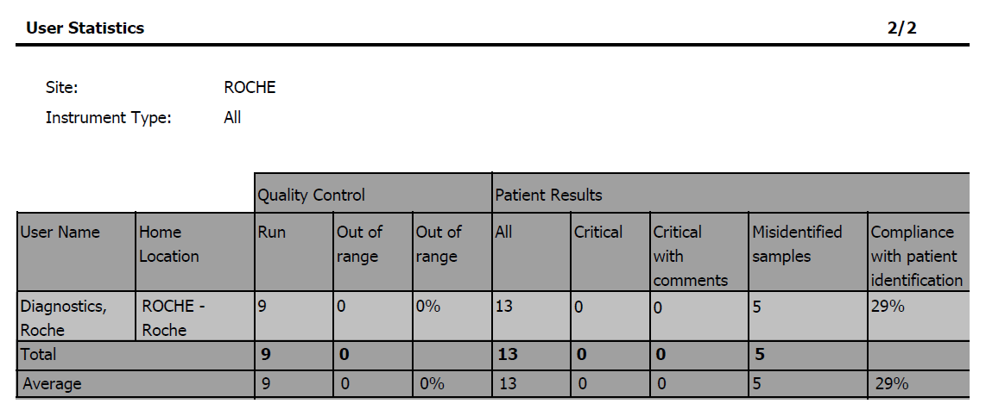
cobas® POC IT solutions
Review operator performance and compliance
Operator-focused analysis
Objective basis for training
Operator statistics report
i
Location
i
Results ranges
i
Data input
i
Comments
Notes:
0 - Similarly, data can be analysed at the operator level. Where a test result requires a comment to be recorded on the device, has this been provided? Have operators been providing valid data, or just keying in “12345”?
1 - Analysis of operator data can reveal where staff need further training or support, and data can ensure that the intervention with staff is based on objective facts.

Slide 38

cobas® POC IT solutions
Reviewing clinical practices
Identify wards/clinics not following protocols
Operator statistics report
i
Location
Find operators that need update training
i
Results ranges
i
Data input
Monitor and improve testing performance
i
Comments
Notes:
0 - Armed with this kind of information, coordinators can identify areas of the hospital, individual operators or testing regimes that need improvement, and take action with additional training, modifications to the testing process or other supportive measures, all based on the objective facts generated from the system.

Slide 39
cobas® POC IT solutions Designed with your expertise in mind to manage POC traffic
Enable maximum integration
Coordinate operator management
Enable work on-the-go
Support continuous improvement

Slide 40


cobas® infinity POC IT solutions
Customer statement from Belgium
‘’When you work with a learning management system you can better monitor if the nurses have done the training's on the system and if they are qualified to use the devices.
We reach 80% of all the nurses. In the old days, 20%, 30%. You were never sure, have they been there? Have they signed it off? Can we put it in their personal records? That took a lot of time.
Now it's the other way around. We have more time to work with the content and less time on the administrative tasks.’’
Liesbeth Verbanck
Quality manager e-Learning,
Jan Yperman Hospital
Notes:
0 - Here we can see a customer testimonial from one of our customers in the Belgium

Slide 41

cobas® infinity POC IT solutions
Customer statement from the Netherlands
“Before POC Tablet I couldn’t be completely mobile. Now I have the freedom to move around the hospital and perform the tasks efficiently at every location.
There is no need of paper any more to write things down like when replacing an instrument or when we have to train a user. It is so easy to use that I never again want to work without it.”
Dianda Hemme-ter Haar
POC Co-ordinator
Treant Zorggroep,
Emmen, The Netherlands
Notes:
Here we can see a customer testimonial from one of our customers in the Netherlands

Slide 43
Doing now what patients need next

