Slide 1
2021 Global Sustainability Report: Key Messages
2030 SUSTAINABILITY PLAN
June | 2022

Slide 2
2021 Global Sustainability Report
Abbott 2030 Sustainability Plan
Key Messages
This report shares our environmental, social and governance (ESG) performance over the past year and highlights the progress we’ve made toward the goals set out in our 2030 Sustainability Plan.
Our 2030 Sustainability Plan puts our central purpose – helping people live better, healthier lives – at the forefront.
We’re laying the foundation for transforming our business over the next decade, advancing healthcare while remaining responsive to the pressing issues of today.
By designing our life-changing technologies for greater access and affordability and breaking down barriers to care, we’re embedding greater access into tomorrow’s innovation.
We intend to improve the lives of 3 billion people – that’s one in every three people on the planet – every year by 2030.
We made significant progress in the past year, reaching 2.2 billion people – up from almost 2 billion in 2020 – through our products and services.

Slide 3
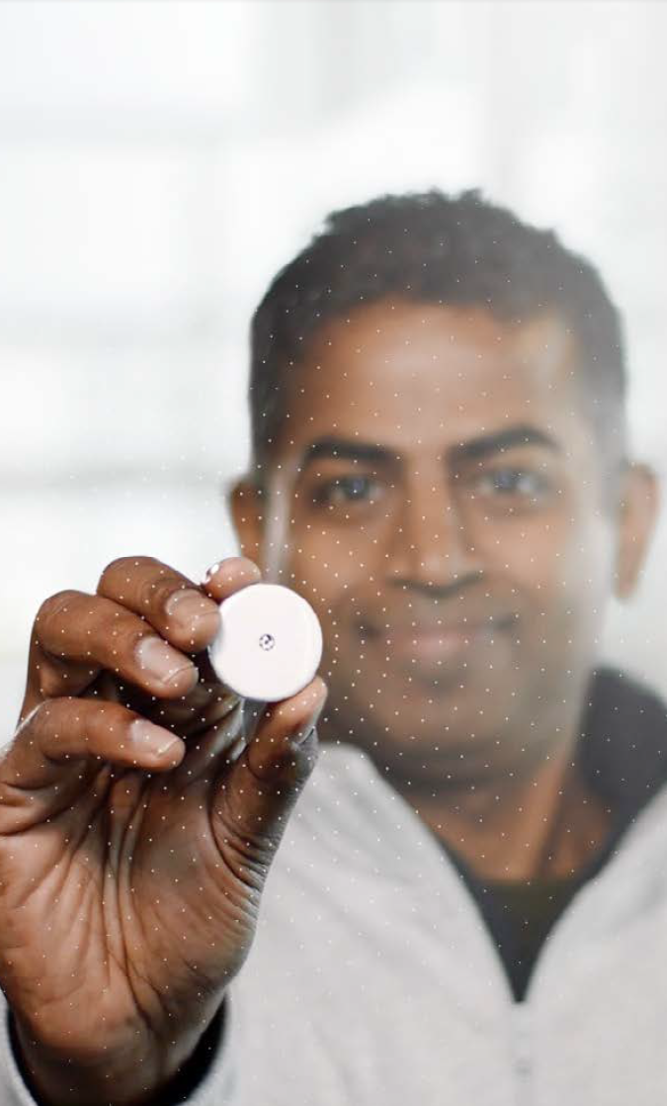
2021 Global Sustainability Report
Abbott 2030 Sustainability Plan
PROGRESS: INNOVATING for Access and affordability
We believe the best healthcare solutions are the ones that help the most people. That’s why we’re designing new products and reimagining existing ones to maximize access to life-changing technologies and services, increase our positive impact on the world, and sustain Abbott for years to come.
2.2 billion* lives improved from Abbott’s products and services in 2021
We have outlined three Design Principles to embed innovating access and affordability in how we develop and bring technologies and products to the people who need them:
Design for Broader Reach and Equity: Building an innovation portfolio that reaches more people, including new geographies and communities with limited access to care
Design for Access: Identifying and overcoming barriers to access and adoption, prioritizing inclusive design as well as strategies to reduce costs across the value chain
Design to Optimize Reach and Value: Making intentional decisions throughout the design process to optimize people reached, consumer benefit, business and societal value
Launched Ultreon 1.0 to help improve outcomes for coronary artery procedures
Launched NeuroSphere Virtual Clinic, increasing access to care by letting doctors remotely assess symptoms and adjust therapies for patients with chronic pain or movement disorders
* Total number of lives improved was adjusted for indirect overlap between businesses using a binomial probability model, and only adjusted for direct overlap within a business where data is currently available to support the adjustment.

Slide 4
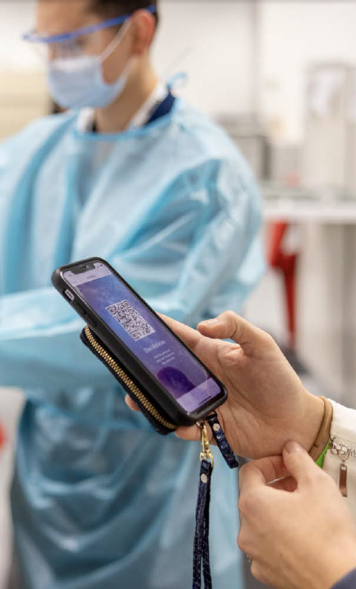
2021 Global Sustainability Report
Abbott 2030 Sustainability Plan
Progress: RESPONSIBLY Connecting DATA, Technology and care Timely, accurate and secure data can empower people to take control of their own health, and it can help connect them to care, wherever they are. Protecting that data is key to achieving our vision of digitized, democratized and decentralized healthcare.
Published an enhanced formal commitment to privacy and protecting sensitive data
Established a coordinated vulnerability disclosure program to enhance reporting of product and system vulnerabilities
Two maturity assessments conducted on privacy and product security
Cybersecurity control framework developed
Founding member of the University of Minnesota Center for Medical Device Cybersecurity

Slide 5
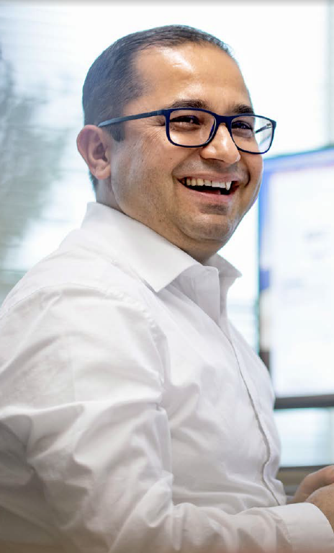
2021 Global Sustainability Report
Abbott 2030 Sustainability Plan
Progress: Building the DIVERSE, Innovative Workforce of Tomorrow
Dedicated employees power Abbott’s sustainable success. As they drive our growth, we provide a supportive, inclusive culture, and programs that help ensure their continued development and encourage them to build successful careers with us.
Achieved 163,315 development and job opportunities for current and future employees
1,375 young people participated in 2021 internship programs
Our Freedom 2 Save program supported the financial security of employees by helping those with college debt save for retirement, with Abbott providing $3.5 million in savings through the program since its launch in 2018
17,000+ Abbott colleagues completed our Leading With Impact program, gaining new skills, tools and perspectives to help them create a more supportive, inclusive and rewarding environment for their teams
Continued to work toward building a more inclusive culture*
40% of global management positions filled by women
44.6% female representation in STEM roles
33% of leadership roles held by people from underrepresented groups
* More details on our progress in this area will be available in our 2021 Diversity, Equity and Inclusion Report, which will be published in the 4th quarter

Slide 6

2021 Global Sustainability Report
Abbott 2030 Sustainability Plan
Progress: Protecting A HEALTHY ENVIRONMENT Safeguarding the environment must be a priority for Abbott if we are to help people around the world live healthier, fuller lives. Evolving our operations to reduce our environmental footprint will also help us build a more resilient business for the long term.
88.5% waste diversion rate
530,200 pounds of packaging impacted through sustainable design since 2020
556 suppliers engaged to evaluate climate, water and waste risk management
5% reduction in emissions from operational activities (vs. 2018)
Committed to a science-based target for carbon emissions
Laid groundwork for future water stewardship certification and management practice accreditation

Slide 7

2021 Global Sustainability Report
Abbott 2030 Sustainability Plan
Progress: CREATING A resilient, diverse and responsible supply chain Abbott’s global supply chain has proven its strength, resilience and ability to amplify our positive impact on the world. When we nurture a supplier network that’s strong and ethical, we multiply our ability to touch people’s lives and reduce shared sustainability impacts. And, by focusing on spend with diverse companies, we’re creating a supplier base as varied as those we serve.
Established language for our social responsibility requirements that’s being incorporated into direct material spend contracts
Launched initiative with LISC (Local Initiative Support Corporation) to build a more diverse supply chain
31% and 15% growth in spend with Black- and women-owned businesses* respectively (2021 vs. 2020)
48.6% spend increase with small businesses**
100% of suppliers assessed for sustainability risk
Funded three packaging initiatives that will impact 8 million pounds of packaging materials
* Includes data from U.S., Canada, and Puerto Rico suppliers.
** Includes data from U.S. only.

Slide 8
For more information and examples, visit Abbott.com/sustainability
2021 Global Sustainability Report

