Slide 1
Product manual(For physicians)
“ASAHI”, “ASAHI Gladius” and “Treasure” are trademarks or registered trademarks of ASAHI INTECC CO., LTD in Japan and other countries.
AMC-K15234

Slide 2



Product characteristics
Soft tip polymer jacket guidewire
Appropriate for a broad range of cases from simple stenosis to occluded lesions
Soft tip polymer jacket guidewire
Enhanced device delivery type with great shaft support and maneuverability

Slide 3


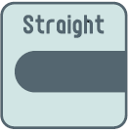
Product structure
Hidrofilinis dengimas distaliai.
Polymer jacket
Hydrophilic coating
Polymer jacket + Hydrophilic coating
Tip load 3.0gf
Hydrophilic coating length 50cm
Length lineup 200cm, 235cm, 300cm

Slide 4
Detailed characteristics
Appropriate for a wide range of cases from simple stenosis to occluded lesions
Composite Core
Tip durability
Appropriate for multi-vessel lesions
Polymer jacket
Crossability
Quickly cross even calcified lesions and fibrous occlusions
Tip load 3gf
Balanced support shaft design
Push force transmission
Smooth wire control in collateral channels

Slide 5
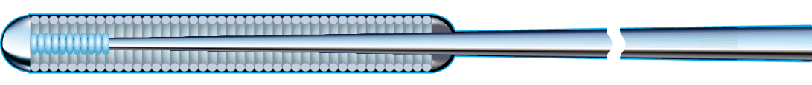
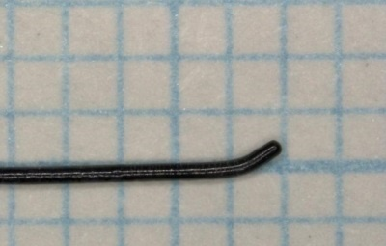
Detailed characteristics
New ASAHI technology
Mini pre-shape
Pre-shaped curve 1mm from the ball tip
Tip pre-shaped in the manufacturing process with a 1mm curve – easier for the physician than shaping manually.
Able to efficiently reshape the curve to a more acute angle.
Able to change the shape depending on the lesion or procedural situation.
Better shape retention throughout the procedure

Slide 6
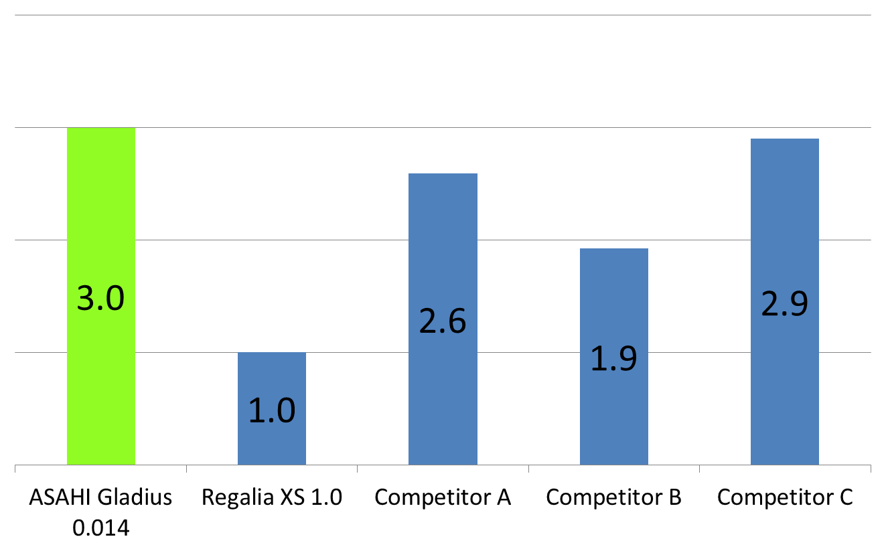
Tip load
0.014” Moderate tip load as an utility guide wire
Tip load
(gf)
Appropriate for a wide range of cases from simple stenosis to occluded lesions
*The above data was obtained by company standardized test, which may differ from industry standardized tests. *The above data does not prove that all devices have exactly the same performance with the samples used for these tests.
Notes:
Competitor A：Command ES
Competitor B：Command
Competitor C：V14

Slide 7
Product structure
Polymer jacket
Hydrophilic coating
Polymer jacket + Hydrophilic coating
Tip load 4.0gf
Hydrophilic coating length 10cm
Length lineup 200cm, 235cm, 300cm

Slide 8
Detailed characteristics
Device delivery with great shaft support and maneuverability
Balanced support shaft design
Polymer jacket
Controllability
Speedy cross over approach
Balanced support shaft design
High support shaft design
Device delivery
Easy delivery of devices, including bulky devices

Slide 9
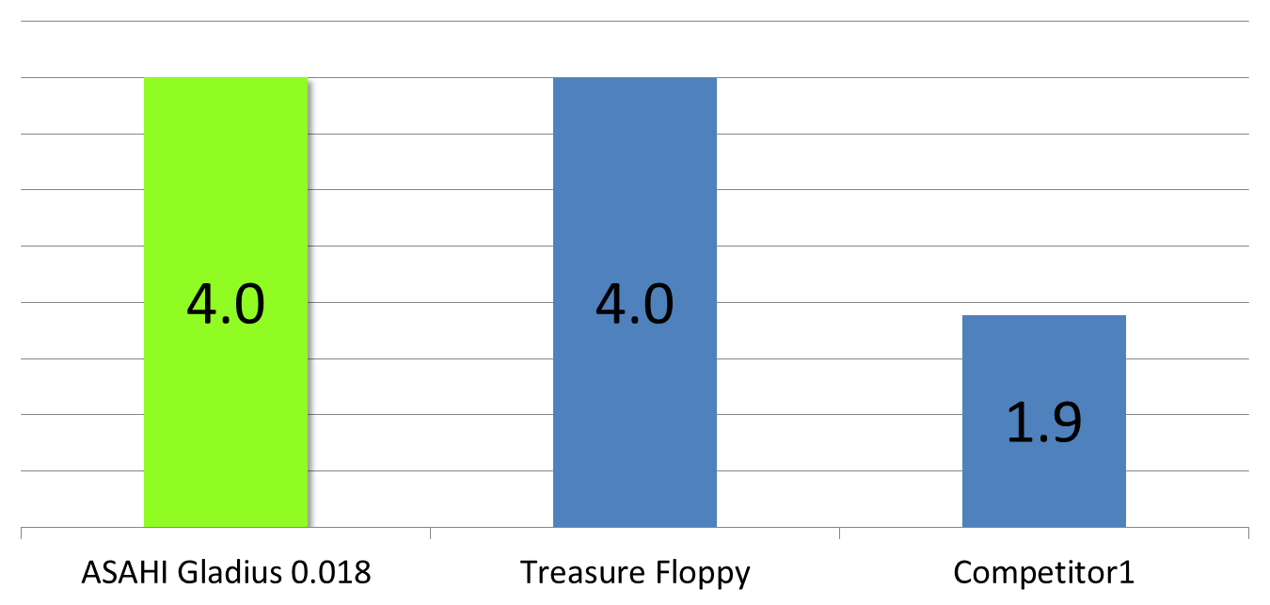
Tip load
0.018” Moderate tip load ⇒ Appropriate for a broad range of cases from simple stenosis to occluded lesions as a soft wire.
Tip load
（gf)
Higher
*The above data was obtained by company standardized test, which may differ from industry standardized tests. *The above data does not prove that all devices have exactly the same performance with the samples used for these tests.
Notes:
Competitor1＝V18

Slide 10
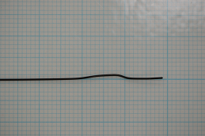
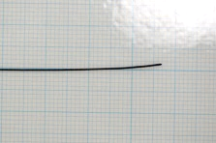
Tip durability
High tip durability
High level retention of core wire due to Composite Core®.
Used for occluded lesion and multi vessel.
Crush test
Competitor1 （Polymer jacket type）
ASAHI Gladius 0.018
After crush test
3D transformed
Push into a simulated blood vessel.
Not 3D transformed
*The above data was obtained by company standardized test, which may differ from industry standardized tests. *The above data does not prove that all devices have exactly the same performance with the samples used for these tests.

Slide 11
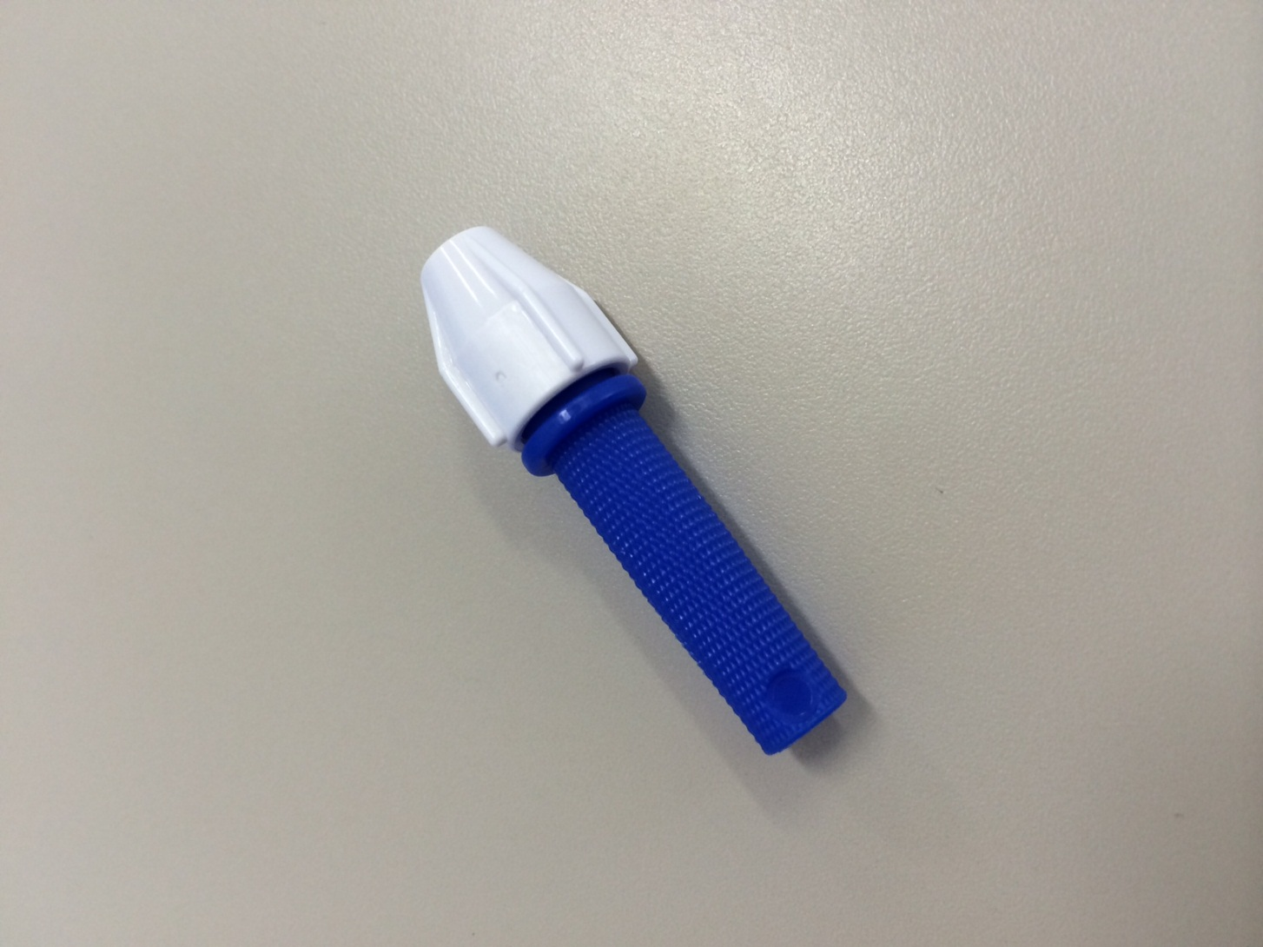
Torque Device
Torque device included

Slide 12
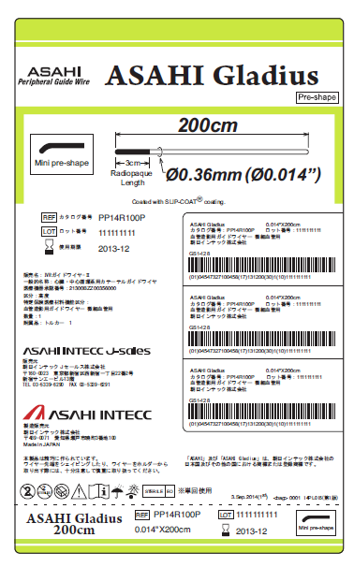
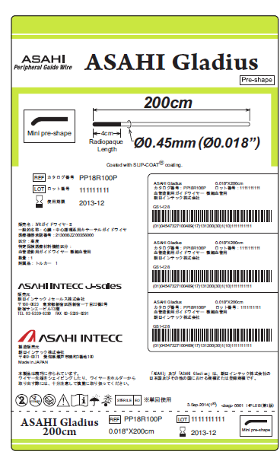
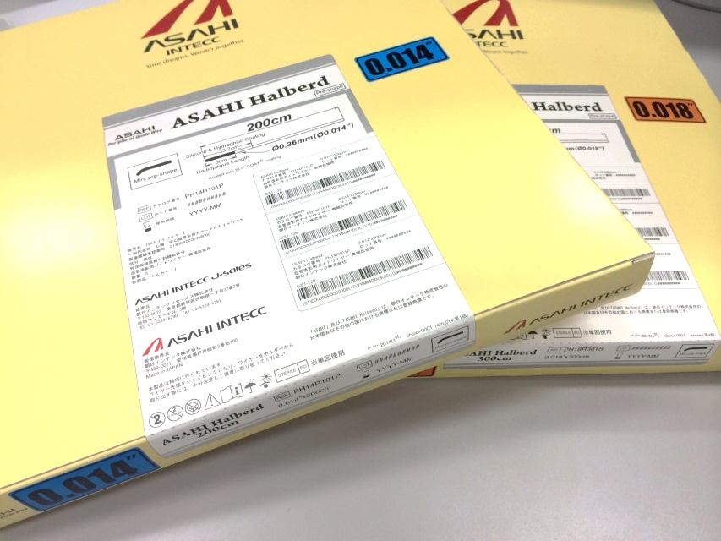
Package information
Available length line up
ASAHI Gladius 0.014 200cm, 235cm, 300cm
ASAHI Gladius 0.018 200cm, 235cm, 300cm
Available length
Inch size
Inch size
Inch size

