Slide 1
Product manual(For physicians)
“ASAHI”, “Halberd” and “Treasure” are trademarks or registered trademarks of ASAHI INTECC CO., LTD in Japan and other countries.
AMC-K15235

Slide 2



Product characteristics
Stiff-tip guidewire
Superior directional control with strong torque transmission and penetration
Stiff-tip guidewire
Balanced power to cross highly resistant lesions

Slide 3
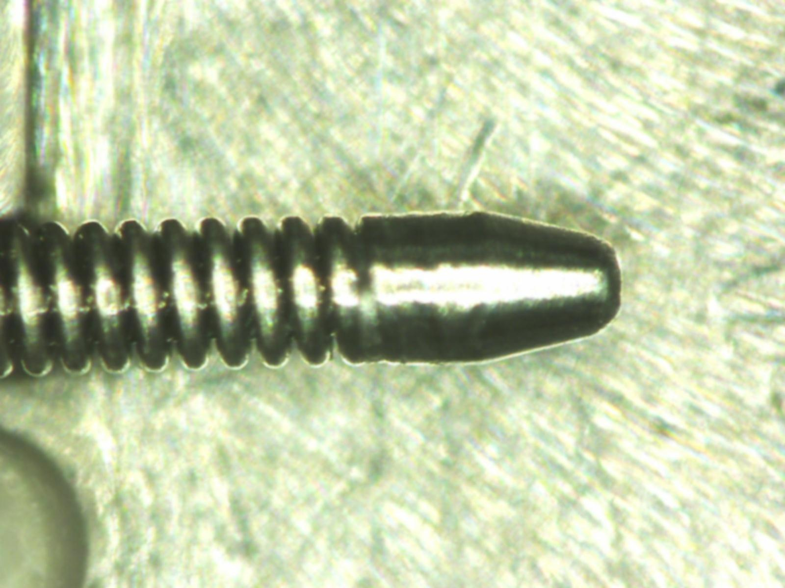
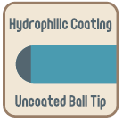
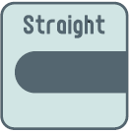
Product structure
Hydrophilic coating
Micro-cone tip
Coil + Hydrophilic coating <Uncoated ball tip>
Tip load 12.0gf
Hydrophilic coating length 33cm
Length lineup 200cm, 235cm, 300cm

Slide 4
Detailed characteristics
Superior directional control with strong torque transmission and penetration
Balanced support shaft design
Advantages in occluded lesions
Push transmission
Tip load 12.0gf
Easily catches the entry point of the occlusion
Micro-cone tip
Penetration
Composite Core
Torque response
Easy directional control
Mini pre-shape
Armored Tip
Shape retention

Slide 5
Detailed characteristics
New ASAHI technology
Mini pre-shape
Armored Tip
Soldered from the pre-shaped part until the ball tip
Retention of the small angle even in occluded lesions
Easy directional control in calcified occluded lesions due to superior tip shape retention
Able to manually apply a second curve after the soldering

Slide 6
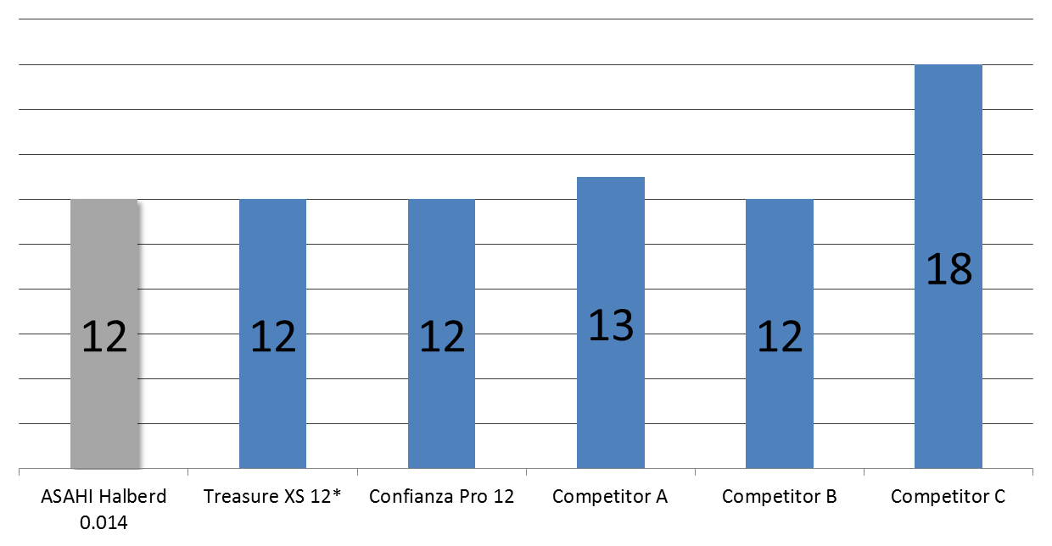
Tip load
Moderate hardness to approach to the occluded lesion.
To keep the guide wire characteristic to approach to the hard occluded lesion
in peripheral artery, tip load is same as Treasure XS 12.
Tip load
(gf)
Higher
*Treasure XS 12 is available only in Japan.
*The above data was obtained by company standardized test, which may differ from industry standardized tests.
*The above data does not prove that all devices have exactly the same performance with the samples used for these tests.
Notes:
Competitor A Win 200T
Competitor B Victory 14 (12gf)
Competitor C Victory 14 (18gf)

Slide 7
Product structure
Hydrophilic coating
Micro-cone tip
Coil + Hydrophilic coating <Uncoated ball tip>
Tip load 12.0gf
Hydrophilic coating length 12cm
Length lineup 200cm, 235cm, 300cm

Slide 8
Detailed characteristics
Balanced power to cross highly resistant lesions
Balanced support shaft design
Advantages in the occluded lesion
Push transmission
Tip load 12.0gf
Easily catches the entry point of the occluded lesion
Micro-cone tip
Penetration
Composite Core
Torque response
Easy directional control
Mini pre-shape
Shape retention

Slide 9
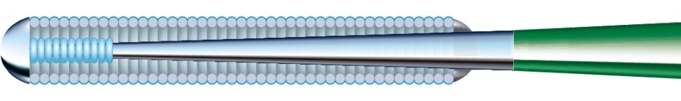
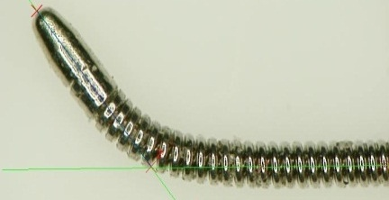
Product characteristics
New ASAHI technology
Mini pre-shape
Mini pre-shape 1mm from the ball tip
Tip pre-shaped in the manufacturing process with a 1mm curve – easier for the physician than shaping manually.
Able to efficiently reshape the curve to a more acute angle.
Able to change the shape depending on the lesion or procedural situation.
Better shape retention throughout the procedure

Slide 10
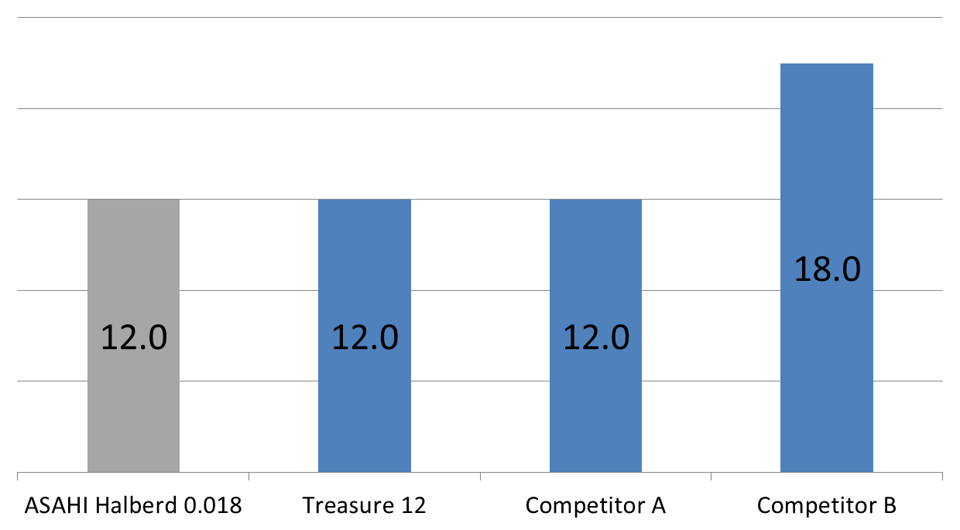
Tip load
Moderate stiffness to for occluded lesions
Tip load
(gf)
Higher
To keep the guide wire characteristic to approach to the hard occluded lesion
in peripheral artery, tip load is same as Treasure 12.
*The above data was obtained by company standardized test, which may differ from industry standardized tests.
*The above data does not prove that all devices have exactly the same performance with the samples used for these tests.
Notes:
Competitor A Victory 18 (12gf)
Competitor A Victory 18 (18gf)

Slide 11
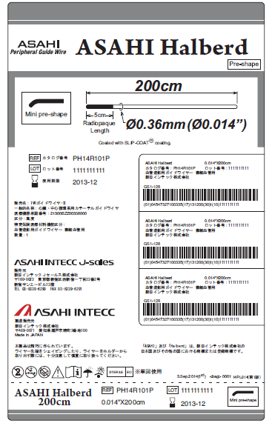
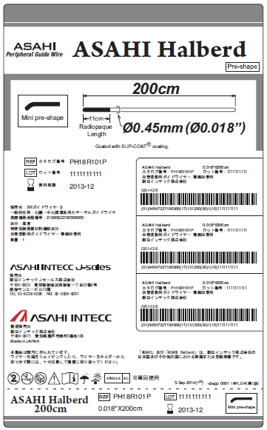
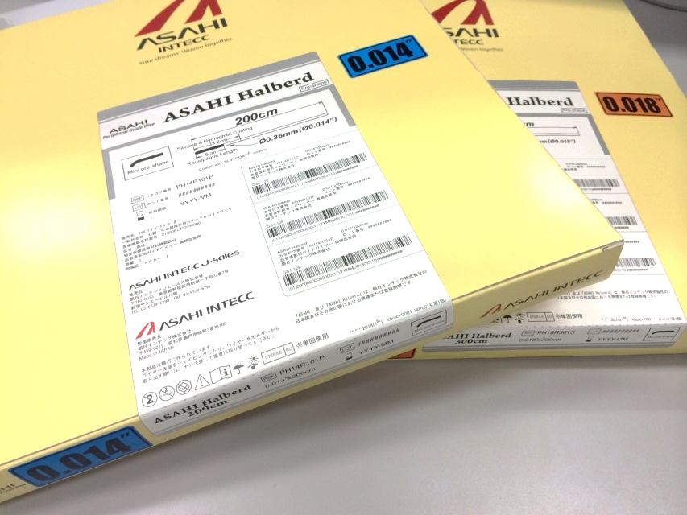
Package information
Available length line up
ASAHI Halberd 0.014 200cm, 235cm, 300cm
ASAHI Halberd 0.018 200cm, 235cm, 300cm
Inch size
Inch size
Inch size

