Slide 1

How to develop and submit a tender (proposal) using CVP IS?
Valid from2025-10-29

Slide 2
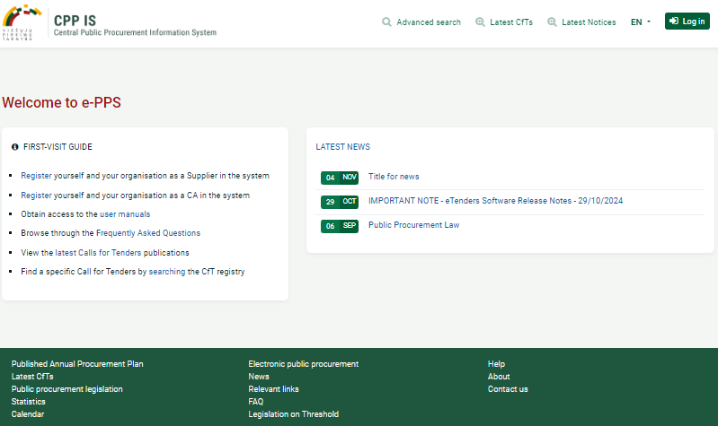
How can I find CVP IS in English language?
First you must visit https://viesiejipirkimai.lt/epps/home.do and choose language (1) and press “Log inn” (2)
1
2

Slide 3
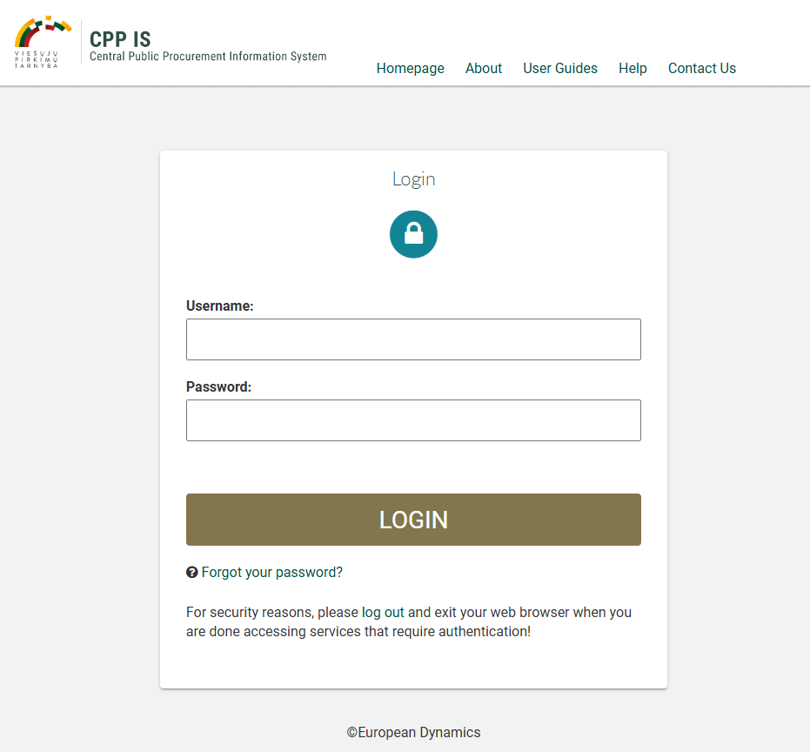
Enter your username (must be all lowercase letters)
Enter password

Slide 4
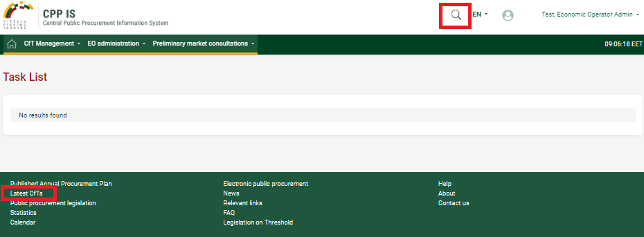
Once logged in, you can search for purchases in several ways 1 or 2:
1
2

Slide 5
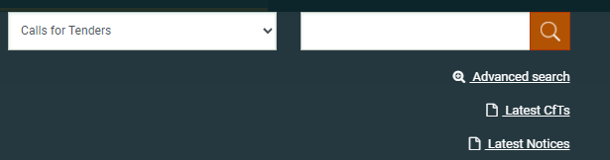
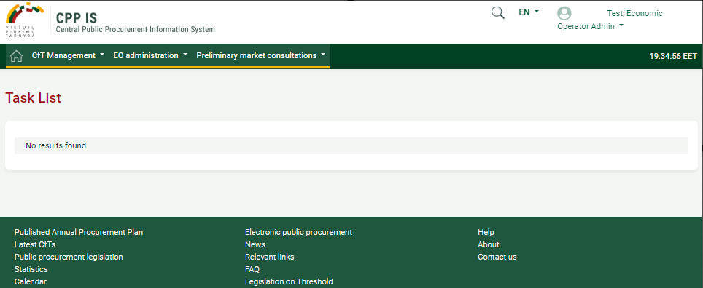
When conducting a search in this way, click on „Latest CfTs" and you will be redirected to all tenders.
You can try out a sample purchase in the DEMO environment European Dynamics - Welcome to CPP IS- </br>URGENT NOTICE : SYSTEM cannot sent email</br>TEST
Please submit bids on a trial tender with ID 28249

Slide 6
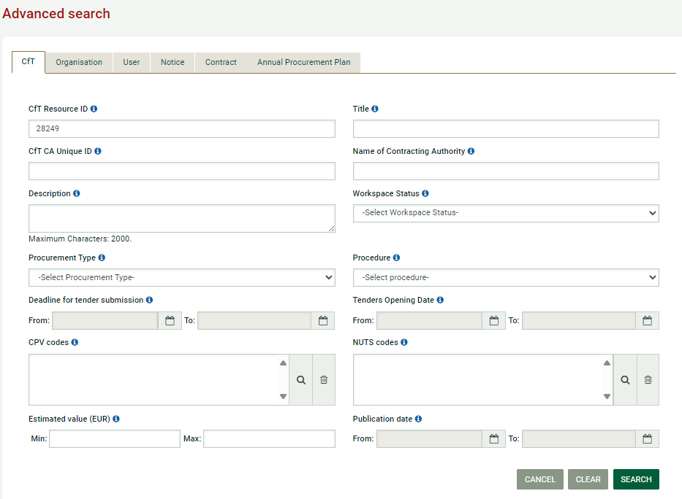
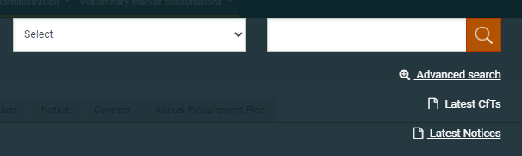
For a more detailed search, click on "Advanced search" and enter the tender ID in the “Cft Resource ID" section and click on "Search".
2
1
3

Slide 7
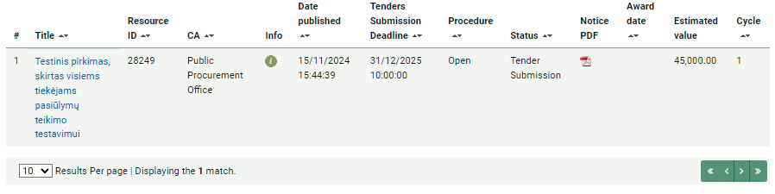
Click on the tender name to bid on a trial tender with ID 28249

Slide 8
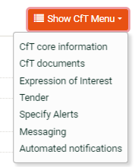
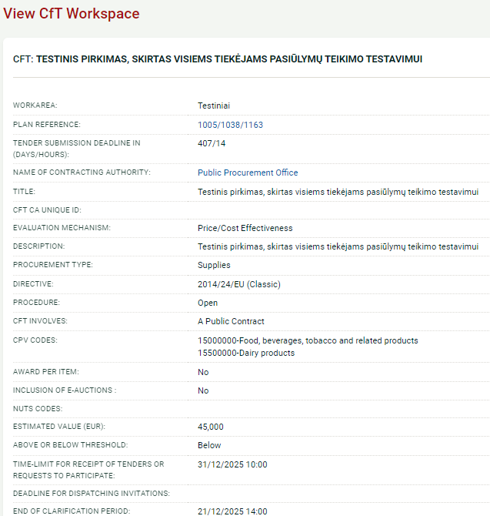
CfT core information
Shows basic information about the purchase

Slide 9
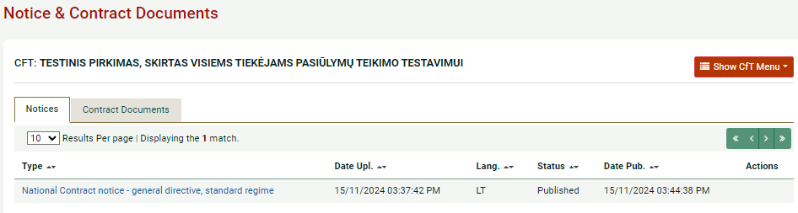
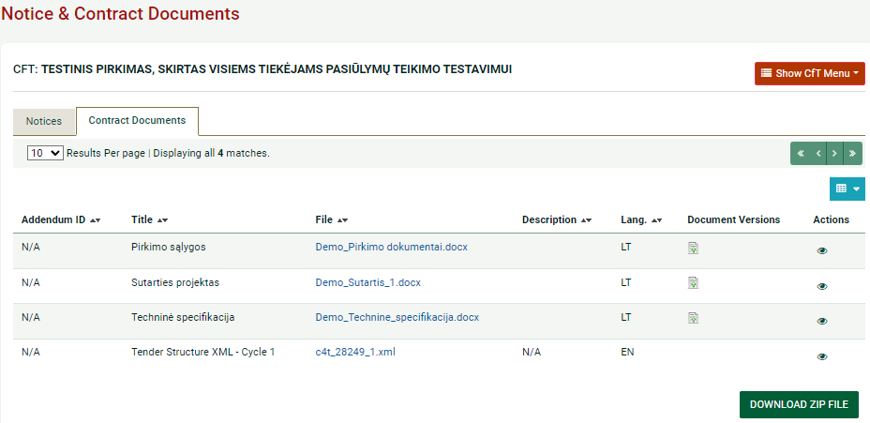
You can find out information about the purchase by extracting the menu "Cft documents"
Cft documents:
Notices
Contracts Documents:
To view
to download zip file

Slide 10
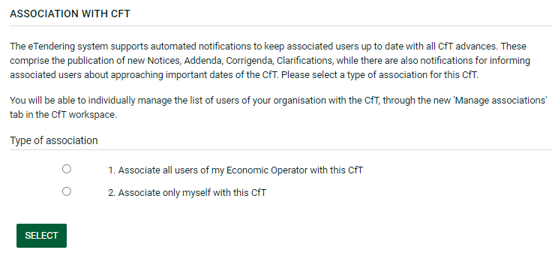
Choose type of association:

Slide 11
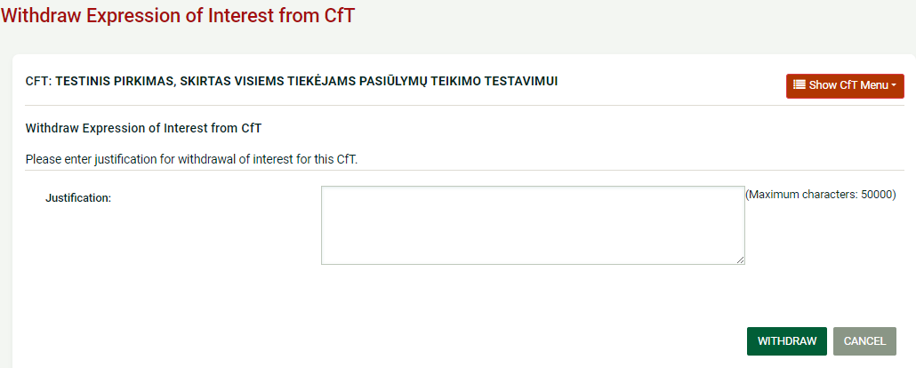
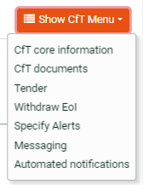
Withdraw Expression of Interest from CfT

Slide 12
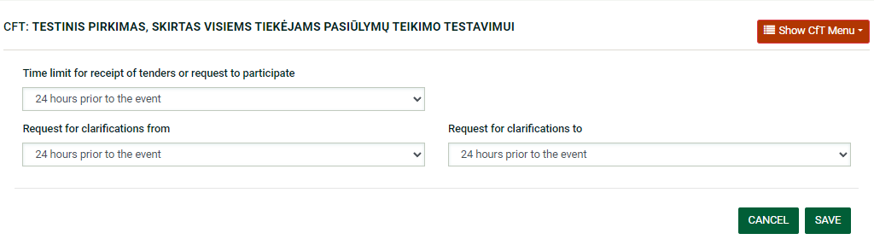
Specify Alerts.
Can set deadlines for receiving notifications.

Slide 13
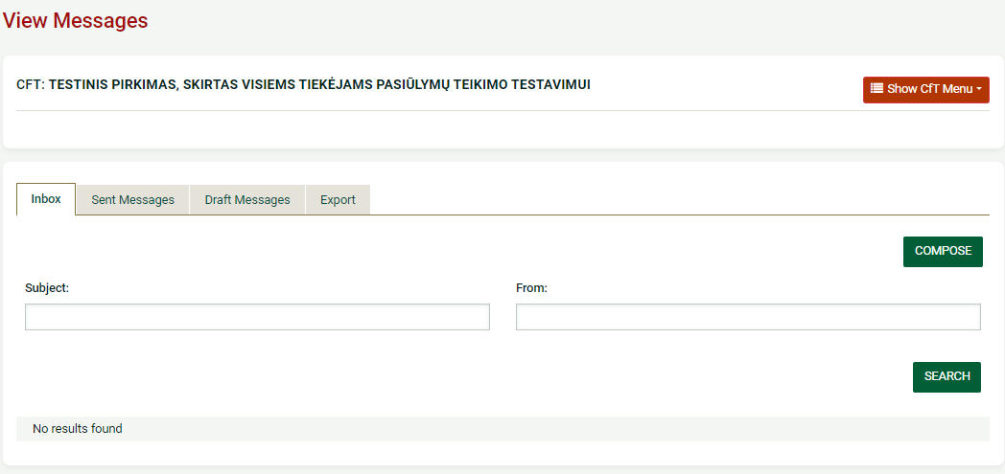
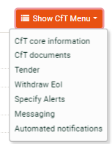
View Messages.

Slide 14
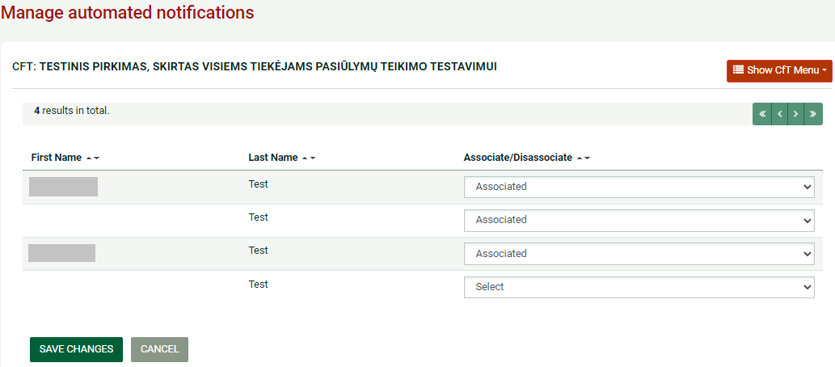

Manage automated notifications. Can edit the notification settings by clicking on the "Automated notifications" section of the tender menu

Slide 15
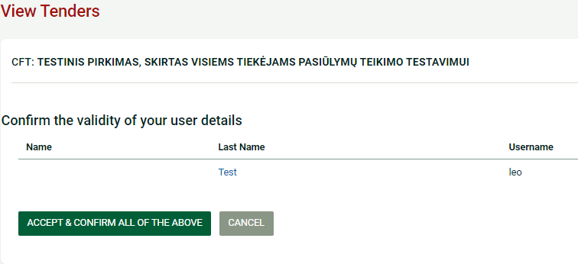
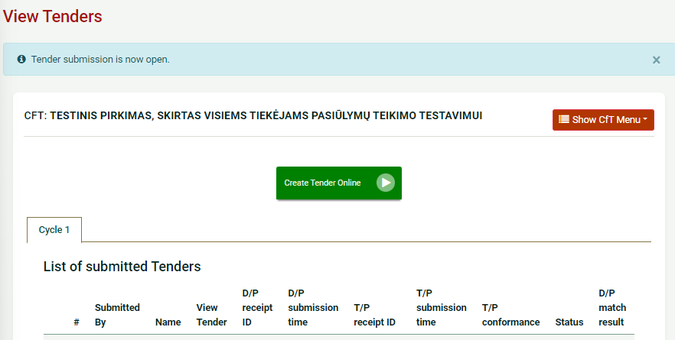
To submit a tender:
2
1
3

Slide 16
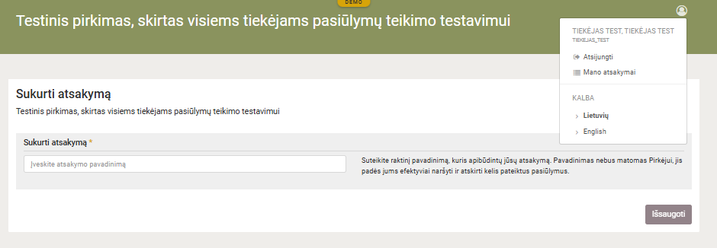
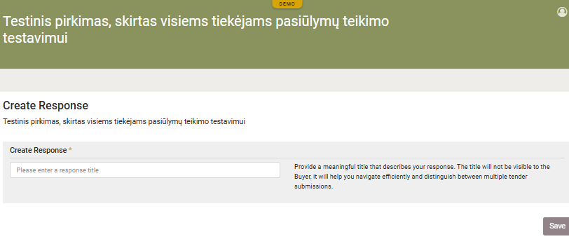
If you see that it is not in English, please set English as the language:
1
2

Slide 17
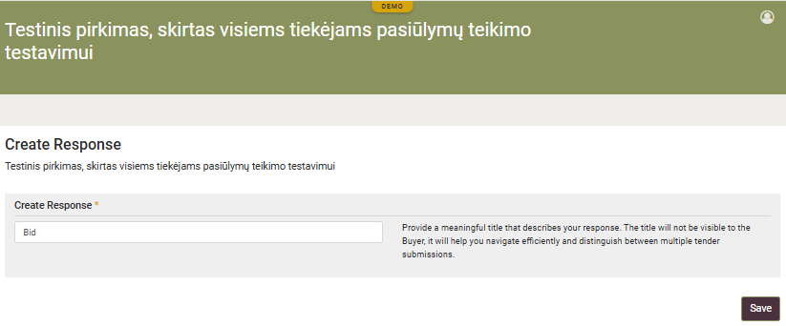
Fill in the field marked with an asterisk by writing “Create Response" and click "Save"
1
2

Slide 18
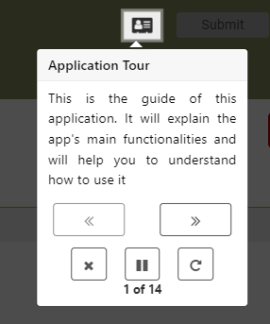
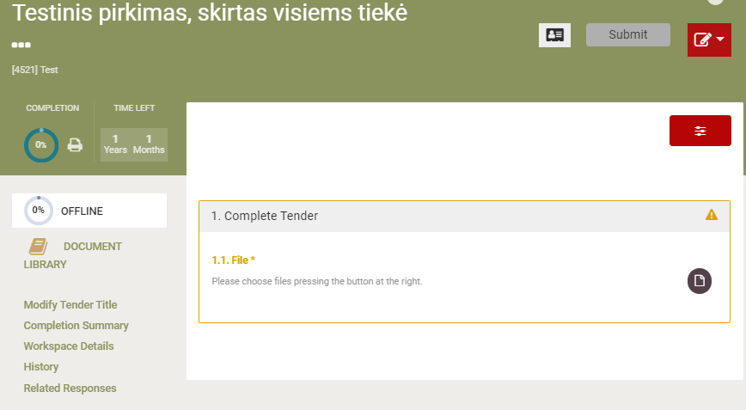
Application Tour.
Clicking through will explain the main features and how to use it.

Slide 19
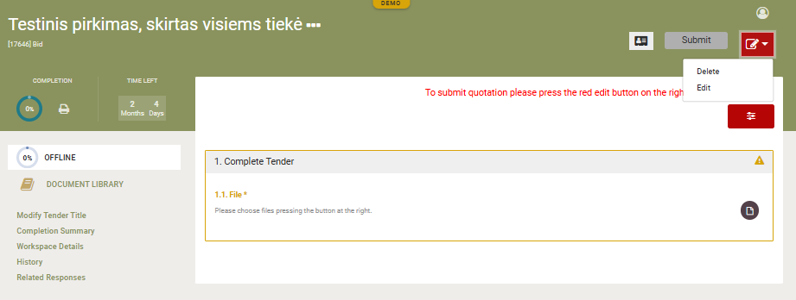
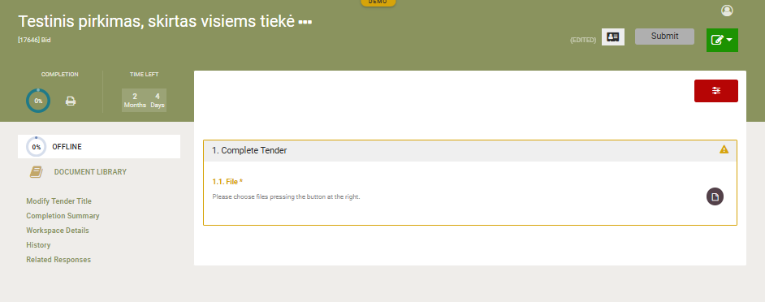

Click the red button (1), click "Edit„ (2) and button changes from red to green
1
2

Slide 20
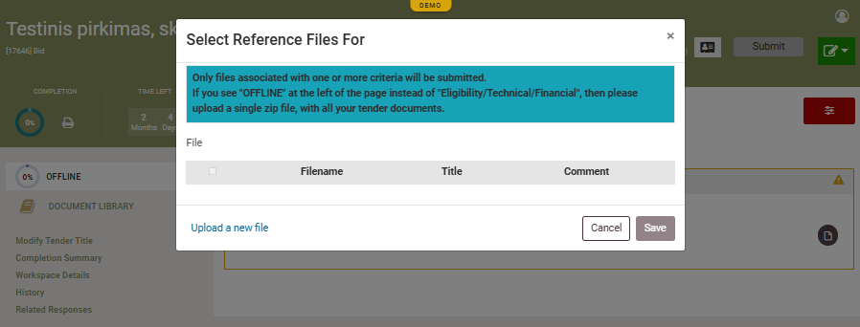
Click on the file icon -> "Upload new file"
2
1

Slide 21
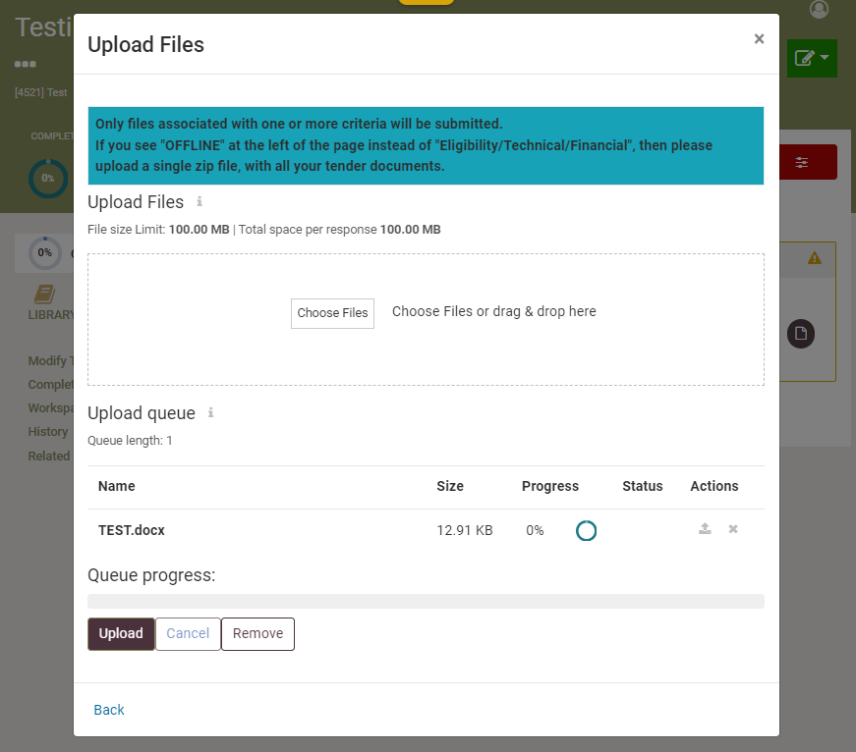
1 - click "Choose files" add the offer document,
2 - the attached document will be visible
3 - press "Upload", when the button turns gray, press “Back„
4- when the "Upload" button will turn light gray, press the blue letters "Back."
1
2
3
4

Slide 22
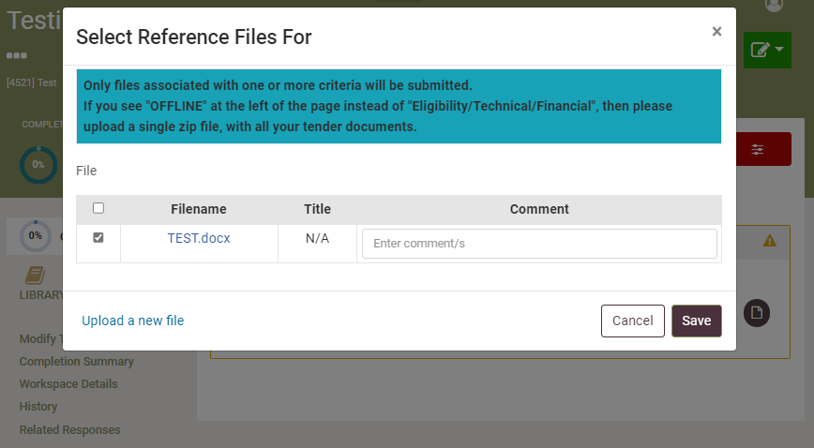
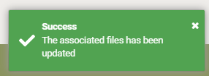
In the "File" column, check the box next to the name of your document, if you want you can write a comment.
IMPORTANT! After ticking, click "Save", otherwise the document will not be attached.
1
2

Slide 23
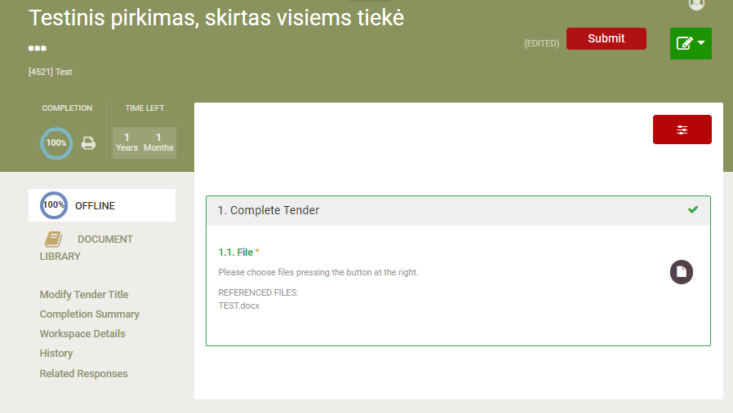
After successfully uploading the bid document (1), the implementation percentages appear.
click ,,Submit” (2)
2
1

Slide 24
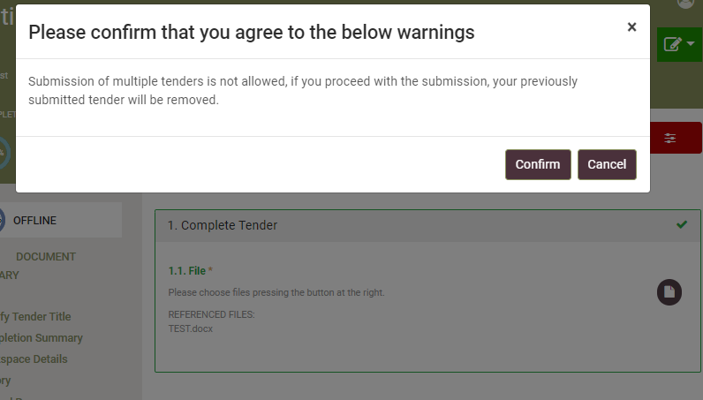
Confirm that you agree to the below warnings

Slide 25
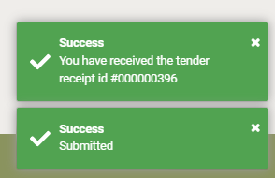
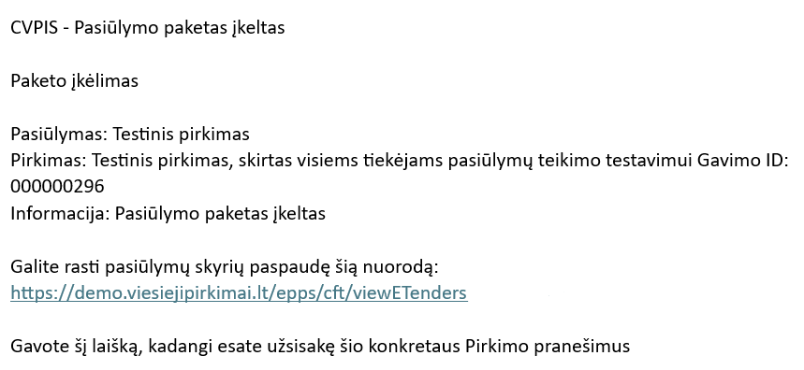
After a successful bid, there will be an entry in the right corner:
You will receive an email about submitting an offer :

Slide 26
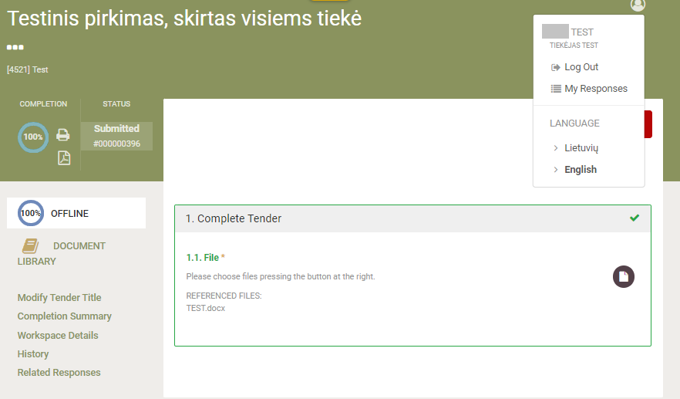
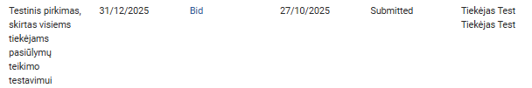
Information about submitting an offer by clicking here
"My Answers" and "Submitted" status.

Slide 27
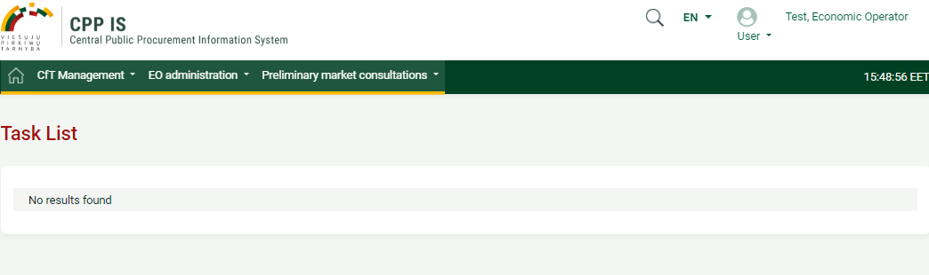
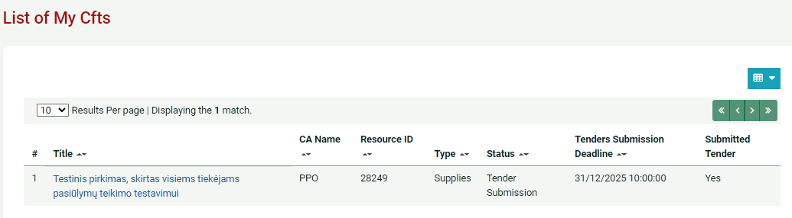
To find your purchase in the main window of your account. Click:
Purchase Management -> My Purchase List

Slide 28
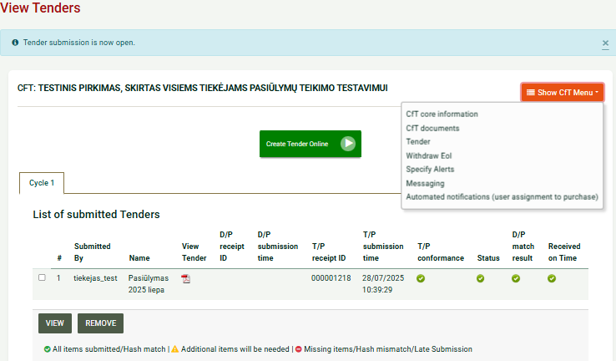
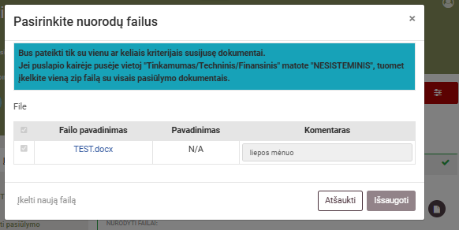
Review the submitted proposal.
In the selected purchase:
Click Show CFT Meniu (1);
Click ,,Tender“ (2);
Mark the inserted proposal (3);
Click ,,VIEW“ (4);
Click on the file icon (5);
view the submitted proposal documents (6)
1
2
3
4
6
5

Slide 29
In the selected purchase:
Click Show CFT Meniu (1);
Click ,,Tender“ (2);
Click ,,Create Tender Online“ (3);
Important! The new offer submitted will automatically replace the previous one, and the previously entered offer will no longer be in the system.
Amend the submitted proposal.
1
3
2

Slide 30
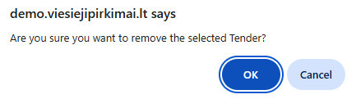
Remove the submitted proposal.
In the selected purchase:
Click Show CFT Meniu (1);
Click ,,Tender“ (2);
Mark the inserted proposal (3);
Click ,,REMOVE“ (4);
Confirm the removal by clicking "OK" (5).
1
2
3
4
5

Slide 31
Technical support
Email: pagalba@vpt.lt

