Slide 1

Guide TO FILL in AND OVERVIEW THE ESPD
for suppliers participating in the procurement
of JSC Lithuanian Railways

Slide 2
ESPD (European Single Procurement Document) – is a declaration submitted by suppliers as a primary evidence that they meet the requirements set out in the contract documents. Whether documents in support of the declared data will be asked to be submitted together with the ESPD, or whether only the successful bidder will be asked to submit these documents is indicated in chapter 4 of the Special Conditions.
ESPD is filled in on the website at: https://ec.europa.eu/tools/espd/filter?lang=lt

Slide 3
# FILL IN the ESPD

Slide 4
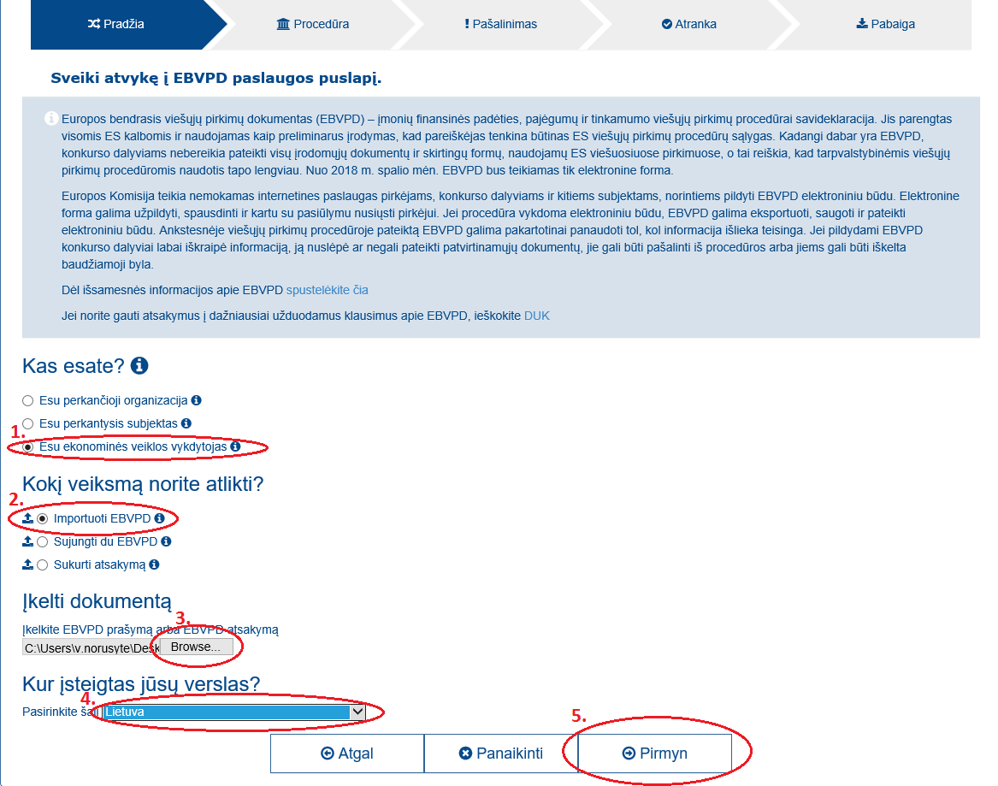
#1 Step in filling in the ESPD
After opening the start window (https://ec.europa.eu/tools/espd/filter?lang=lt):
1. Tick the checkbox “I am an economic operator“;
2. Tick the checkbox “Import ESPD”;
3. Upload document
Upload Annex 2 “EBVPD“ of the Special Conditions (is downloaded by XML format) using a “Browse” button;
4. Select country where your business located;
5. Click “Next” .

Slide 5
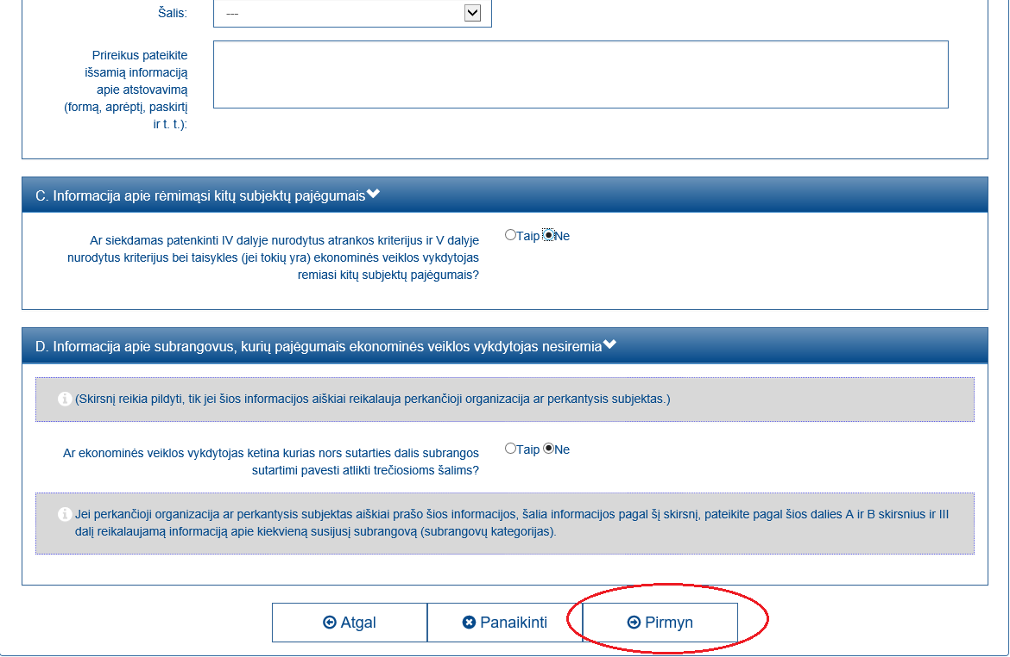
#2 Step in filling in the ESPD
In the window opened, complete all information required in Part II on the economic operator and click “Next“.

Slide 6
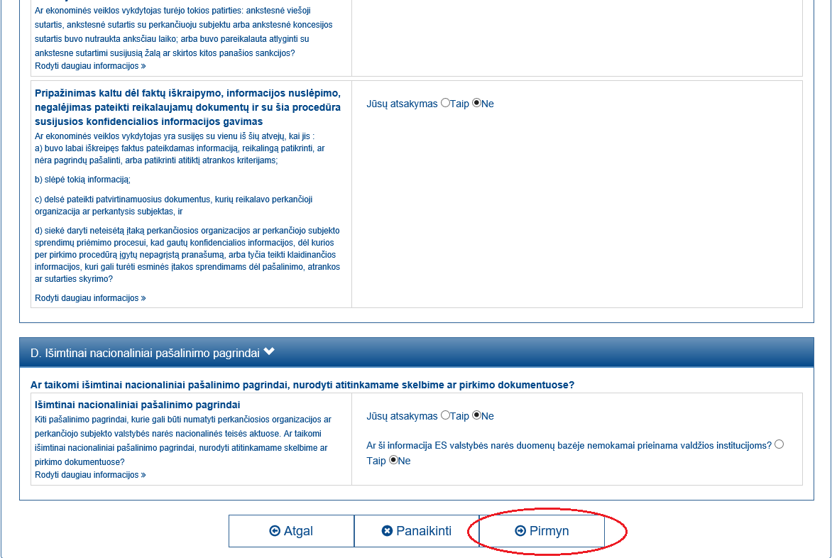
#3 Step in filling in the ESPD
In the window opened, complete all information required in Part III “Exclusion grounds“ and click “Next“.

Slide 7
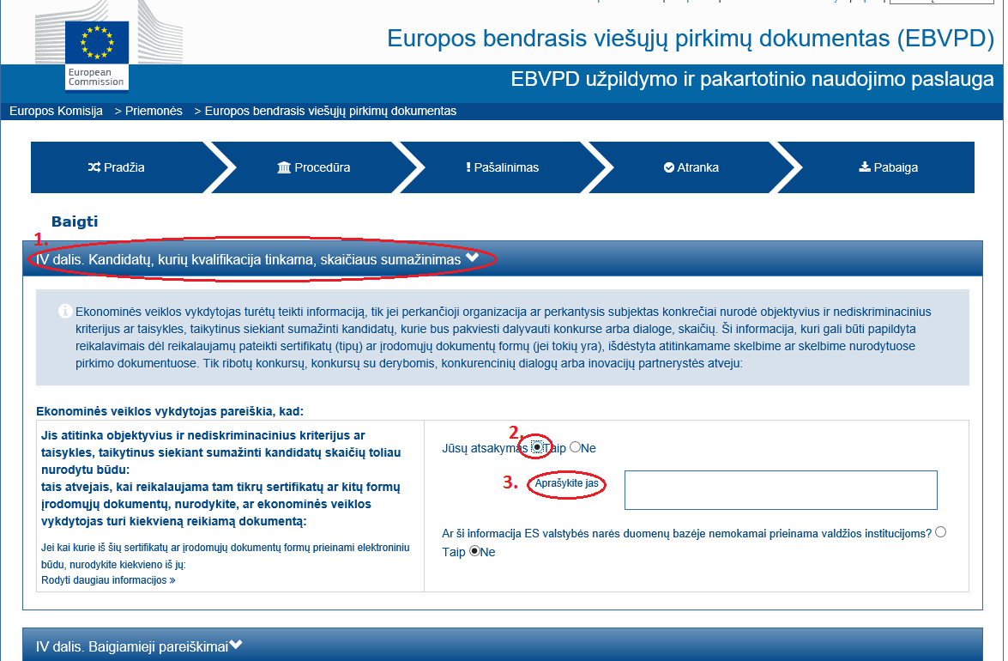
#4 Step in filling in the ESPD
In the opened new window, fill in Part IV “Reduction of the number of qualified candidates” only in the case if restricted procedure, negotiated procedure with publication of a contract notice or competitive dialogue is carried out and it is indicated in chapter 4 of the Special Conditions that qualitative screening is conducted.
In this case:
1. If you fulfil at least on qualification selection criterion indicated in chapter4 of the Special Conditions, tick “Yes” in checkbox 2;
2. Ticking of Checkbox 3 is optional.

Slide 8
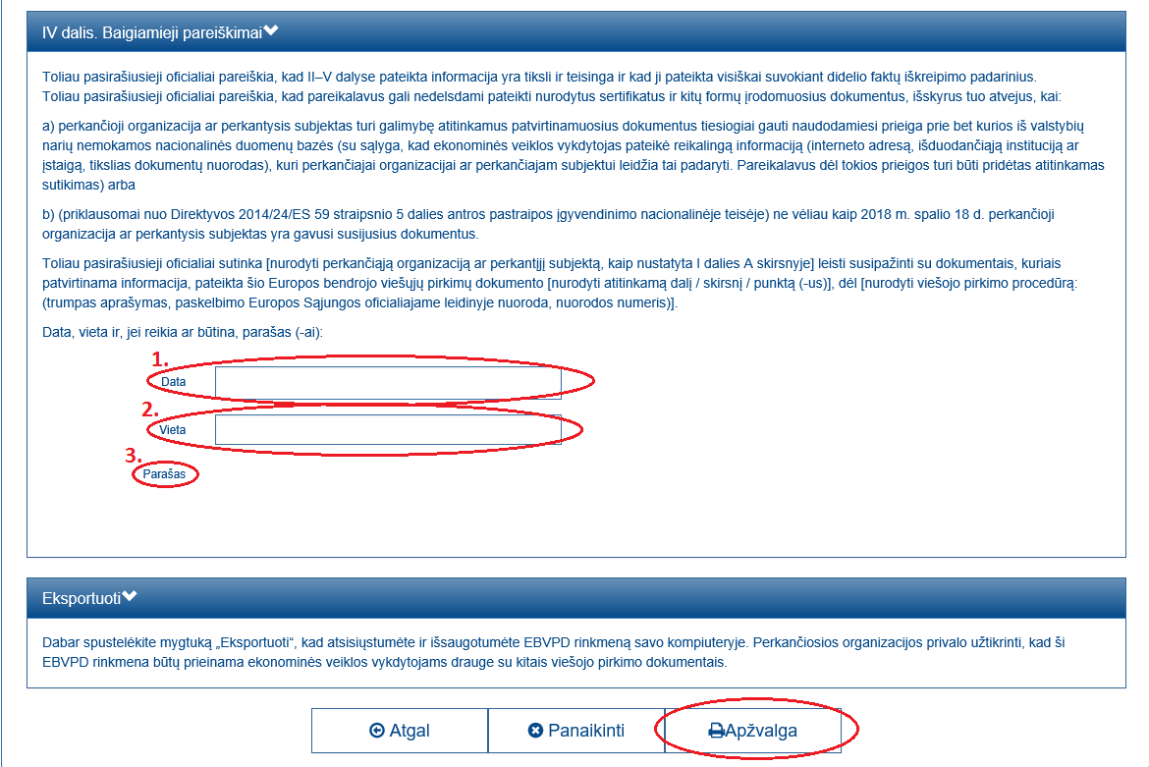
#5 Step in filling in the ESPD
1. Fill out Part IV “Concluding Statements” by indicating the date and place .
2. If ESPD is filled out by a supplier or a member of supplier’s group and the person indicated in Part I “Information concerning the economic operator” signs the overall tender by electronic signature, it is not necessary to sign this document separately.
Otherwise (when the application is filled out by an economic entity on whose capacities the supplier relies, a member of the suppliers’ group who is not responsible for the submission and signing of the tender, also when the person indicated in Part I “Information concerning the economic operator” does not coincide with the person who signs the tender by electronic signature), ESPD must be downloaded in PDF format, printed and signed;
3. After filling out the required checkboxes, click the button “Overview”.

Slide 9
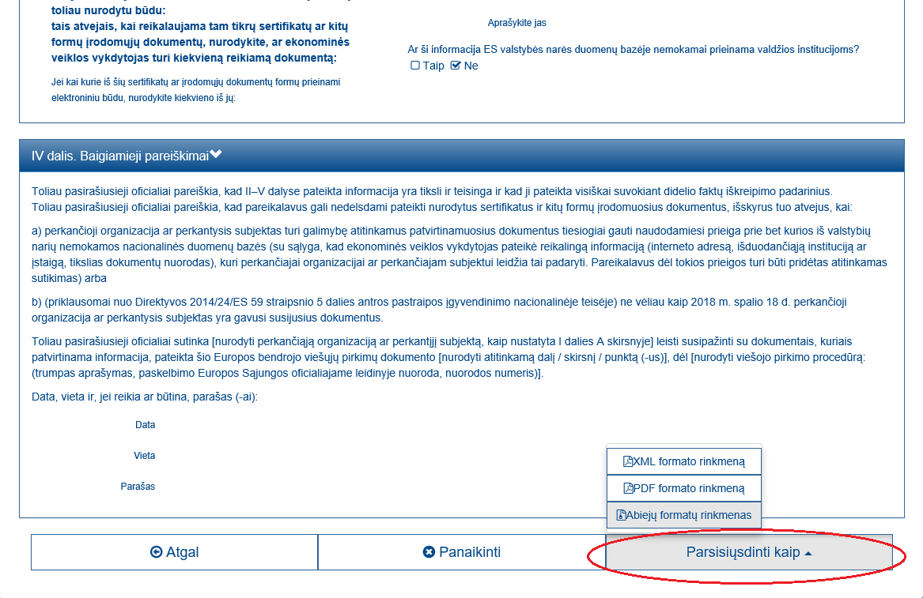
#6 Step in filling in the ESPD
In the window opened, review whether the data has been completed correctly, and click the button “Download as”. Select XML format document, if you do not need to submit the ESPD signed by physical signature, or select “Both format files” if this document must be signed (cases concerning signing are indicated in slide “#5 Step in filling out ESPD”). XML format file must be attached to the tender and, when ESPD signed by physical signature is submitted, also a PDF format document.

Slide 10

If you have questions about filling in and submission of ESPD, please ask them through the Central Portal of Public Procurement.

