Slide 1
ORTHO Vision e-Connectivity

Slide 2
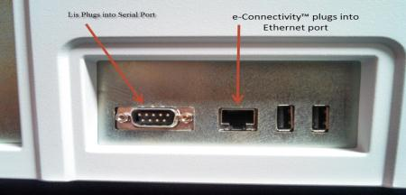
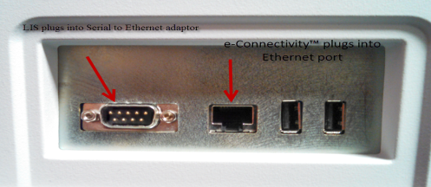
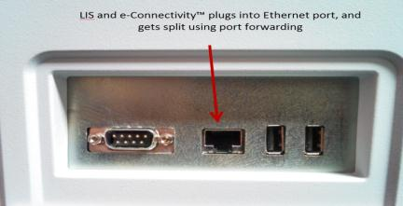
E-Connectivity and LIS connection options
#1
#2
There is only 1 Ethernet port on Vision.
So there are 3 options to connect the LIS on an e-connected instrument :
#1---Connecting LIS in serial mode
or
#2 ---Connecting LIS in Ethernet mode using the serial port with an serial to Ethernet adaptor
or
#3---Connecting LIS in Ethernet mode using the same Ethernet port than the e-connectivity,.In that case, the LIS vendor will have to dispatch appropriately the information on customer network
#3

Slide 3
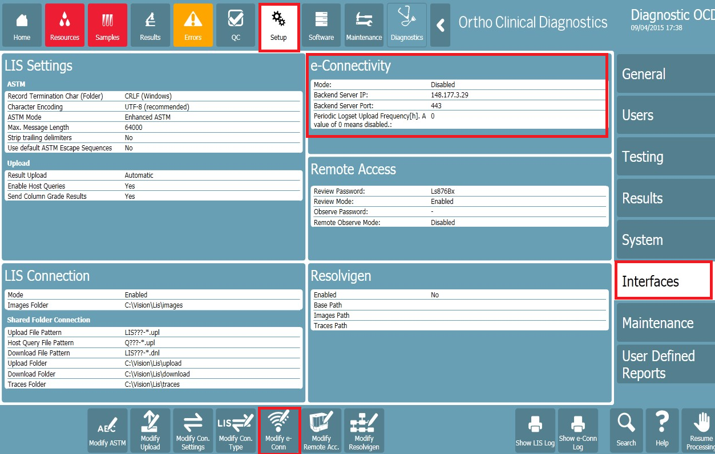
E-Connectivity configuration

Slide 4
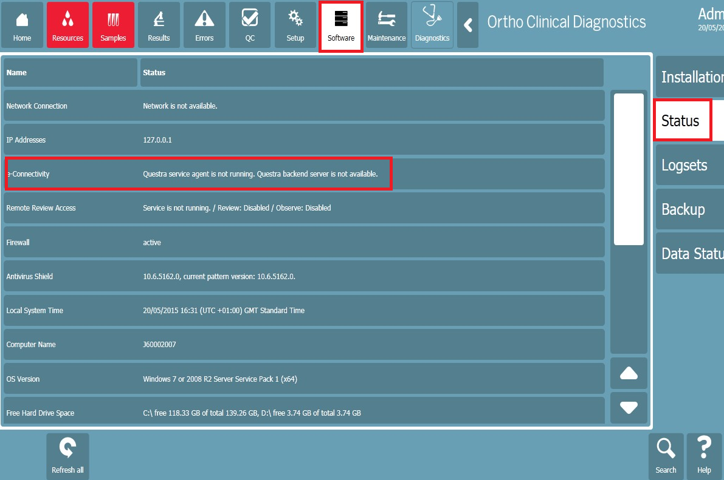
Check E-Connectivity is running
Following should be written in Software menu > Status:
      Questra service Agent is running-Questra Backend server is available

Slide 5
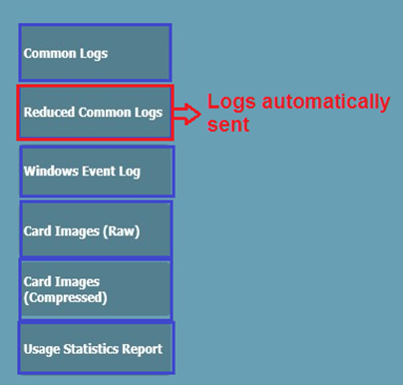
Logs File types on Vision

Slide 6
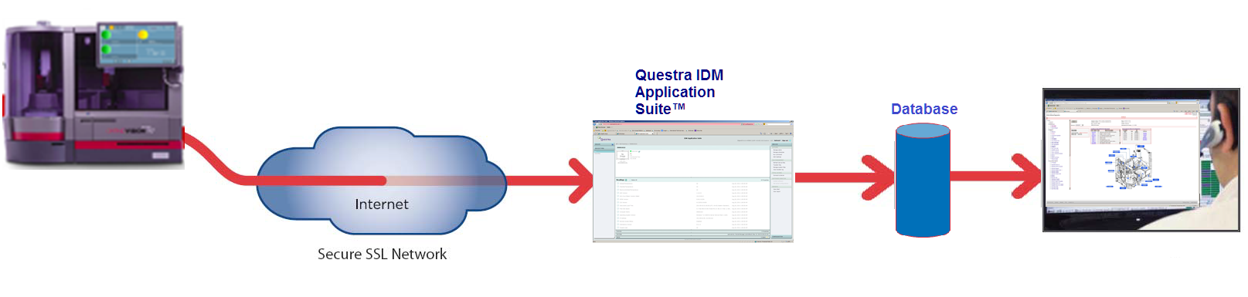

E-Connectivity Structure for ORTHO Vision
Vision e-Connectivity uses Questra applications and software*
  A Questra agent is running on the analyzer
  Log files are sent to Questra Enterprise Server
Some type of files stay in Questra, other file types are also uploaded in the e-Connectivity database
Only the files loaded in the e-Connectivity database are viewable in the Vision e-Connectivity Dashboard
*By the end of 2015, we will move from Questra
to Axeda
Dashboard
CTS can log in Questra Application

Slide 7
How to get the log files
3 possibilities
    Log files are sent automatically from the instrument
    Log files are manually sent from the instrument by the customer (only 1 to 7 days of files can be sent)
    Log files are “grabbed” or “pulled” by CTS employee using the Questra application (only one file at a time can be grabbed)

Slide 8
Reduced common logs files
Automatically sent to Questra server
Automatically uploaded to the database.
Contain the most pertinent data from the common log files. Those data will be displayed in the Vision Dashboard
Frequency of data upload is set on the analyzer in Setup > Interfaces> Modify eConn, The default is 2 hours.
Can also be manually sent by the customer
As there are hundred of files per day, it is not very convenient to have CTS uploading these files using Questra application (because you upload files one by one)

Slide 9
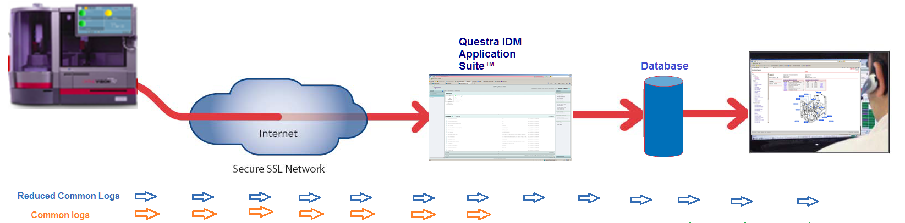
Common logs files
Original files created by the analyzer.
Not sent automatically
Can be sent manually by the user from the instrument but there is a risk of timeout because the user cannot send one single file but only from 1 to 7 days of files
Can be grabbed from the instrument using Questra application
The CL files manually sent or uploaded from Questra will always remain in Questra. They are not sent in the database and so the data in these logs are NOT viewable in the Vision e-Connectivity Dashboard
Manual
Automatic

Slide 10
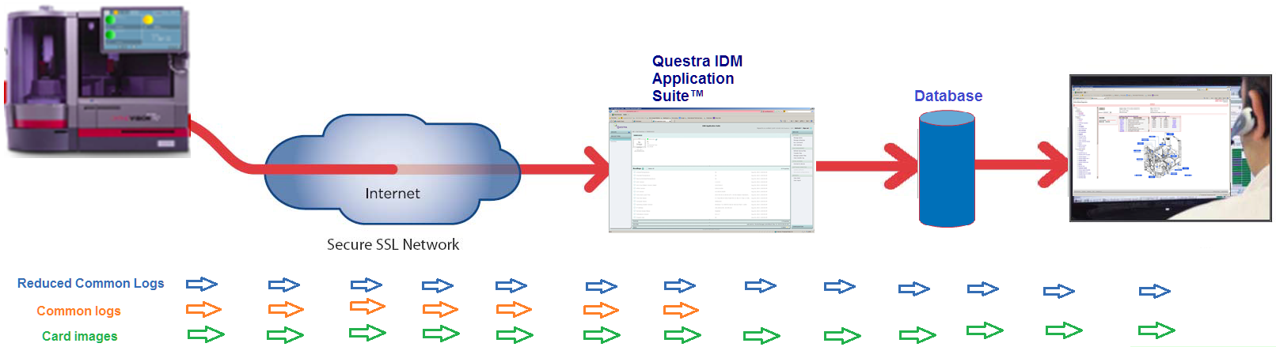
Cassette/ Card images
Image files (.jpeg & .png) can be sent manually by the user from the instrument. The user cannot send one single image file but 1 to 7 days of image files
Image files (.jpeg & .png) can be grabbed one by one from the instrument using Questra application
Images files will go in Questra, and then in the Database. They are viewable in the Vision e-Connectivity Dashboard (Result tab)
Automatic
Manual
Manual
Business confidential -For internal use only

Slide 11
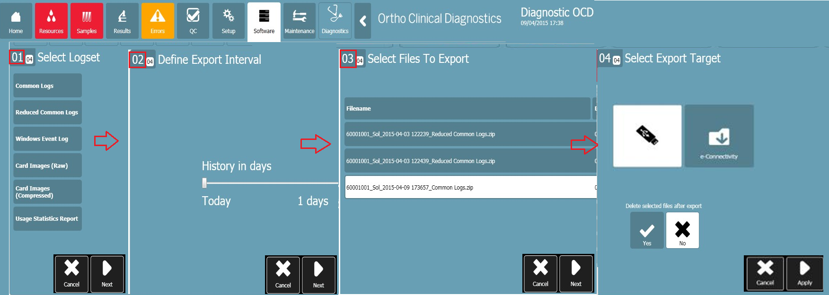
Sending files manually from the analyzer
Go in Software > Logsets.
After each step, press next and at the end press Apply to proceed
You can only select a time interval (between 1 and 7 days), not a specific file. Therefore:
  Avoid sending CL files because they are too large. They will be zipped into an enormous file and there is a risk of time out error during the transfer.
  Because of their size, sending raw images (.png) may also result in time out error during the transfer
Notes:
Note that you cannot select a spec

Slide 12
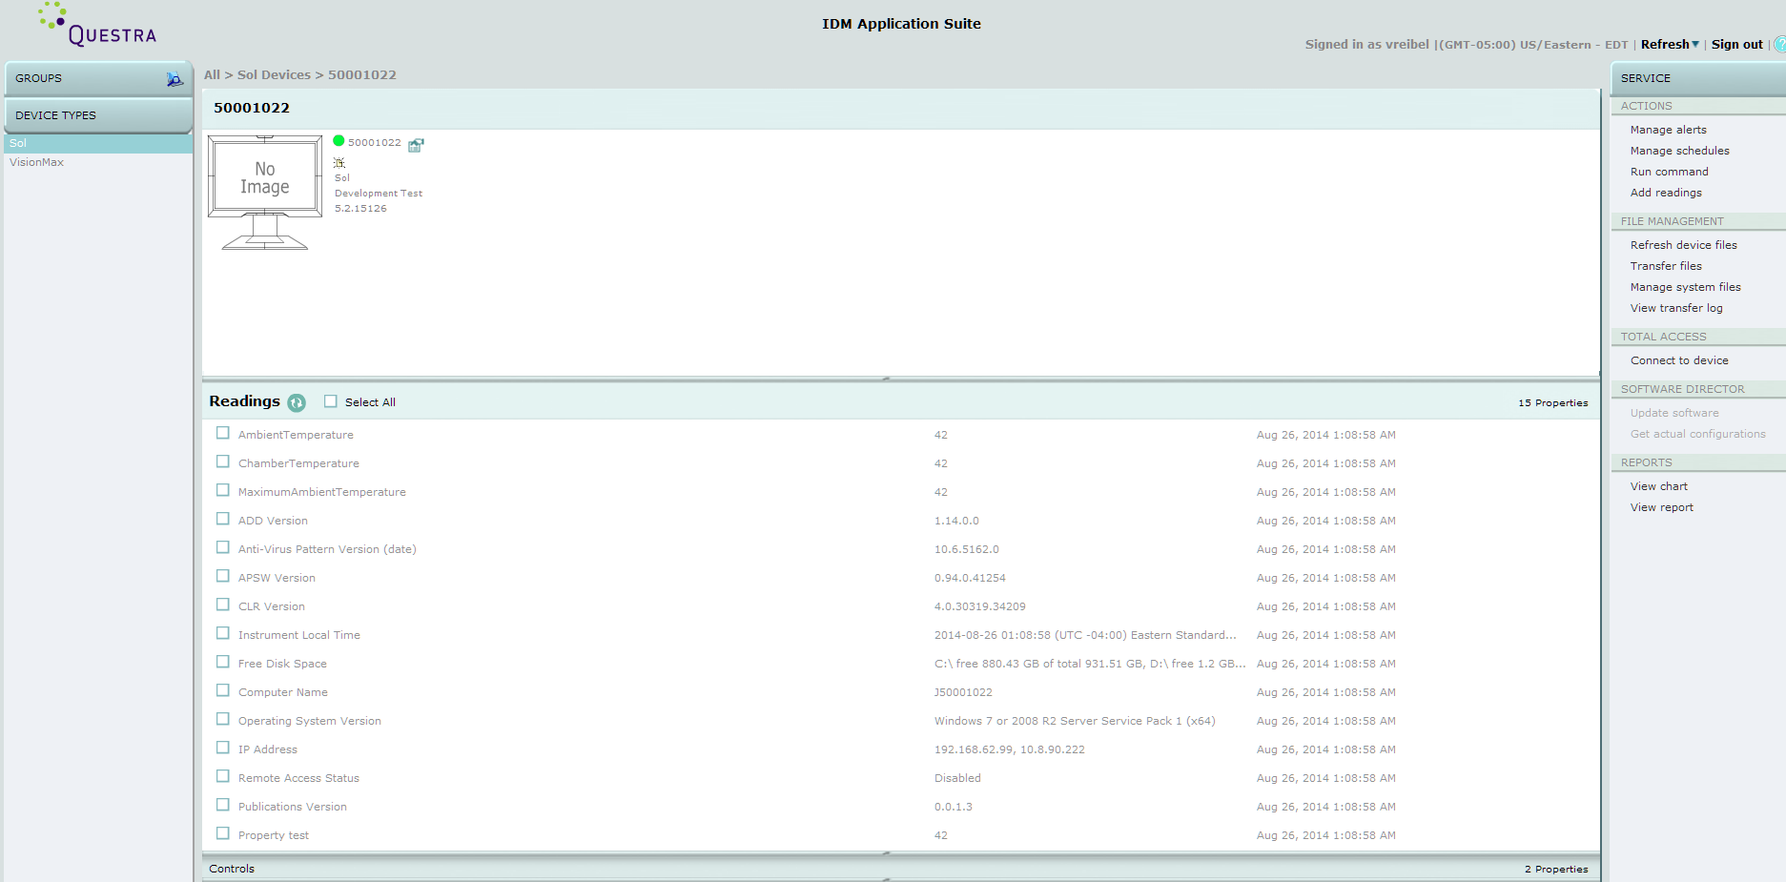
Questra IDM Application suite™
https://web.econnectivity.com/qss/
By connecting to Questra application, CTS can upload files (images/ CL files) – one by one - from the analyzer to Questra application, download files which are in Questra to their PC and remotely connect/ observe the Instrument.
*Currently the Vision are connected to the QA (test) environment, The link to QA dashboard is below
https://webq.econnectivity.com/qss/

Slide 13
ORTHO Vision
The Vision Dashboard

Slide 14
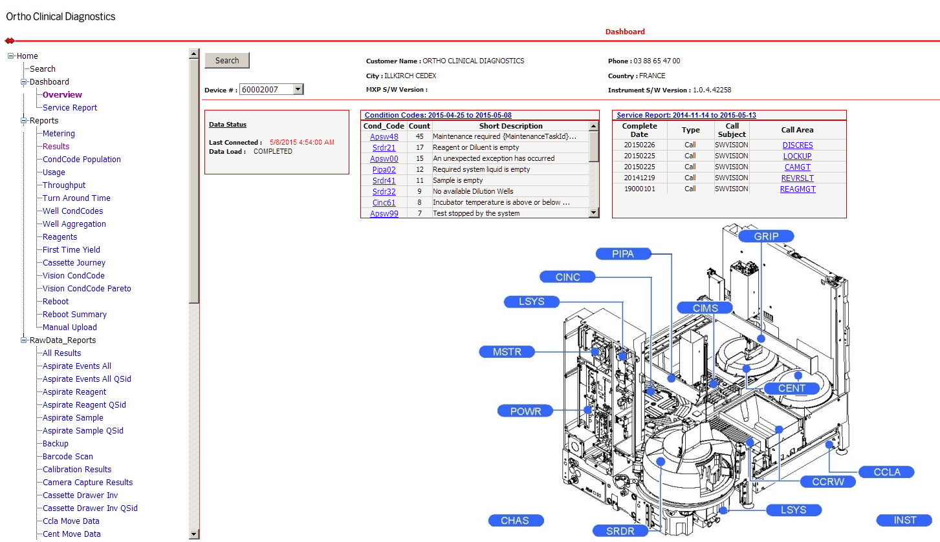
Vision e-Connectivity dashboard
The dashboard is a tool linked to the Database and displaying the data sent by the Vision*
*Currently the Vision are connected to the QA (test) environment, The link to QA dashboard is below,
https://itsusraecappqa1.na.jnj.com/eServices.Vision/App/Dashboard/Overview.aspx

Slide 15
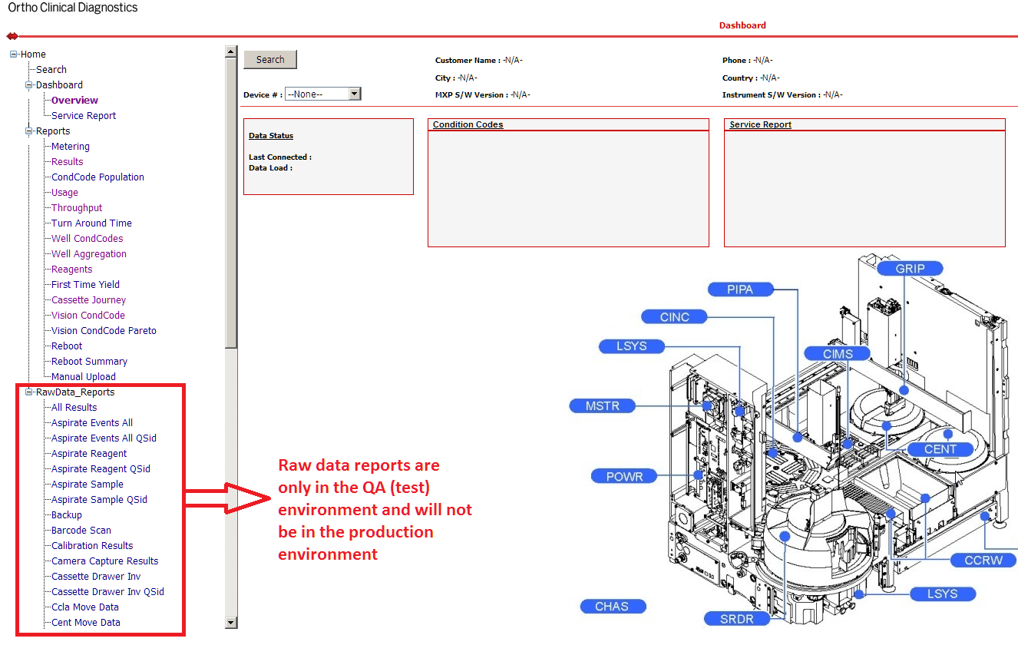

The Dashboard: Data & reports
Available reports

Slide 16
ORTHO Vision
Vision dashboard: Data of use for CTS

Slide 17
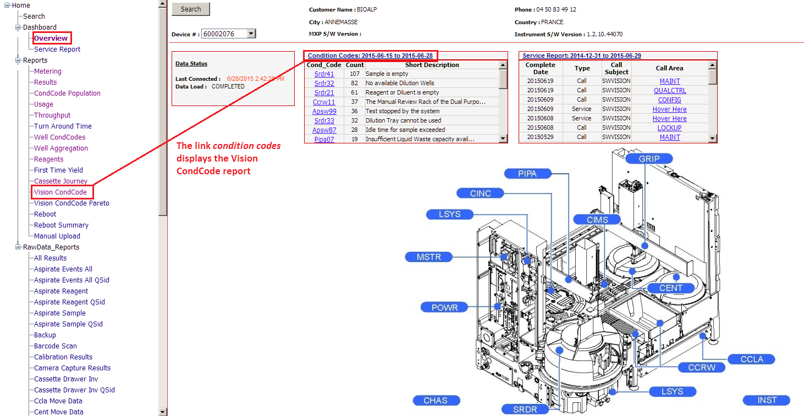
The Dashboard: The Overview page

Slide 18
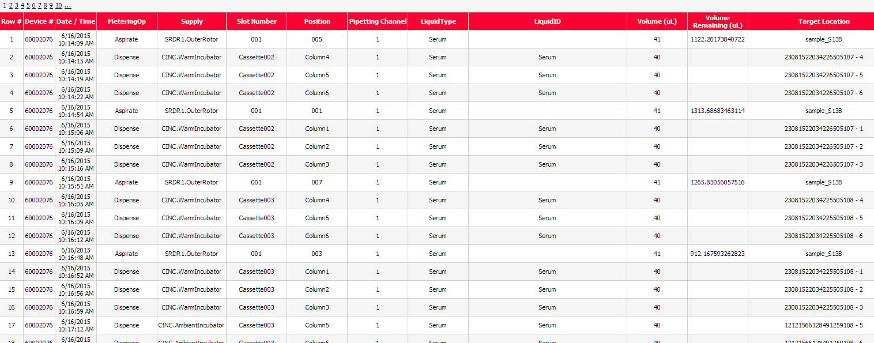
The Dashboard: The metering report
The Metering report provides the detail of all operations performed by the PIPA (Aspiration, dispense and dilutions)

Slide 19
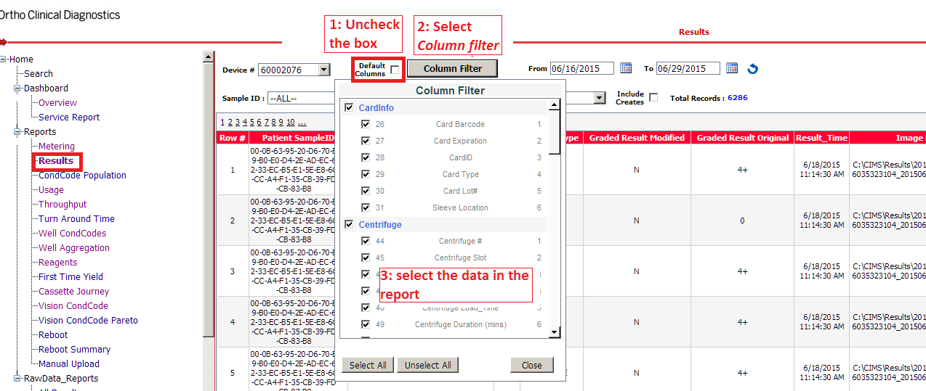
The Dashboard: The results report
The result report provides with results details. Default data provided are:
Additional information can be added to the report:

Slide 20
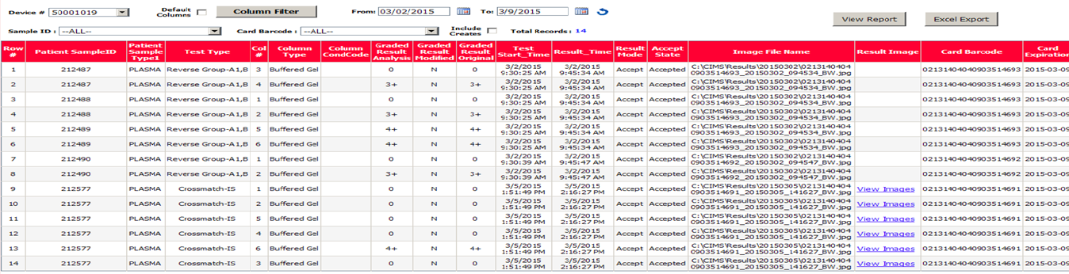
Cassette/Card images in the dashboard
Images that have been sent by the user will be found in the result report, under the Result Image column: select the link to display the image,
Note: The Default Columns checkbox from the Report Header must be first unchecked for the column to be displayed.

Slide 21
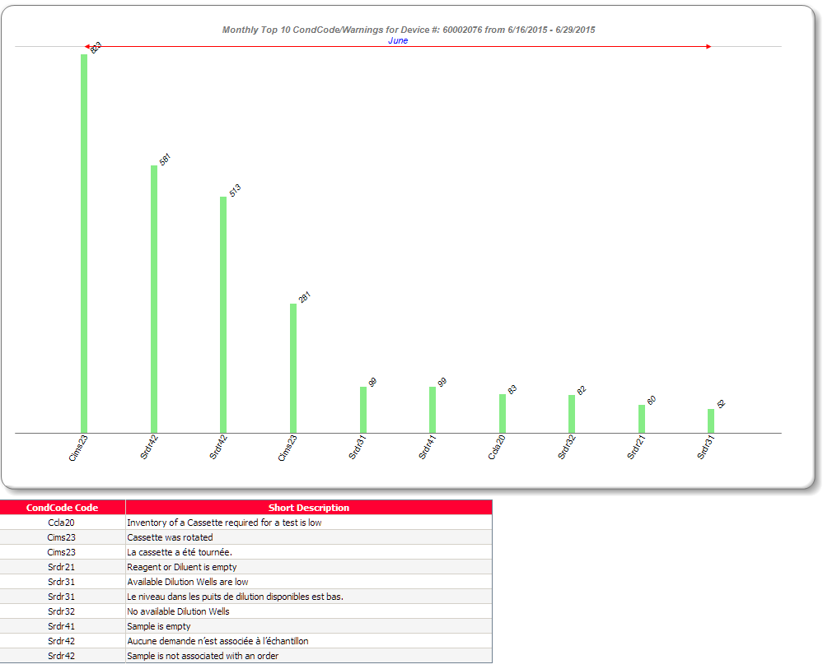
The Dashboard: The CondCode Population report
The Condition Code population report shows weekly/monthly statistics for the top 10/15/20 condition codes

Slide 22
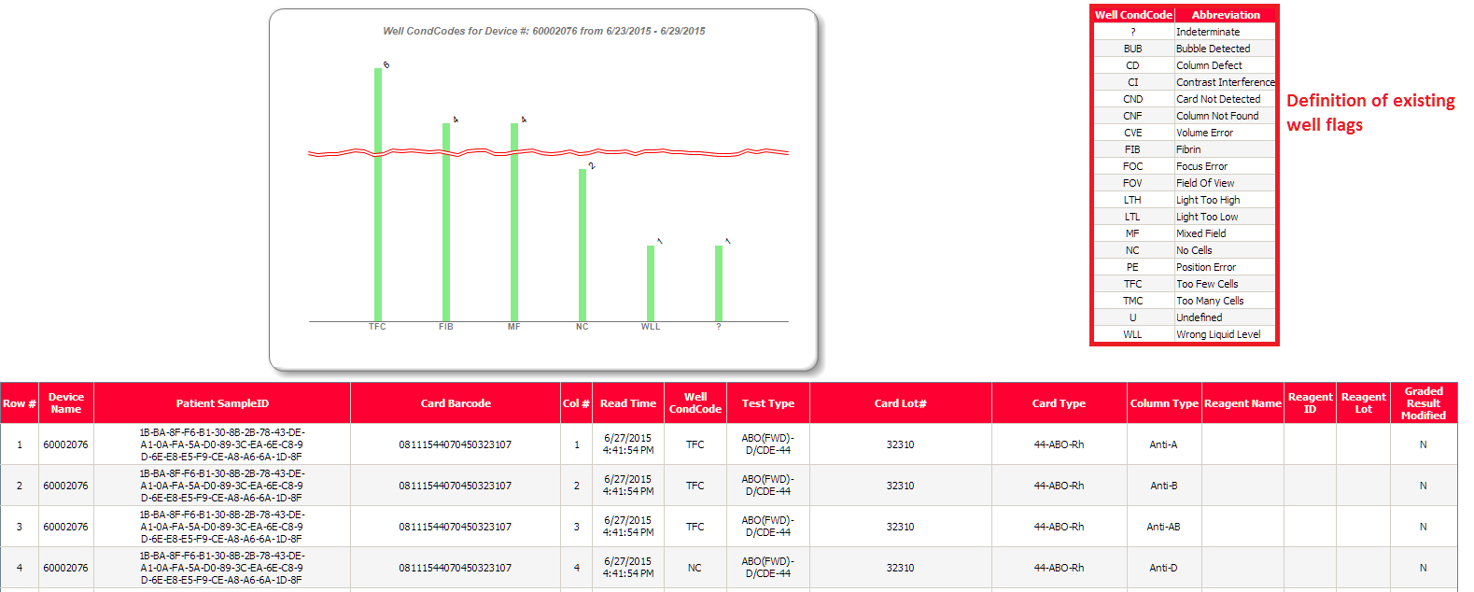
The Dashboard: The Well CondCode report
The Well CondCode report displays
  a graph with the number of samples for each well flag.
  a table reagents information for the samples that had a well flag.

Slide 23
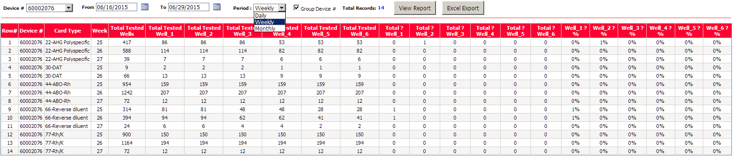
The Dashboard: The Well aggregation report
The Well aggregation report provides with daily, weekly or monthly statistics of indeterminate results per card/cassette type.

Slide 24
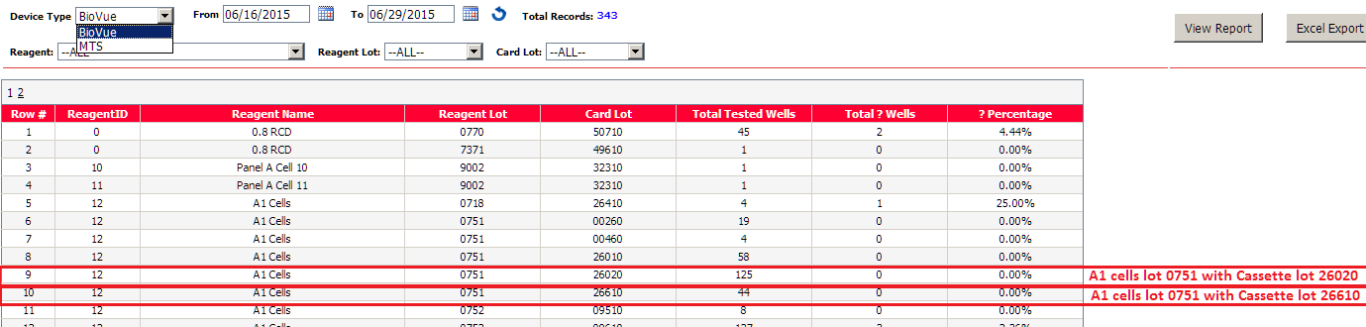
The Dashboard: The reagents report
The Reagents report shows the total number of well tested + the number of indeterminate results per combination of reagent lot/ card-cassette lot

Slide 25
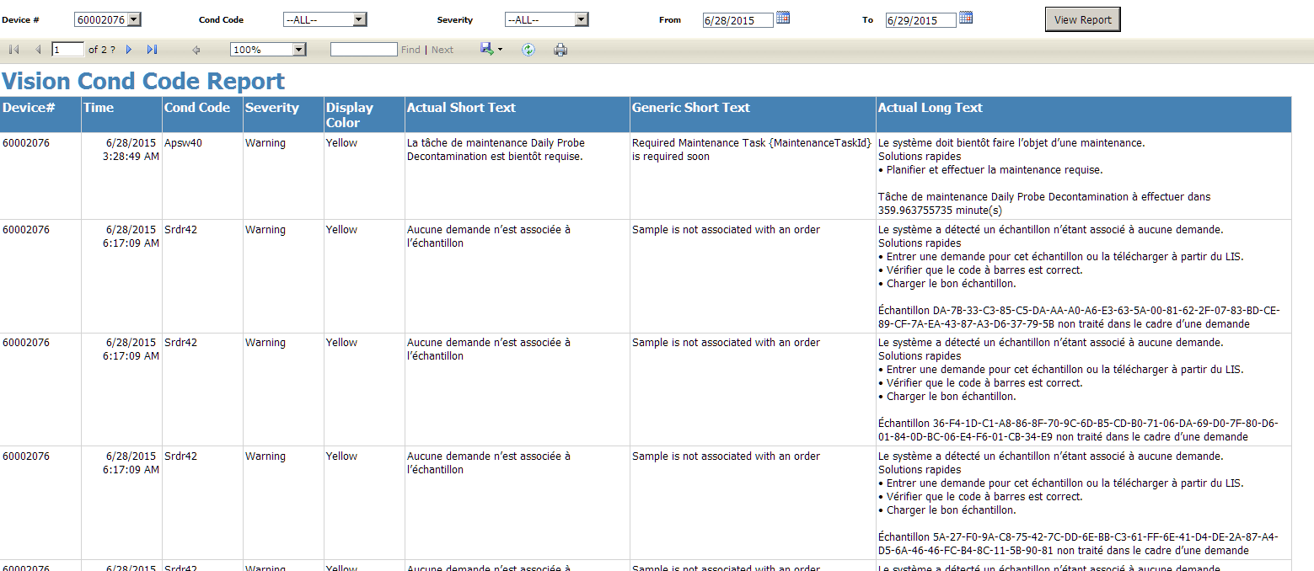
The Dashboard: The Vision CondCodes report
The Vision CondCodes report shows all condition codes including the actual long text as displayed on the analyzer (local language)
The report is accessible also from the page Overview

Slide 26
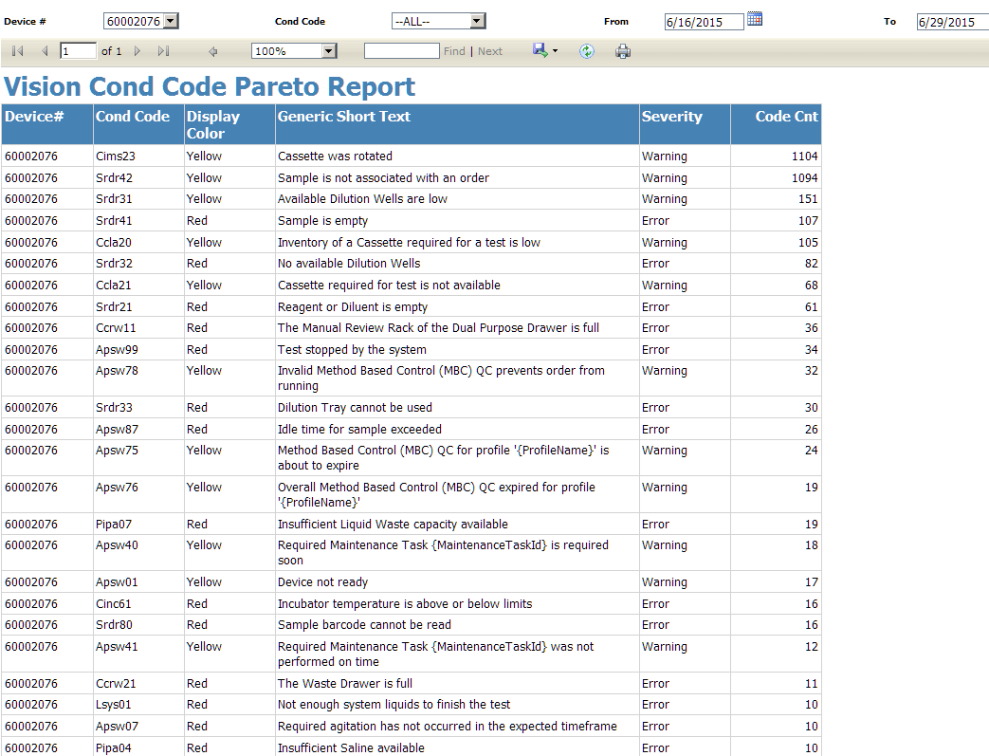
The Dashboard: The Vision CondCodes Pareto report
The Vision CondCodes pareto report gives how many times each condition code is posted

Slide 27
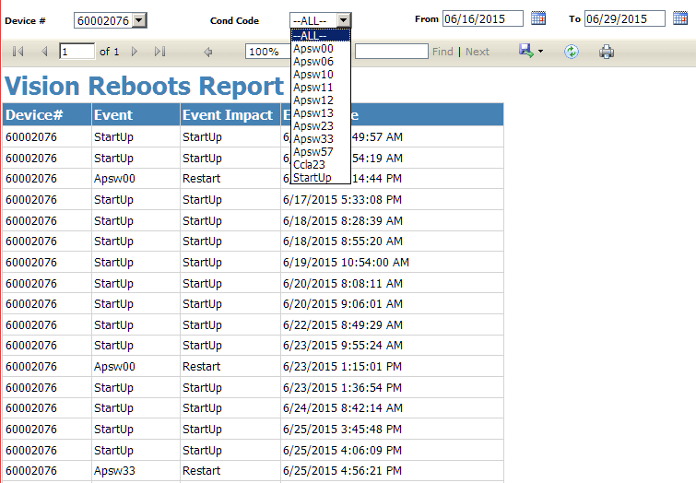
The Dashboard: The Reboot report
The Reboot report displays each instrument startup and also the codes for which a restart was done

Slide 28
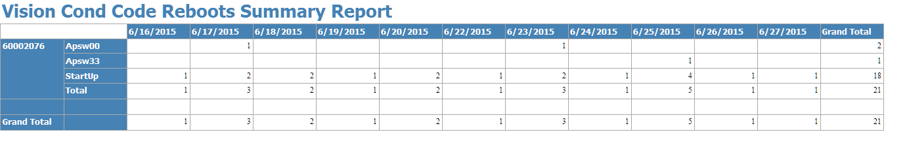
The Dashboard: The Reboot summary report
The Reboot summary report displays a table with the number of ASPW00, ASPW03 and Start up events per day

Slide 29
Key message to CTS
Use the tools!
    Use the tools!
        Use the tools!
        If there is something you don't like, tell us and we will improve things!

