Slide 1

3D Visualization Samples
Final Tender rft #344849

Slide 2
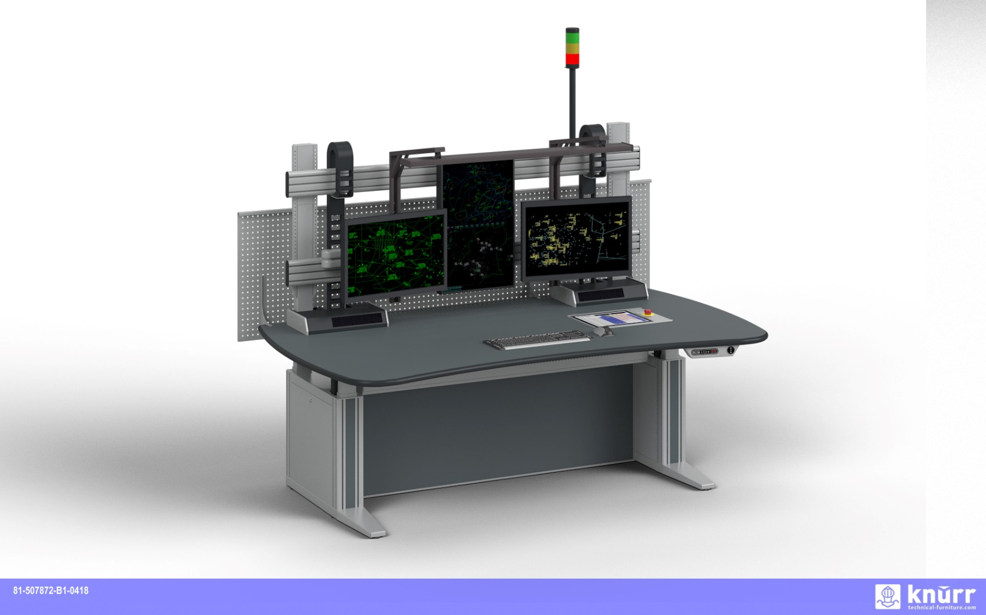
Knürr Ergocon (detailed drawings in CAD)

Slide 3
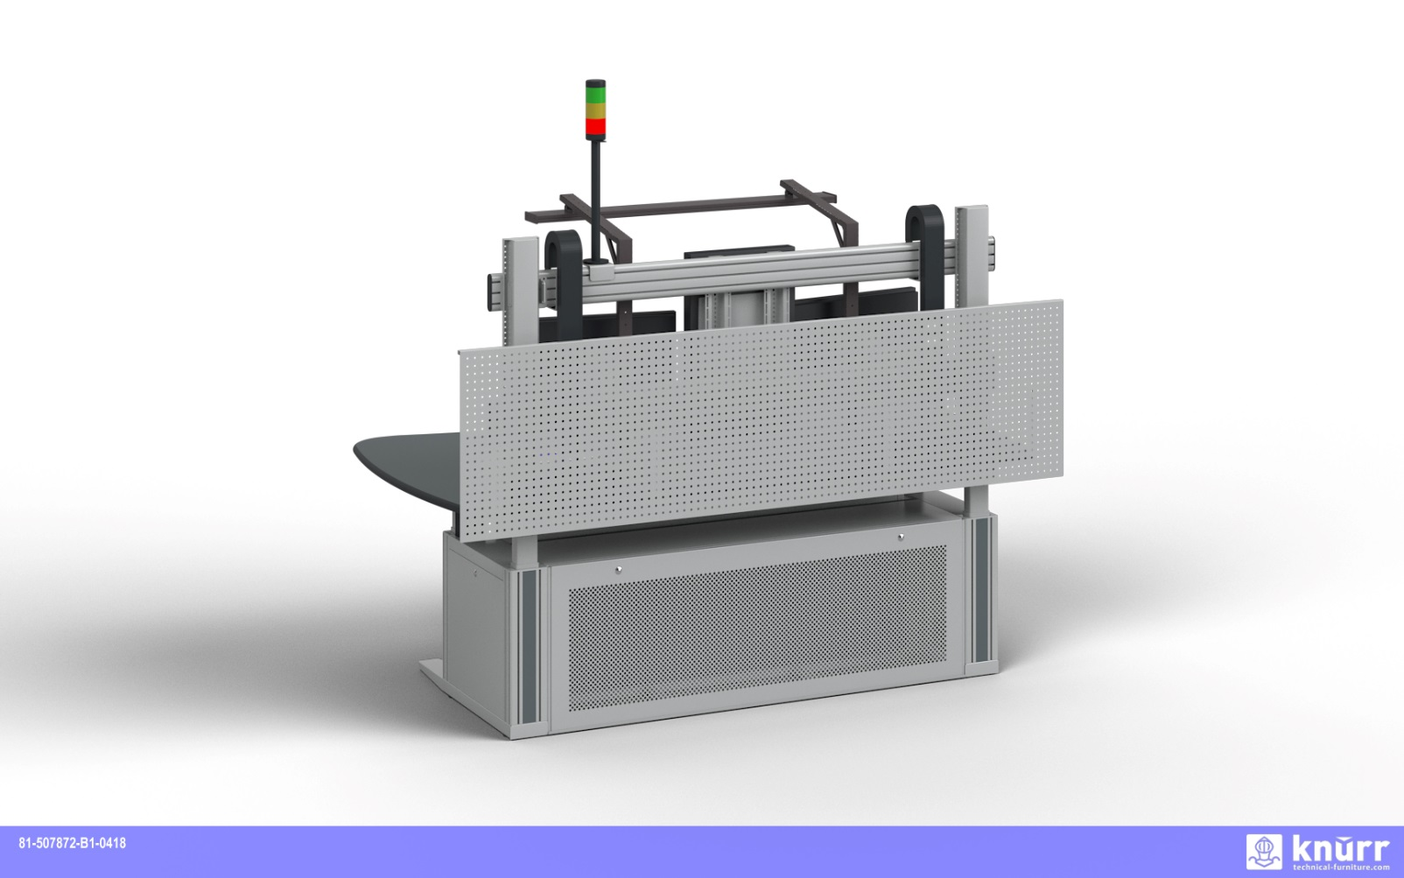
Knürr Ergocon (detailed drawings in CAD)

Slide 4
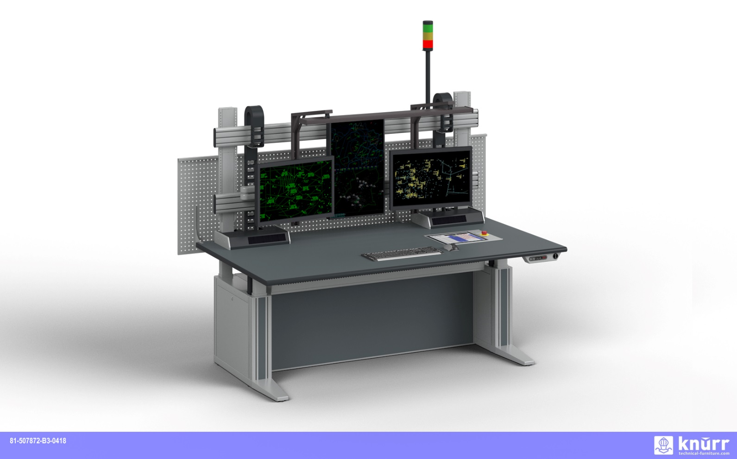
Knürr Ergocon (detailed drawings in CAD)

Slide 5
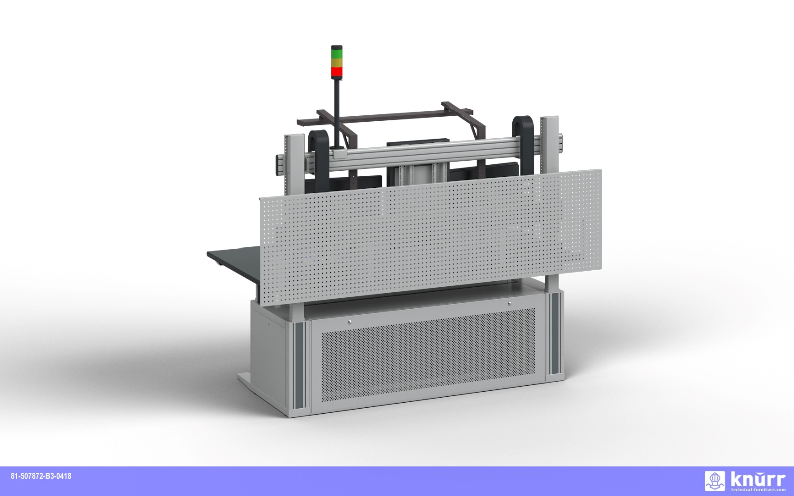
Knürr Ergocon (detailed drawings in CAD)

Slide 6
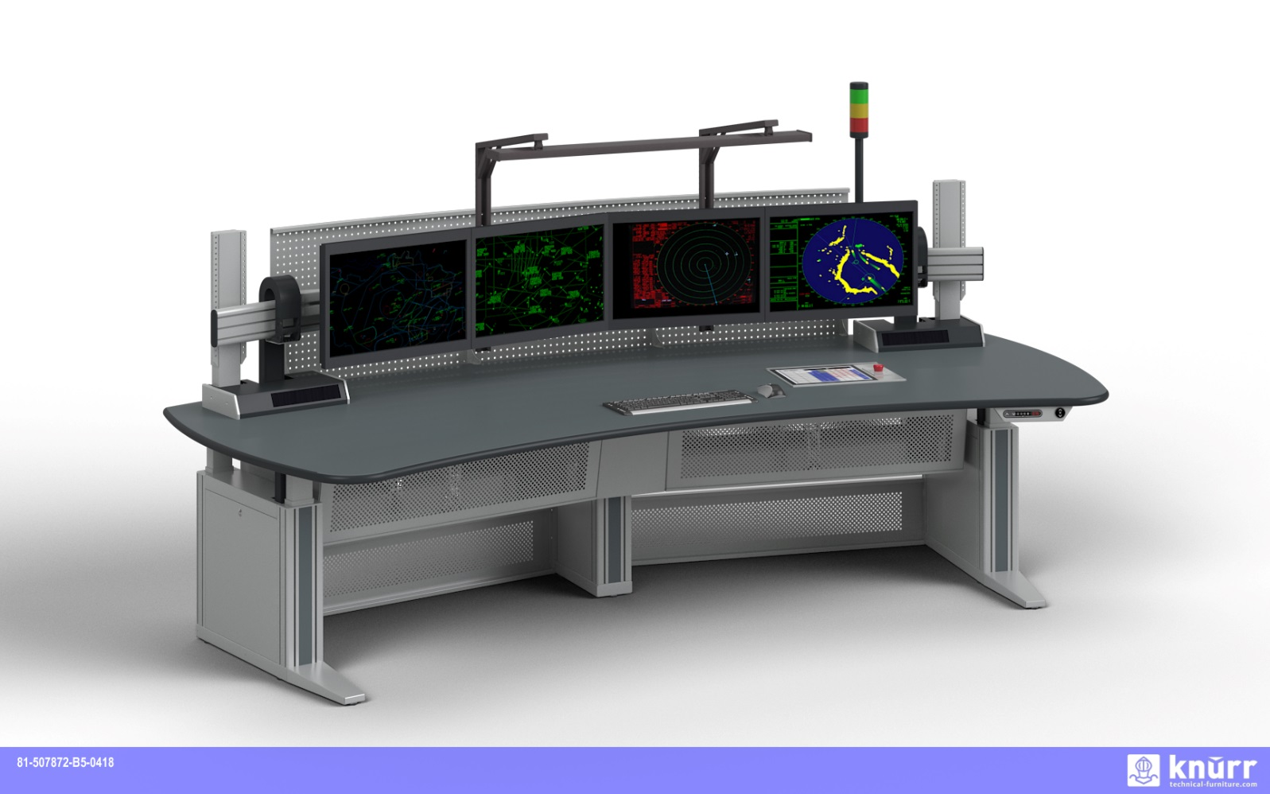
Knürr Operational Supervisor Desk

Slide 7
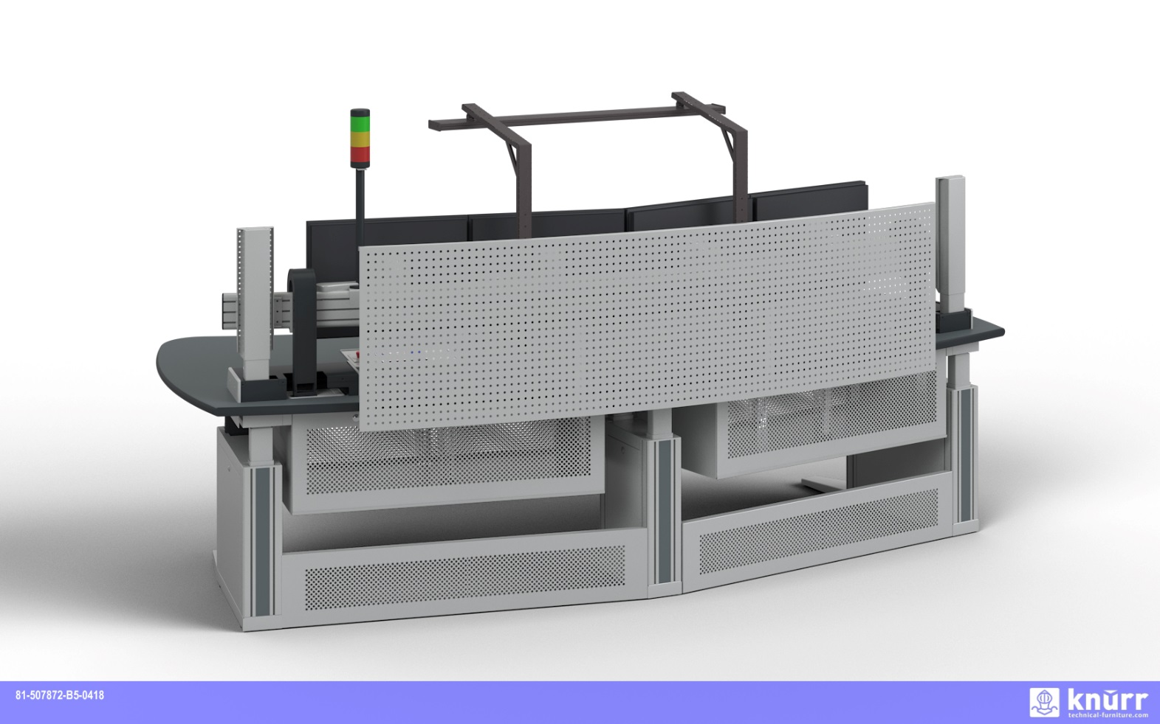
Knürr Operational Supervisor Desk

Slide 8
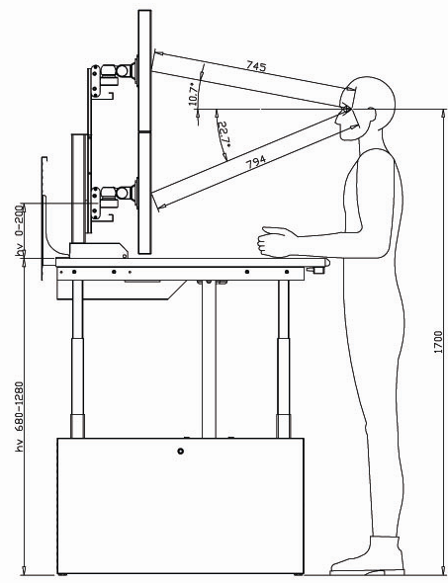
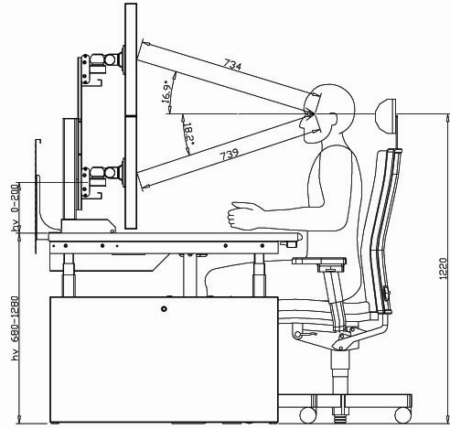
Ergonomic height setting
Hv 0-150
170
Hv 0-150
170

Slide 9
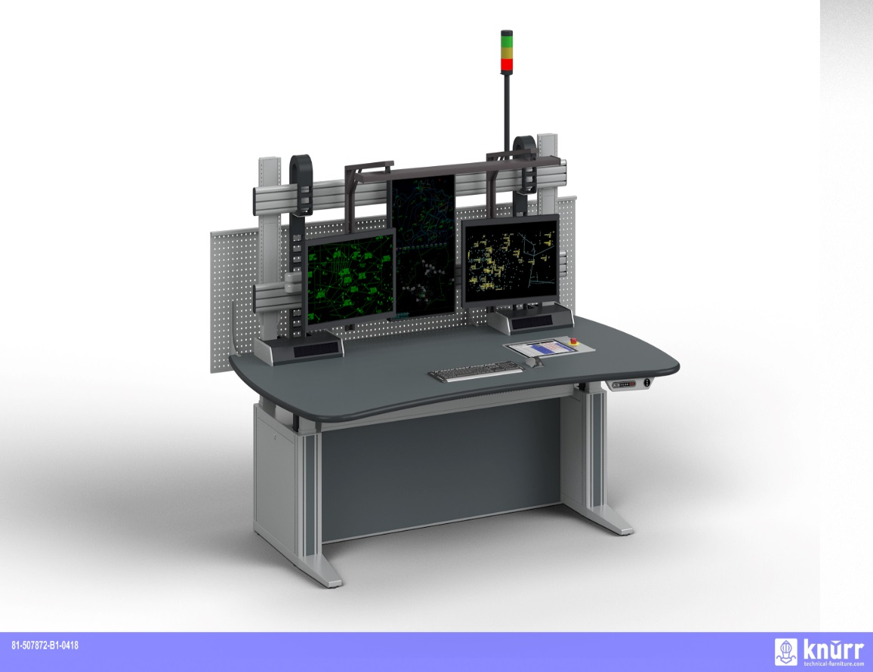
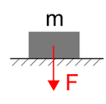
Maximum weight of console
The net weight of the console
will be in the range of 300kg.

Slide 10
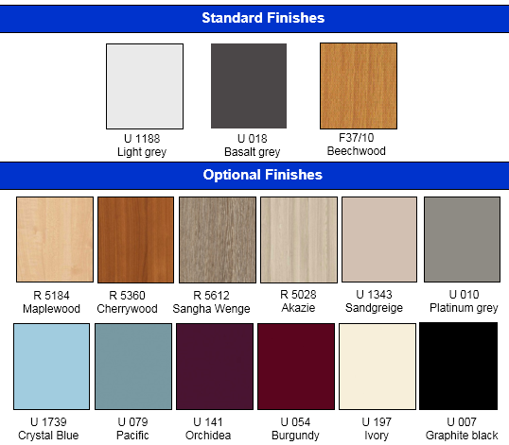

Color of the tabletops
A range of finishes is available.
Proposed options are:
HPL material “Basalt grey”

Slide 11
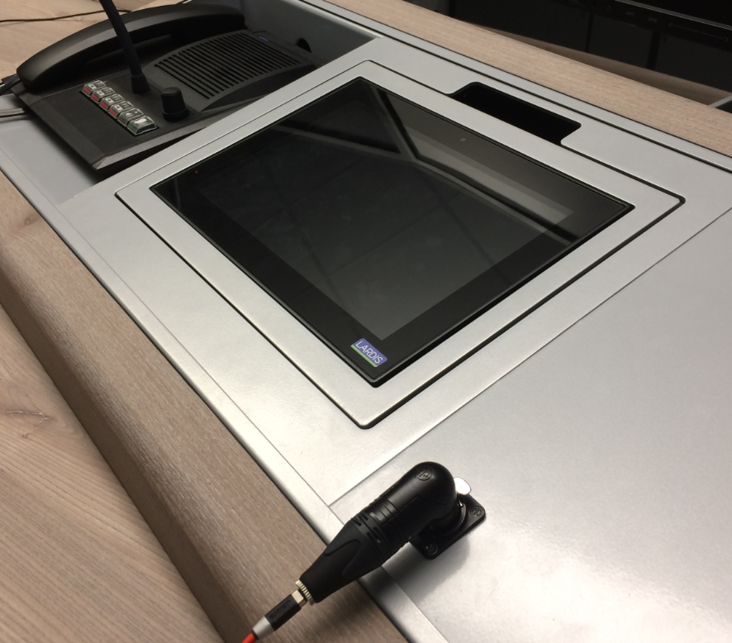
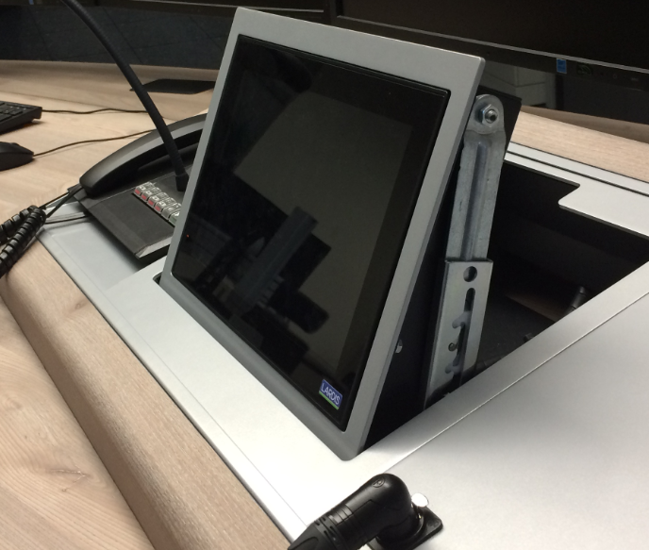
Tilt Adapter for VCS
Imbedded in console top at an angle at safe reaching distance.
Sturdy, vibration free, ideal for touchscreen VCS systems (frame-mount)
Tilt mechanism with latching mechanism see photo (with click).

Slide 12
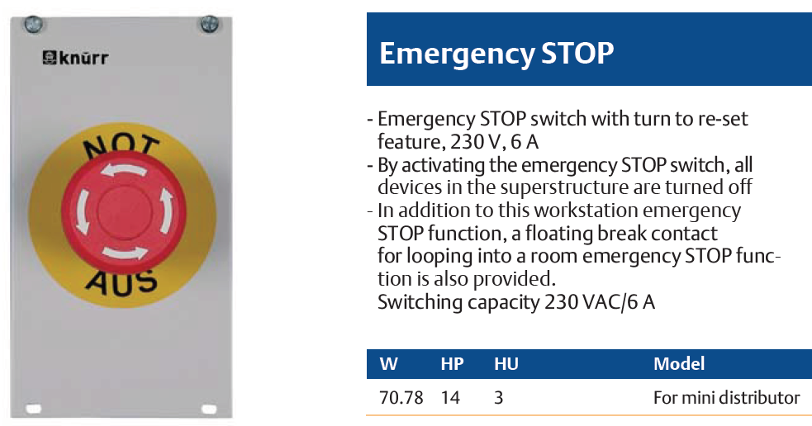
Panic Button
Installed in console at safe reaching distance. Variable position through front-panel mounting.

Slide 13
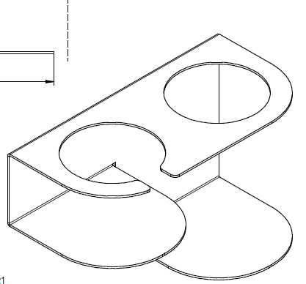
Cup holder
Mounted under tabletop, left or right For cup and bottles/cans diam. 90mm
Robust sheet steel design, powder coated

Slide 14
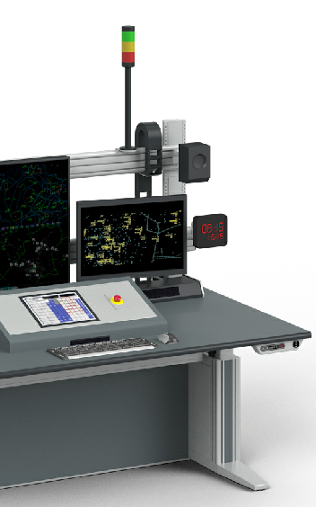
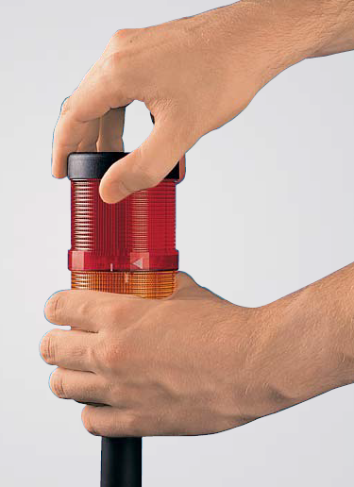
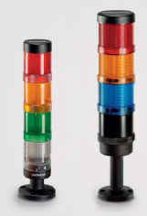
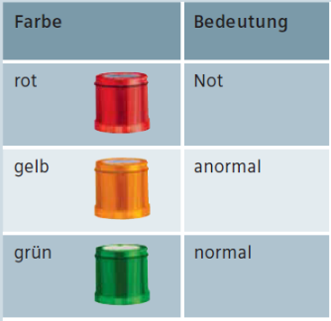
10.) LED Status Light, Red
Mounted to an upright of the monitor fixture Constant light (no flash) LED integrated 24V or 220V AC

Slide 15
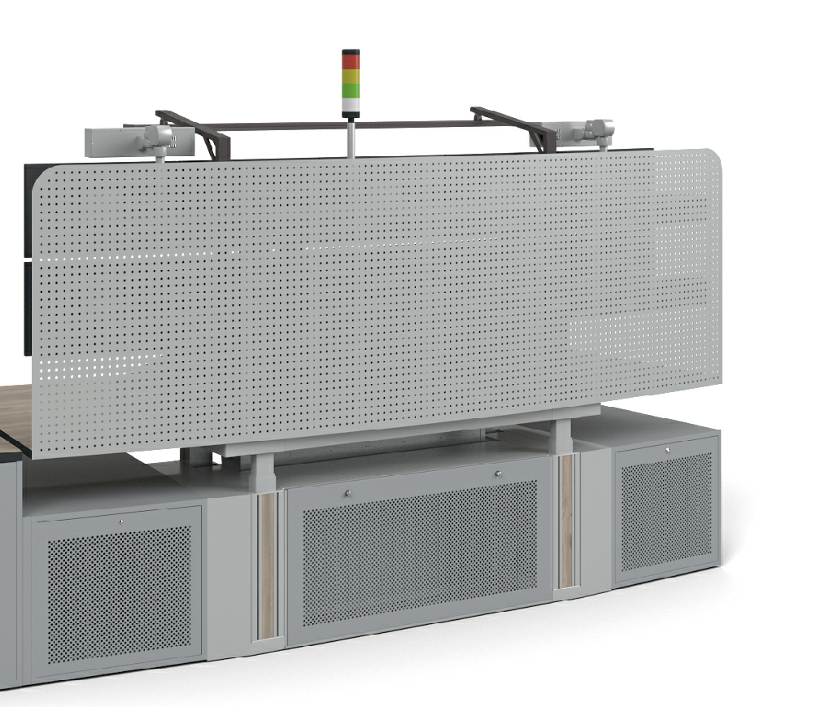
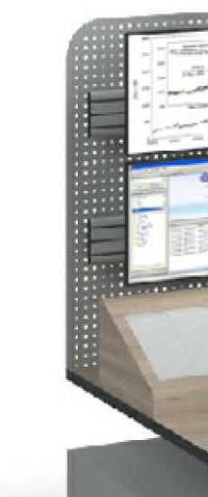
rear panel behind monitor array
Perforated Sheet Steel Panel, height 600mm. Mounted to the back of the tabletop behind the monitor array to hide cable and monitor rear sides.
Perforation minimizes sound reflections.

Slide 16
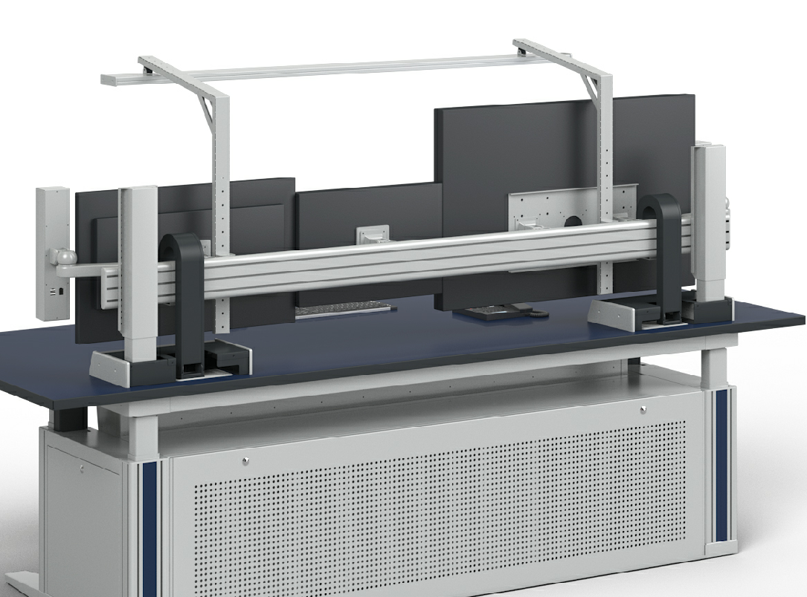
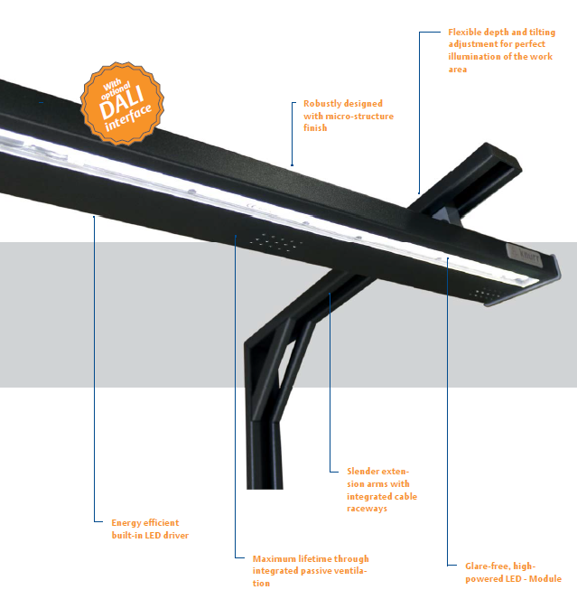
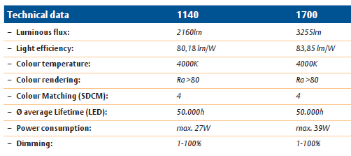
Overhead LED lamp

Slide 17
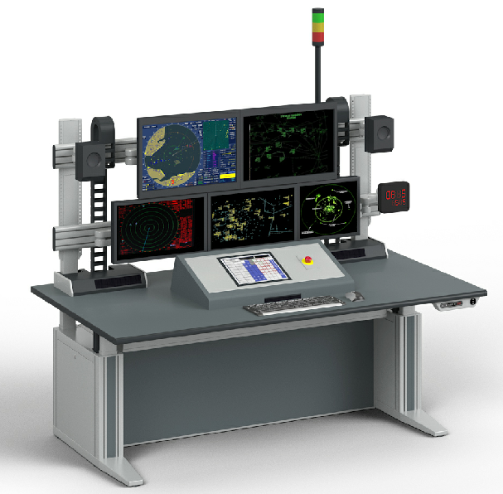
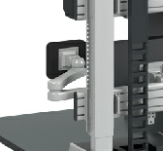
Type G arm for digital clock
Digital clock to be mounted on an articulated arm
Knürr type G, mounted to the lower extrusion
Clock is not included in offer.

Slide 18
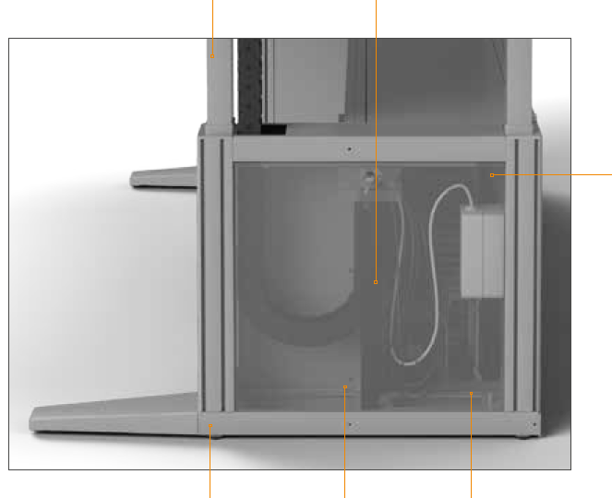
Ergocon Cable & Installation
Ergocon Smart Side Element with multiple advantages
Anti- collision
with integrated Piezo sensors
Safe cable-management
For optimized cable bending radii
Multiple Installation options
Integration of power and data transfer points with Knürr accessories
Consistent grounding
Hidden cable routing
From the raised floor through spacious cabling openings
Easy access
for service and installation through fully removable covers, optional with lock

Slide 19
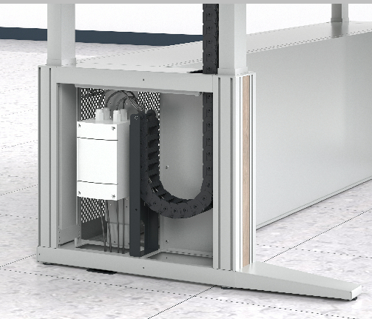
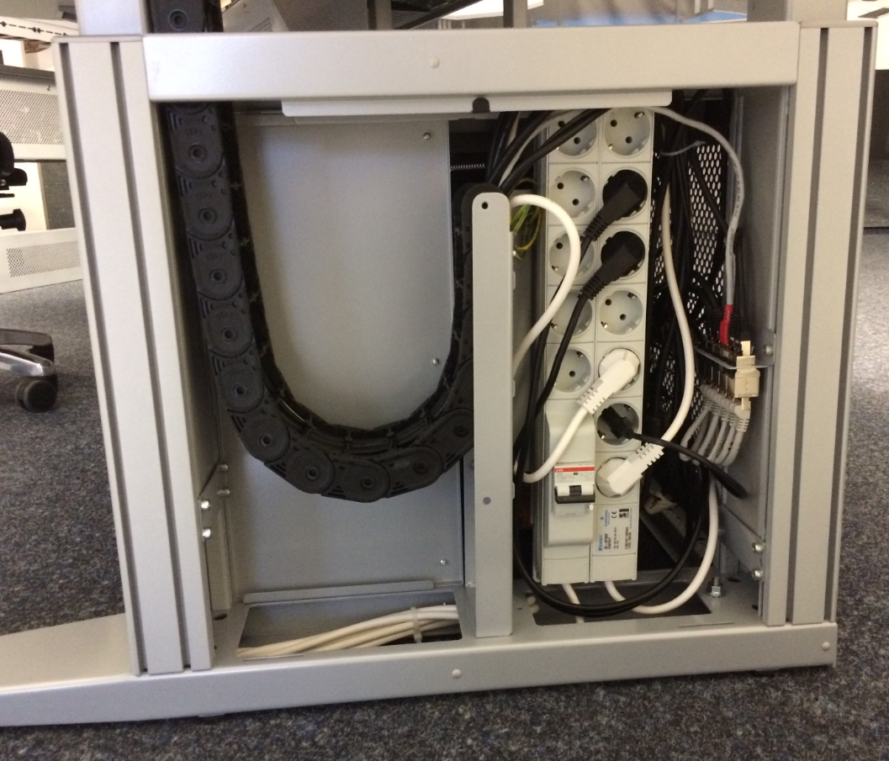
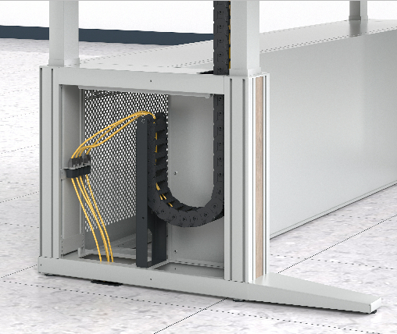
Ergocon Cable & Installation
Intelligent cabling
High-volume concealed cable raceways in the legs, access from in- and outside, bottom and from installation cabinet in base.
Space for PDUs, connector boxes or other equipment.
Inside space: 130mm x 450mm

Slide 20
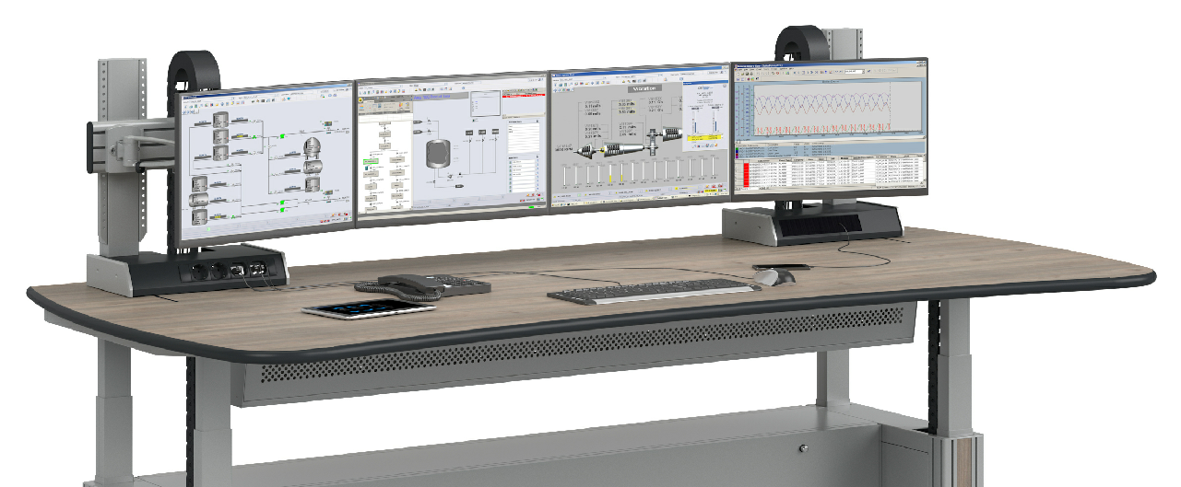
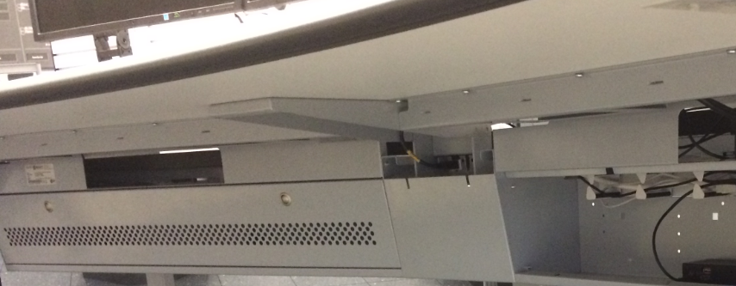
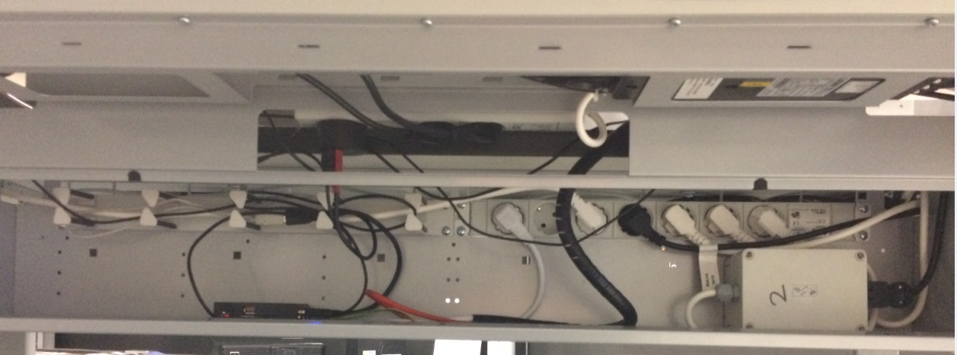
Ergocon Cable & Installation
Installation Module below worktop (featured with all ATC consoles)
Installation Module below worktop with removable perforated front panel
Always free access to PDU mounted under worktop
Front access Space (height 198/140mm, depth 120mm) over full width for cable, PDUs, power distribution boxes, video splitter etc.

Slide 21
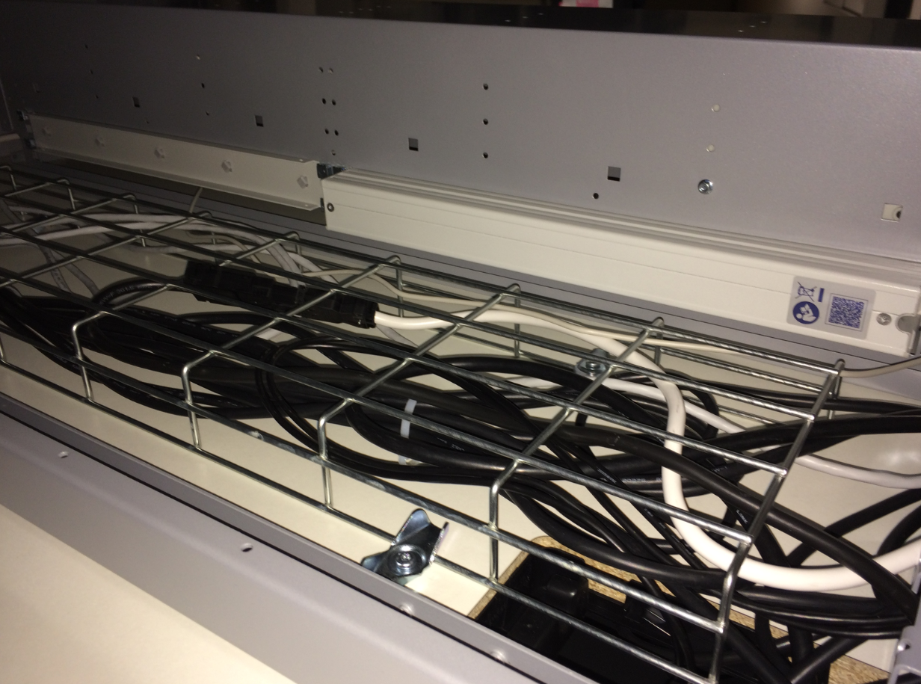
Ergocon Cable & Installation
Installation Space below worktop on the rear of console
Open rear space with depth of 380mm for cable raceways.

Slide 22
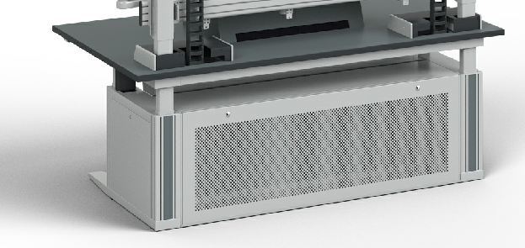
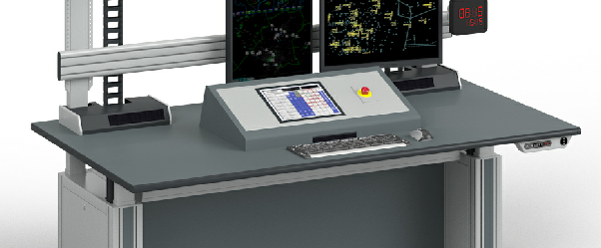
Ergocon Cable & Installation
Installation floor pedestal, while keeping the Installation Module below worktop
Largest space for tower- or 19“ workstations with high space requirements, typically high-power server and rack module equipment.
Perforated rear panel for best ventilation.
Installation Module below worktop

Slide 23
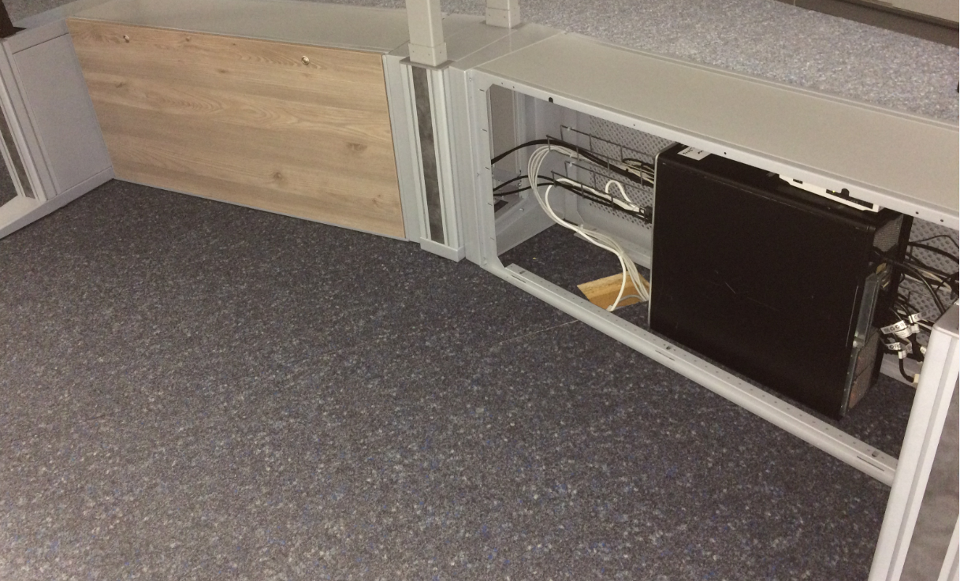
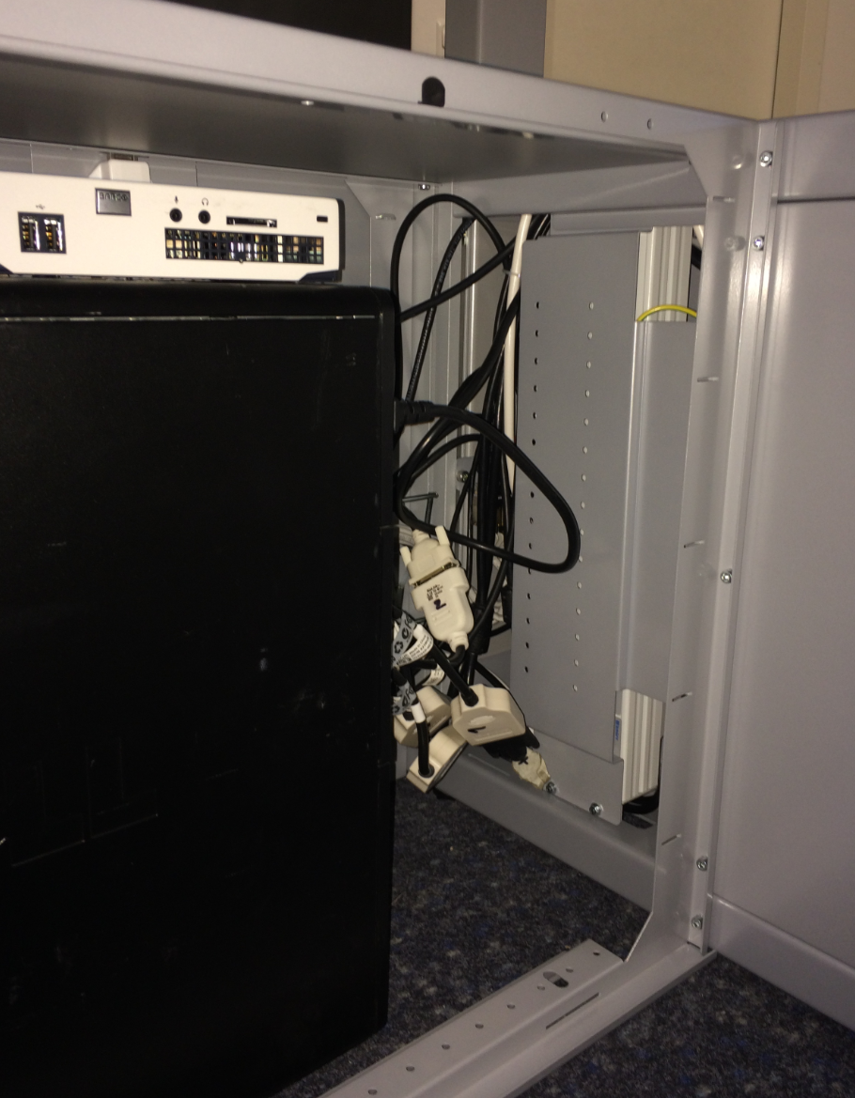
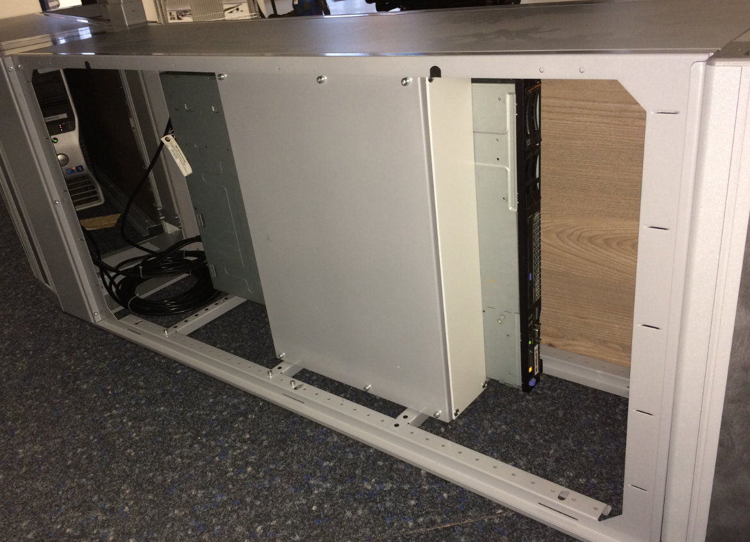
Cable & Installation
Installation pedestal
Open for access to raised floor Cover plates available
Access from/to workstation pedestal into side elements
19” swivel frame, 4HU

Slide 24
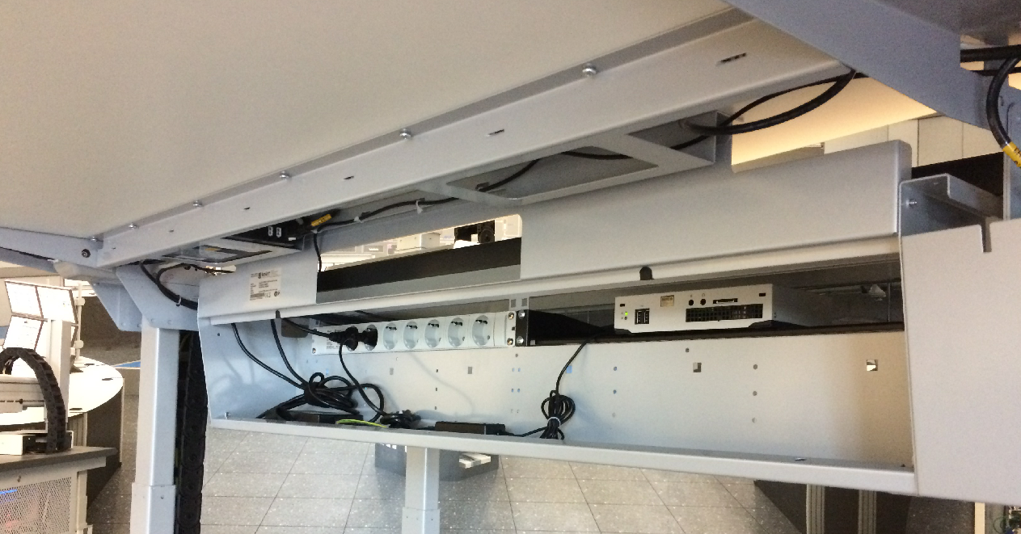
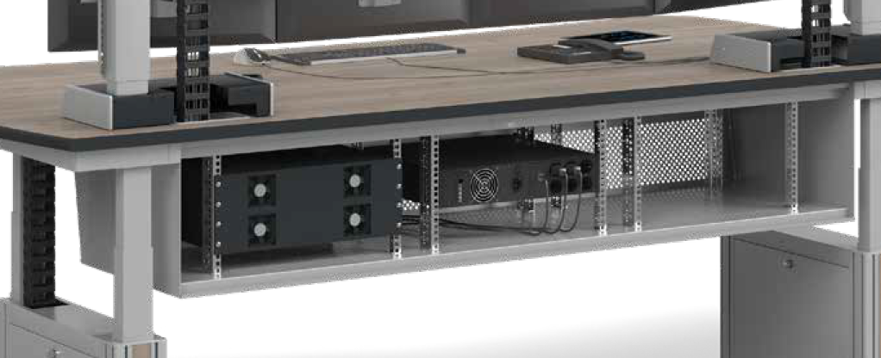
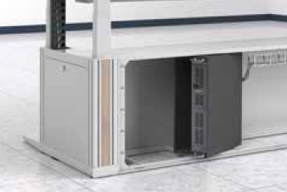
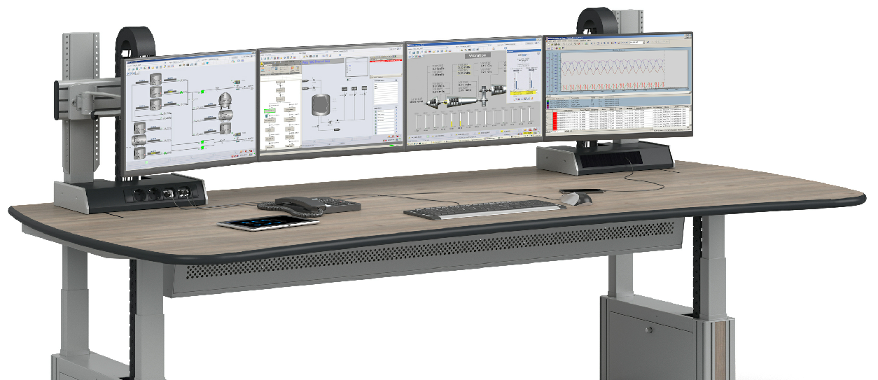
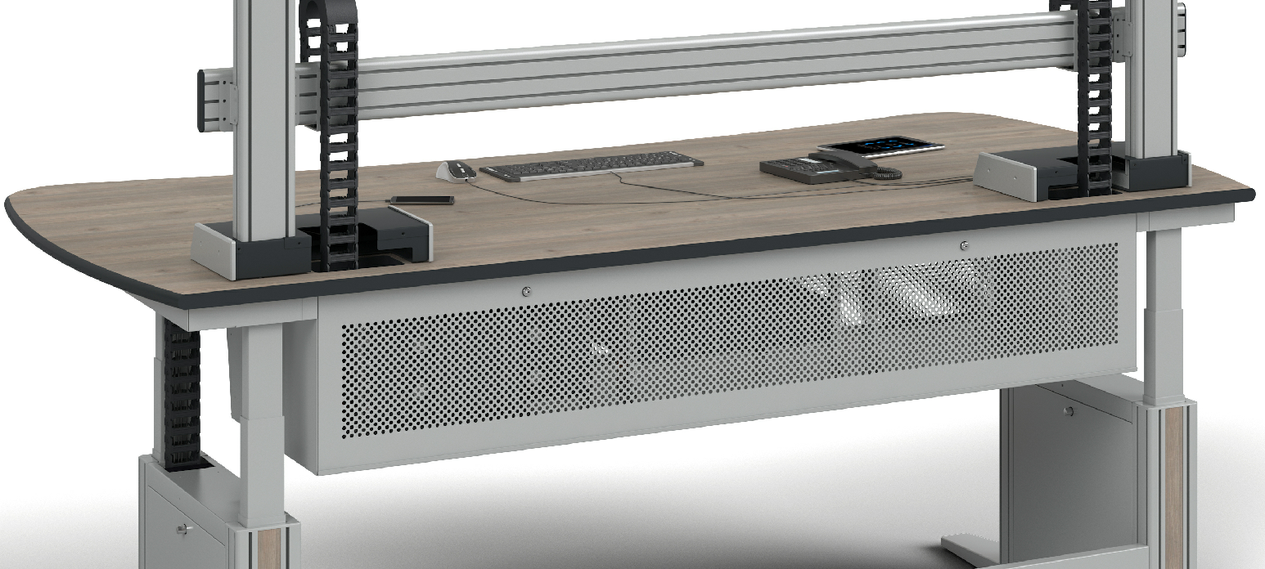
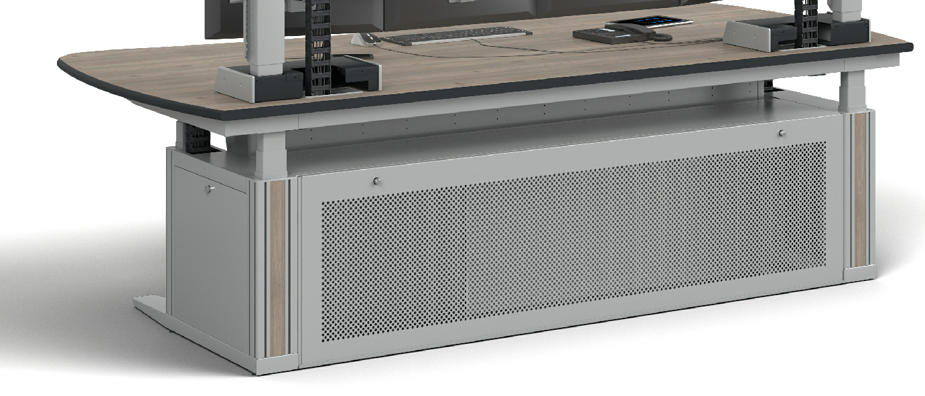
Installation space dimensions
Installation Module KVM ready 6HU Technical floor pedestal 8HU

Slide 25
Power sockets: Ergocon Functional Unit
High-volume cable guiding chain
For protected cabling and best cable bending radii
Knürr Functional Unit
Lifting column
With fixture for monitor rails
Knürr DICON module
Add individual keystone modules for data and power connection
Hidden cabling
From pedestals to monitor level

Slide 26
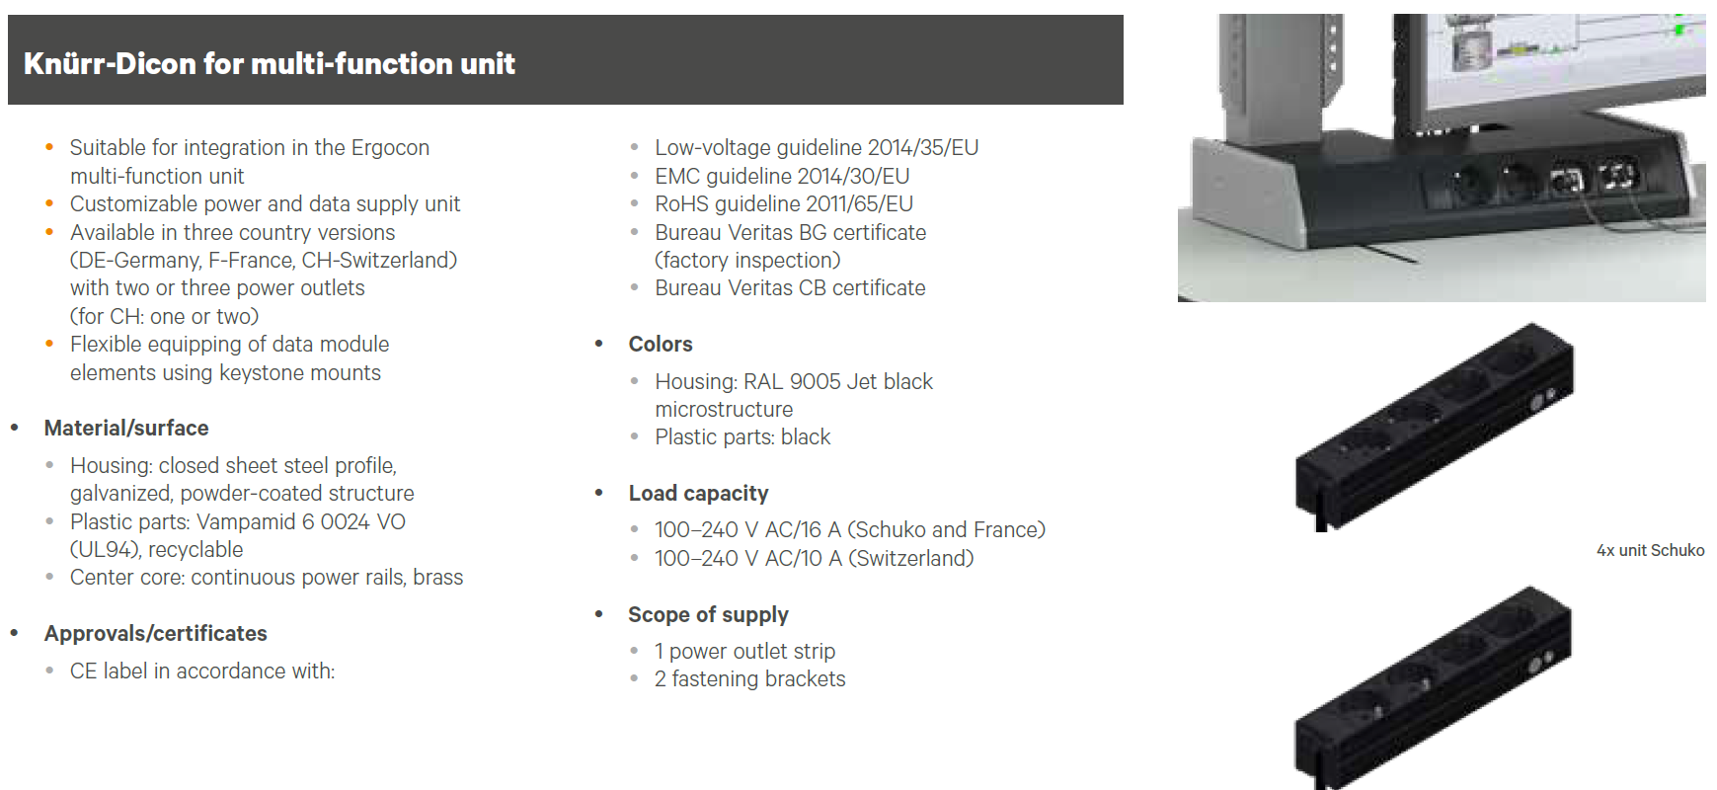
Power sockets: Ergocon DICON module

